Slide 1
Ch. 10 Molar Quantities Notes
Learning Target 1

Slide 2
Mole Activity connection
1 dozen
1 ream
1 pair
Baker’s dozen
others?
Moles are a unit of measurement used for atoms which are REALLY SMALL so the number is REALLY BIG!!!
1 mole = 6.02 x 10²³ particle

Slide 3
The Mole Activity connection
1 R.G.U. represents 1 mole (because we can’t see atoms)
1 mole will always equal the same # of particles (6.02 x 10²³) just like 1 R.G.U. always equaled the same number of particles.
The mass of 1 mole of an element changes based on the SIZE OF THE ATOM (just like it depended on the size of the bean)
The standard for ALL elements is CARBON-12. All elements masses are relative to (compared to) CARBON-12.

Slide 4
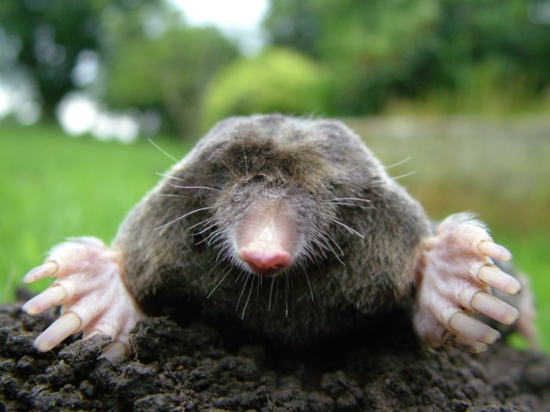
The MOLE (mol)
Not
Definition:
An AMOUNT
A unit that represents the number of particles in a substance
Application:
1mol= 6.02 x 10²³particles

Slide 5
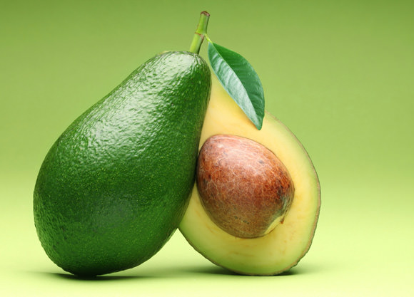
1 mole= Avogadro’s number
Think Avocado
Definition:
Equal to 1 mole of a substance
Application:
6.02 x 10²³

Slide 6
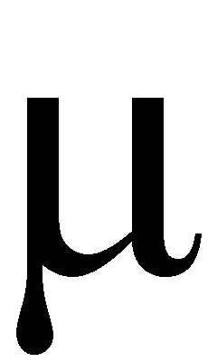
Representative particles- the smallest part of a substance that retains the properties.
Definition:
Element--→atom
Molecular compound→ molecule
Ionic compound→ formula unit
Application:
1 mole Na= 6.02 x 10²³ atoms
1 mol H2O= 6.02 x 10²³ molecules
1 mol NaCl= 6.02 x 10²³ formula units

Slide 7
Conversion Factors
Definition: # of equivalent values with different units
Application:
Use the card to convert 13 inches to miles

Slide 8
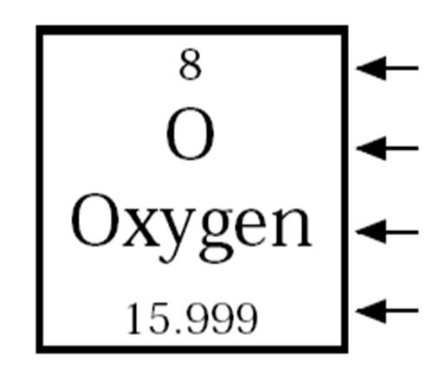
Atomic Mass
Definition:
Average of all the isotopes of an element relative to Carbon-12
Unit= amu (atomic mass unit)
Application:
Expressed as 1 mole of the substance
The value given on the periodic table

Slide 9
Molar Mass (formula weight, molecular weight)
Definition:
Equal to atomic mass in value
The mass of 1 mole of a substance
Unit= g/mol
Application:
Find on the Periodic Table
Write as a conversion factor:

Slide 10
Volume of Gases (molar volume)
Definition:
1 mole of any gas at standard temperature and pressure (STP) is equal to 22.4 Liters of space
Application:
1mol/22.4 L OR 22.4 L/1mol

Slide 11
STP
Definition:
Where gases behave predictably.
Application:
0 degrees C and 1 atmosphere (pressure unit)
273 K and 101.3 kPa (pressure unit)

Slide 12
Percent Composition
Definition:
Percent by mass of elements that make up a compound
Application:
% mass of element=
(mass element/mass of compound) x 100

Slide 13
Empirical Formulas
Lowest whole number ratio form of a formula
Ex. C₆H₁₂O₆ reduces to CH₂O
Solving to find the empirical formula:
1) grams→moles
2)Divide by smallest mole amount to get ratios
3)Write formula with ratios
4)If any ½’s multiply all by 2 to get whole numbers

Slide 14
Molecular Formulas
True formula
Solving: Same as Empirical PLUS
1) Molar Mass/Empirical Formula Mass= x
2) Multiply Formula subscripts by x

Slide 15
Important Conversions:
1 mole/6.02 x 10²³particles
1 mole/____g (from periodic table)
1 mole/22.4L for gases at STP

