Slide 1
LT 2: Covalent Bonding

Slide 2
Why do atoms bond?
Atoms gain stability when they share electrons and form covalent bonds. This gives the atoms a FULL outer energy level.

Slide 3
VOCABULARY
Covalent bond- chemical bond that results from sharing valence electrons in a NON-ionic compound
Always between 2 Nonmetals
Ex: Fluorine atoms share 2 e- to become F₂

Slide 4
VOCABULARY
Molecule- formed when two or more atoms bond covalently
Ex: H₂O, C₆H₁₂O₆

Slide 5
Diatomic Molecules
Formed when 2 atoms of each element share electrons
2 atoms molecules are more stable than the individual atoms
Pneumonic to remember diatomics: HOFBrINCl
Hydrogen (H₂)
Oxygen (O₂)
Fluorine (F₂)
Bromine (Br₂)
Iodine (I₂)
Nitrogen (N₂)
Chlorine (Cl₂)

Slide 6
Formation of F₂
The rest are unshared e-
Shared e-

Slide 7
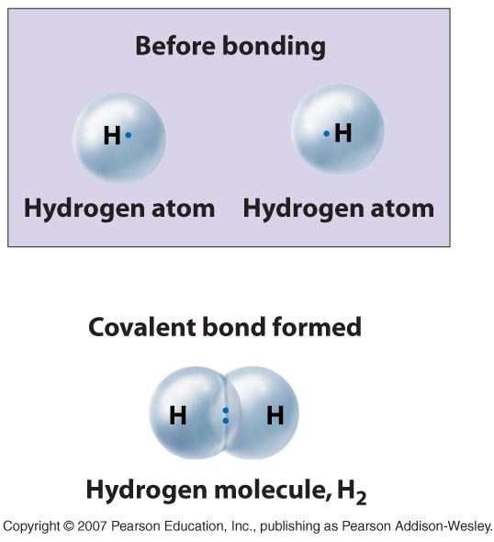
Single Covalent Bond
2 e- are shared
1 pair
H—H

Slide 8
Double Covalent Bond
4 e- are shared
2 pairs
O=O

Slide 9
Triple Covalent Bond
6 e- are shared
3 pairs

Slide 10
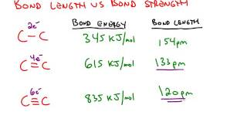
Bond Length/ Strength- Inverse relationship
The MORE bonds present, the SHORTER the bond
The SHORTER the bond length, the STRONGER the bond

Slide 11
Energy and Bonds
Breaking bonds= Requires energy
Like breaking a pencil
Making bonds= Releases energy

Slide 12
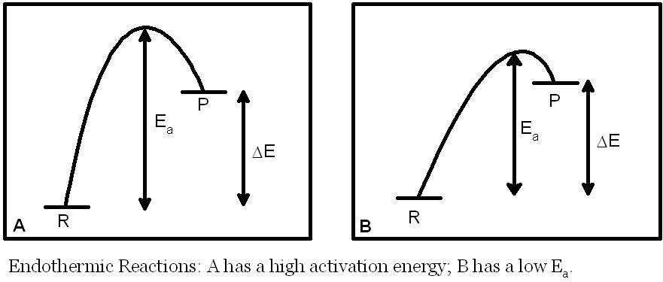
Endothermic – Greater energy is required to BREAK the bonds in the reactants than is released when new bonds FORM in the products
Think: Simpler reactants make more complex products so ENERGY is NEEDED

Slide 13
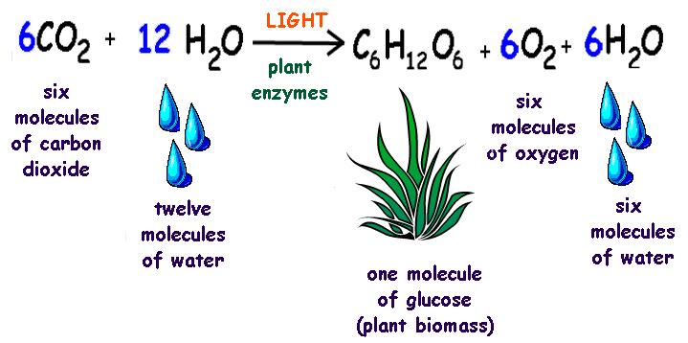
Example:

Slide 14
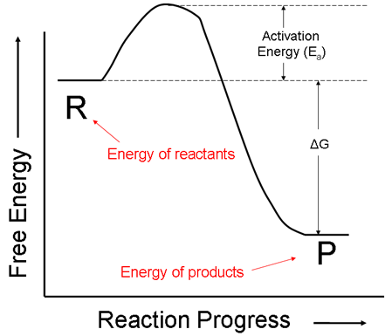
EXOTHERMIC: Like a ball rolling down a hill (releasing potential energy)

Slide 15
Energy and Bonds
Exothermic – Less energy is required to BREAK the bonds in the reactants than is released when new bonds FORM in the products
Think: more complex reactants make simpler products so EXTRA energy is released

Slide 16
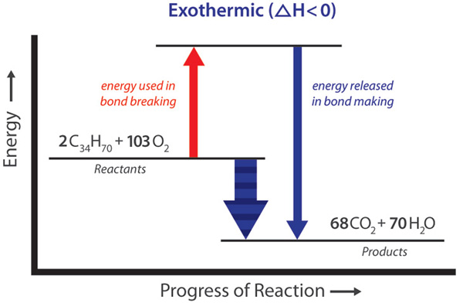

Slide 17
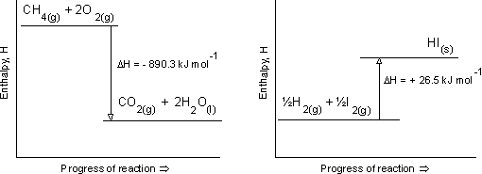
Which is endothermic?
A B

Slide 18
simulation

Slide 19
Solubility—LIKE DISSOLVES LIKE
POLAR substances are soluble in POLAR solvents
Ex: Sugar dissolves in H₂O but oil does not.
NON-POLAR substances are soluble in NON-POLAR solvents
Ex: Oil will dissolve in CCl₄ but not water.

Slide 20
State of Matter
Can exist as Solids, many are Liquids, and Gasses due to weaker bonds
Solids: Sugar, candle wax
Liquids: Oil, water
Gas: Oxygen, carbon dioxide

Slide 21
Boiling/ Melting Points
Weaker forces of attraction than ionic compounds so Melting points and Boiling points are LOWER than those of ionic compounds

Slide 22
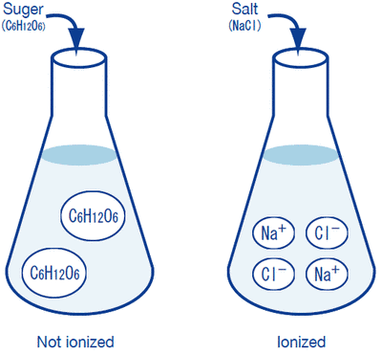
Conductivity---NO
Covalent compounds are not made of ions so when they dissolve, they do not allow a current to flow.

Slide 23
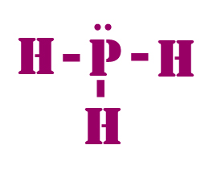
What is a Structural formula?
Letters, symbols and bonds that show relative position of atoms
Example:

Slide 24
How do you complete a structural formula for covalent compounds?
1. predict the central atom (the one that can make the most bonds typically)
2. draw the Lewis diagram for each atom (with central in middle)
3. determine the number of bonding pairs (lone electrons)

Slide 25
How do you complete a structural formula for covalent compounds?
4. bond unpaired electrons to central atom (make pairs)
5. determine if any double or triple bonds are needed (any lones need pairs?)
6. check that all have a full octet (except Hydrogen)

Slide 26
Coordinate covalent bonds and polyatomic ions
Coordinate covalent bonds- when one atom donates both electrons to be shared by another atom/ion that needs 2 electrons to be stable
Polyatomic ion- ion with covalent bonds some of which can be coordinate covalent bonds.
Back of your periodic table
Example NH₄⁺

Slide 27
Expanded Octets (Exceptions to the octet rule)
Phosphorus can make:
3 bonds
6 bonds
5 bonds
Sulfur can make:
6 bonds
Xenon can make:
6 bonds
Boron can make:
3 bonds

