Slide 1
Tie DYE CHROMATOGRAPHY
Why does isopropyl alcohol cause sharpies to tie dye fabric?

Slide 2
Polar Substance
A molecule with:
2 atoms bonded that have an electronegativity difference of 0.5-1.9
AND the molecule has a distinct dipole

Slide 3
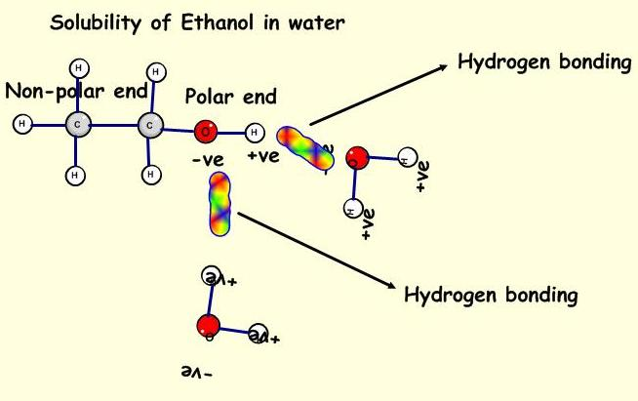
Application to Tie Dye– Why won’t water cause the sharpie to tie dye the fabric?
The sharpie is made of dye (the solute) dissolved in alcohol (the solvent).
The alcohol has both polar and nonpolar regions.
The isopropyl alcohol we drop on the sharpie mixes with non-polar region to allow the dye to diffuse.
Water (polar) won’t separate the mixture due to the nonpolar region of the dye it can’t interact with.

Slide 4
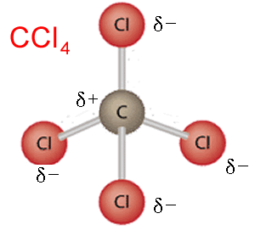
Nonpolar Substance
A molecule that:
Does NOT have a dipole
OR Does NOT have polar bonds

Slide 5
Application to Tie Dye
The alcohol in the sharpie and that we use as the solvent to diffuse the dye have nonpolar regions.
This allows nonpolar solvents, like isopropyl alcohol, to separate the mixture (ink)
Water cannot interact with the mixture (ink) because water is polar.
Remember, “like dissolves like.”

Slide 6
Diffusion

Slide 7
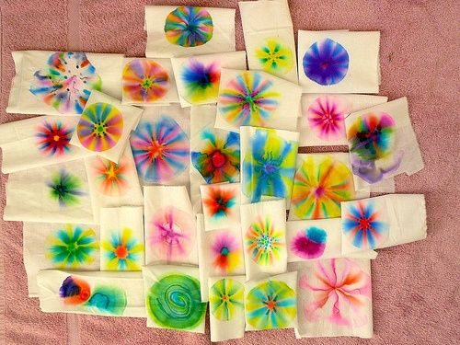
Application to Tie Dye
Draw with a sharpie in one area.
Add solvent (isopropyl alcohol) to the sharpie.
The dye will move from an area of HIGH concentration to an area of LOW concentration= Diffuse.

Slide 8
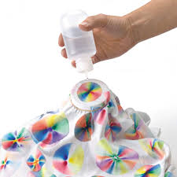
Chromatography
The separation of a mixture by passing it in solution or suspension or as a vapor (as in gas chromatography) through a medium in which the components move at different rates.

Slide 9
Application to Tie Dye
The sharpie will separate into different color components as it moves with the solvent (alcohol).
A component will travel at a rate that is determined by its affinity to the fabric and solvent.
The affinity can be impacted by a molecule’s mass as well. Larger molecules = slower movement
Since each component (of the sharpie color) has its own solubility with the solvent and its own affinity to the solvent and fabric, they can be separated.
Example: Green
dye separated into blue and yellow
yellow dye is soluble in isopropanol concentrations >0%
blue dye is less soluble than the yellow, but is completely soluble in 100% isopropanol

Slide 10
Solution
A mixture of a solvent and a solute
Application to Tie Dye
The sharpie is the solution
Dye (solute) in Alcohol (solvent)

Slide 11
Solute
The part of the solution that gets dissolved
In a smaller proportion than the solvent.
Application to Tie Dye
The dye

Slide 12
Solvent
The part of the solution that does the dissolving
Typically in greater proportion than the solute.
Application to Tie Dye
The isopropyl alcohol

Slide 13
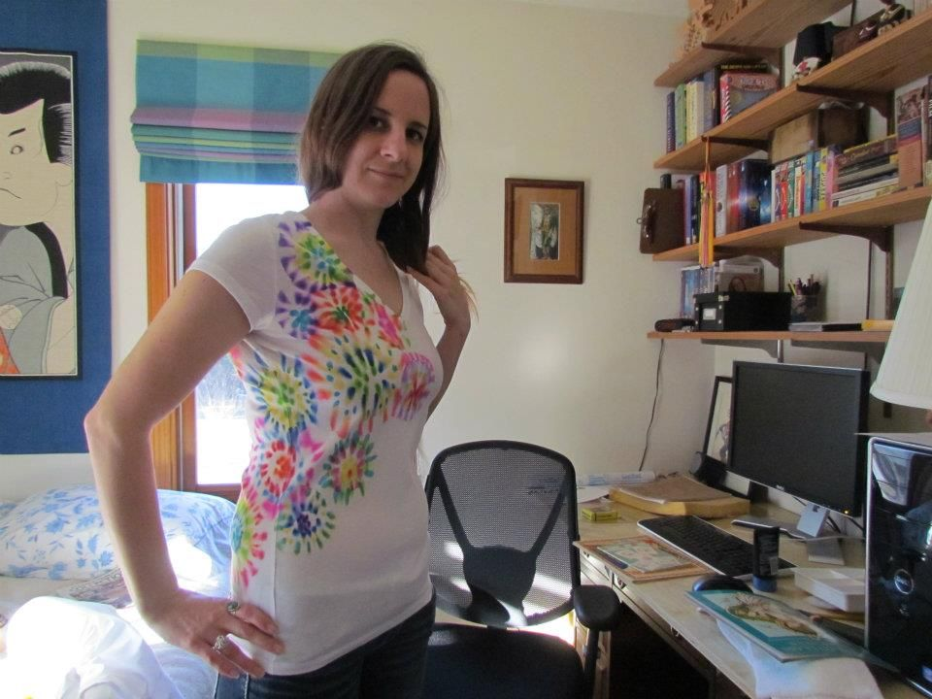

Slide 14
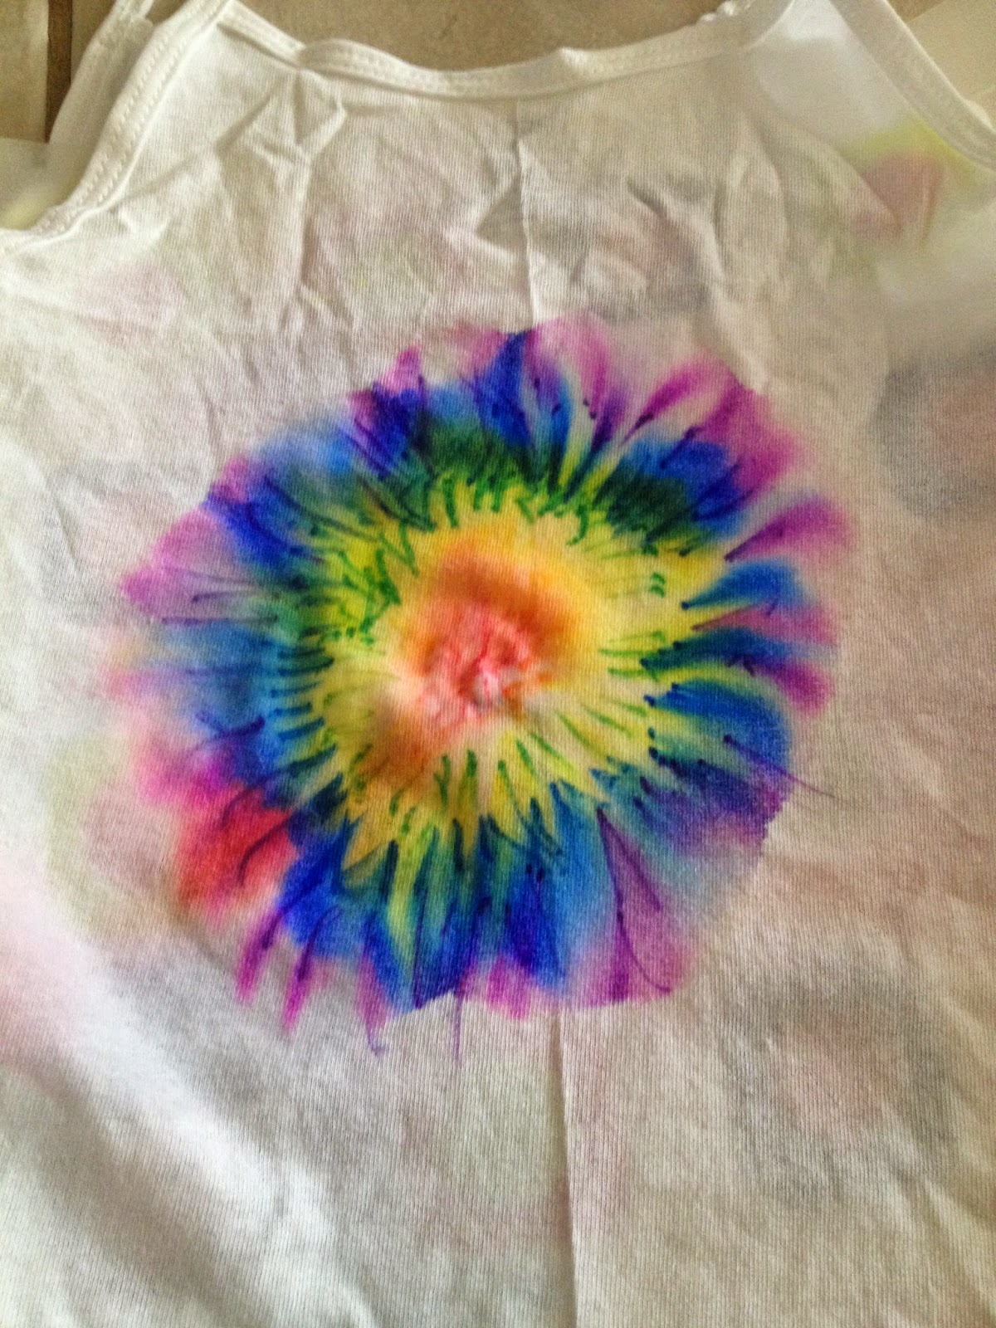
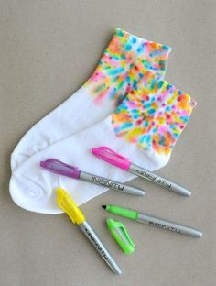

Slide 15
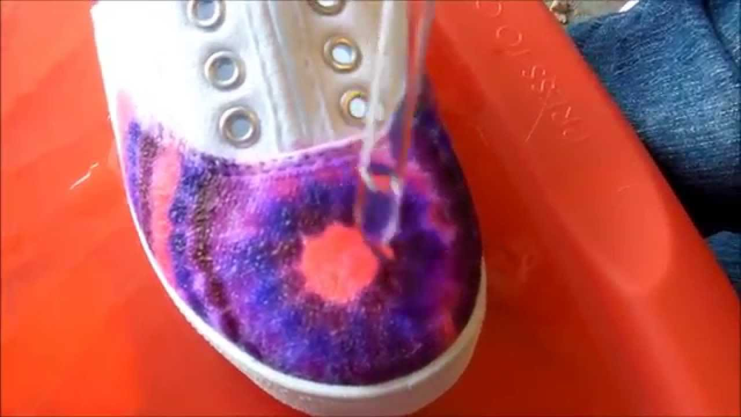

Slide 16
Look for cool designs you want to try!
Video
video

