Slide 1
States of Matter (Ch. 12) and Gas Laws (Ch. 13)
LT1: KM theory and states of matter
LT2: Gas Laws

Slide 2
Lesson 1:Nature and Behavior of Gases

Slide 3
Obj. 1 How does the kinetic molecular theory apply to gas laws?
The kinetic theory as it applies to gas behavior | Description | Illustration
Particle size | Small particles, LOTS of empty space, no significant attractive or repulsive forces
Particle motion | Constant, random motion. Move in a straight line until collide, collisions are elastic and DO NOT slow down
Particle energy | Determined by mass and velocity. KE=1/2 mv² Temperature is a measure of the avg KE of all particles

Slide 4
Obj. 2 Use the KM theory to explain the behavior of gases
Behavior | Description and Application of KM theory
Low Density | Lots of empty space between gas particles D=m/v mass of gas particles very low compared to volume so density is LOW
Compression and Expansion | Can compress and expand easily due to empty space between particles Can liquefy with enough pressure applied
Diffusion and Effusion | Diffusion- movement of particles from high to low concentration to reach an equilibrium state. Effusion- similar to diffusion but through pores (holes) of matter (the smaller the particle the faster the effusion rate)

Slide 5
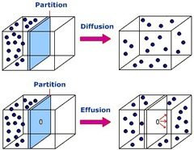

Slide 6
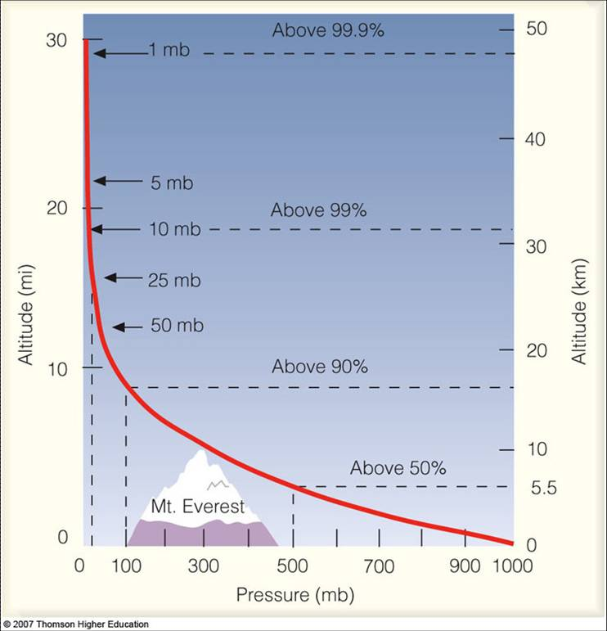
Obj. 3 How does atmospheric pressure change as elevation changes? Why?
High altitudes= low pressure

Slide 7
Lesson 2: Unit conversions Obj. 4 What are pressure units and how do you convert between them?
202 kPa= _________ Pa
2.4 atm= _________ mm Hg
775 mm Hg=_________kPa
Metric conversions review:
K H D U D C M

Slide 8
Switch to Practice page

Slide 9
Lesson 3: Dalton’s Law Obj. 5 What is Dalton’s Law of Partial Pressure?
P _{total}= P₁ + P₂+ P₃…

Slide 10
Cabin Pressure reading and video
Why must an airplane cabin be pressurized?

Slide 11
Lesson 4: Forces of Attraction Obj. 6 What is the difference between INTRAmolecular and INTERmolecular forces?
Intra is within the molecule (ionic, covalent, metallic)
Inter is between two neighboring molecules

Slide 12
Type of Intermolecular Force | Strength | Description/Illustration | Physical Properties
London Dispersion | Weak | Temp. shifts in density of electrons. (The more electrons the stronger the attraction) All molecules have. | Gases Low BP Low MP
Dipole-Dipole | Stronger | Between permanent dipoles. Opposite ends attract | Gases or liquids Higher BP Higher MP

Slide 13
Intermolecular Forces
Hydrogen Bonding | Strongest | Special case of Dipole where H is bound to O,N, F and the large electronegativity difference creates a strong dipole | Liquids Highest BP Highest MP

Slide 14
Lesson 5: IMF Activity

Slide 15
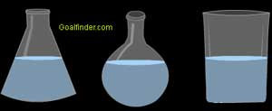
Lesson 6: Prop. Of Liquids and Solids Obj. 7 What determines the properties of a liquid?--- the strength of the forces of attraction between the molecules
Characteristic | Explanation
Volume | Fixed
Shape | Takes the Shape of the container
Density | Much higher than gases but lower than solids
Compression | Very little due to little space between particles to compress liquid
Fluidity | Less than gases but more than solids (which cannot flow) IMF stronger than gases so harder to flow

Slide 16
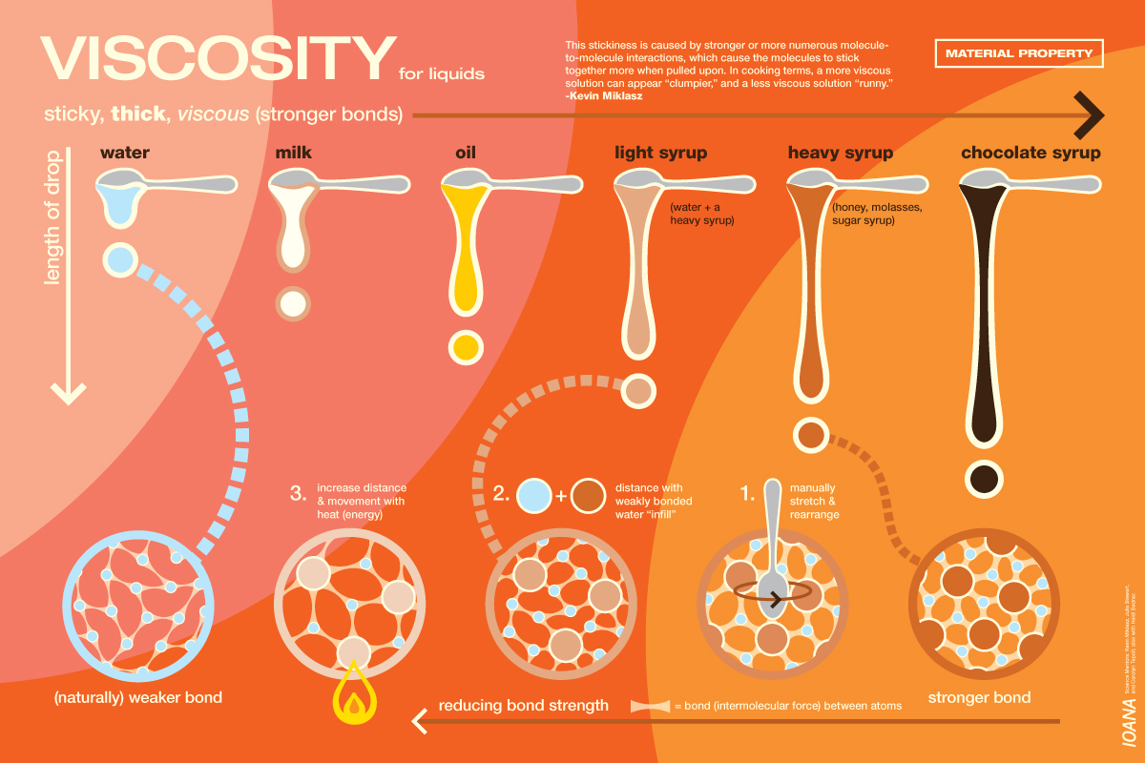
Viscosity- resistance of a fluid to flow | Attractive forces- Greater IMF= higher viscosity and vice versa Particle size and shape- greater size=higher viscosity Temperature-high temp= lower viscosity

Slide 17
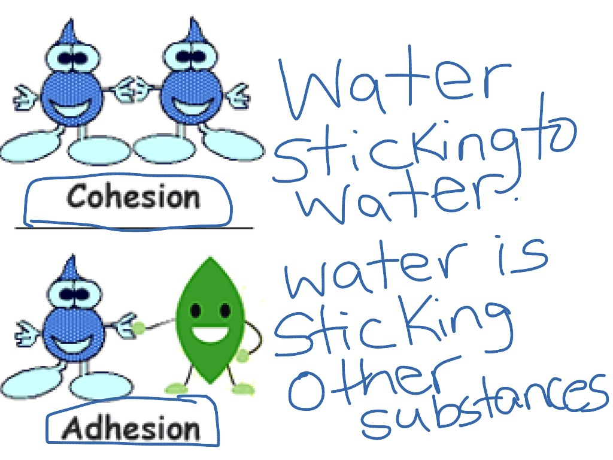
Obj. 7 continued
Surface Tension | Higher the IMF= higher the S.T. because attractions cause film on the surface of the liquid
Cohesion | Attractions between molecules
Adhesion | Attractions between molecules and container (or different molecules)

Slide 18
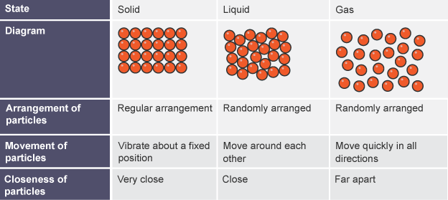
Obj.8 How are the structure and properties of solids related?
Arrangement of particles and Density? | Strong attractions limit movement to vibrations. Most dense state of matter
Shape and volume? | Fixed shape and volume
Compressibility? | NOT compressible because no space between molecules

Slide 19
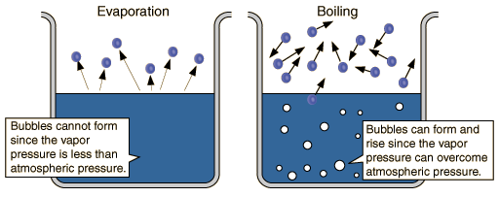
Lesson 7: Vapor Pressure and Boiling Obj. 9 Describe vapor pressure. How does changing temperature affect vapor pressure?
Pressure exerted by a vapor over a liquid
Vapor pressure=Atmospheric pressure= BOILING

Slide 20
Obj. 10 Describe boiling in terms of KE, VP, and atmospheric pressure.
When VP= Atm Pressure a liquid will boil
You can speed up the process by increasing the Kinetic Energy of the liquid by adding HEAT.

Slide 21
Obj.11 Where does a liquid boil faster and at a lower temperature; at sea level or on top of a mountain?
Think:
Where is there more atmospheric pressure?
Where would you need more VP so more heat?

Slide 22
VP graph worksheet

Slide 23
Lesson 8 Part 1: Phase Changes Draw the phase change diagram to see the changes that can occur.

Slide 24
Obj. 12 Relate energy to the phase changes
Phase change | Description | Temperature for water ˚C | Endothermic or Exothermic
Melting
Freezing
Boiling/vaporization
Condensing
Sublimation
Deposition

Slide 25
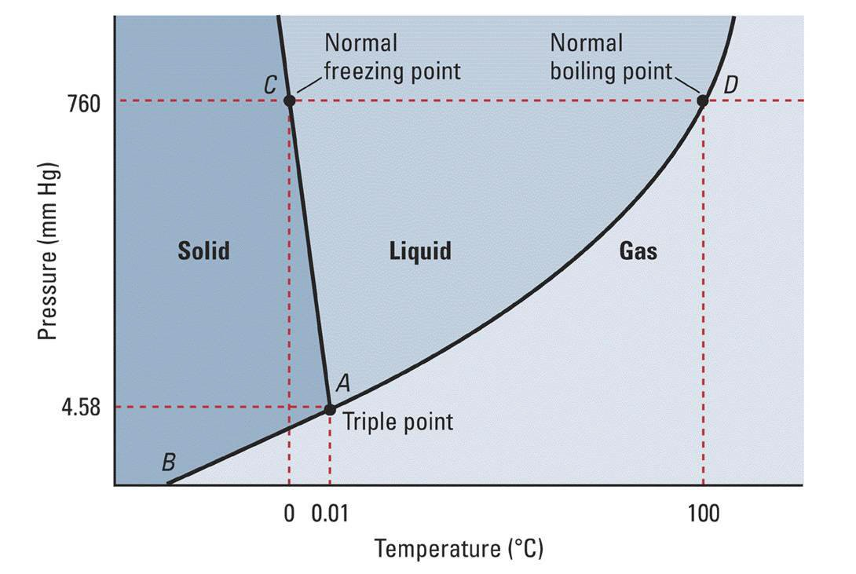
Obj. 13 Triple Point Graph and more- answer the questions on your notes guide

Slide 26
More graphs to interpret

Slide 27
Lesson 8 Part 2 Obj. 14 (Pre AP)What is latent heat of fusion and latent heat of vaporization?
Read the supplement provided and answer the question in your notes
KEY: Fusion is melting and vaporization is boiling both are ENDOTHERMIC processes.

Slide 28
Obj. 15 How do you solve for energy change in a system where temperature remains constant? Temperature Changes?
See supplement and practice page
Q=mΔH_{(vapor. Or fusion)}
Q=mΔTC
Where Q = Energy Change, m= mass, C specific heat, T= temperature, H= heat of vaporization or fusion

Slide 29
LT2: Gas Laws

Slide 30
Lesson 9 What factors affect gas behavior?
Temperature
Pressure
Amount (moles)
Volume of container

Slide 31
Lesson 9 Charles’ Law- Vol and Temp
Volume and temperature are DIRECTLY related
Equation: V1/T1=V2/T2
What remains constant? Pressure

Slide 32
Lesson 10 Boyle’s Law- Press. and Vol.
Pressure and Volume are INDIRECTLY related.
Equation: P1V1=P2V2
What remains constant? Temperature

Slide 33
Lesson 11 Gay-Lusaac’s Law: Press and temp.
Pressure and temperature are DIRECTLY RELATED
Equation: P1/T1=P2/T2
Temperature must be in Kelvin (C+273)
Constant?: Volume

Slide 34
Lesson 12 Combined Gas Law
Combination of all 3 Gas Laws where only moles remains constant.
Equation: P1V1/T1=P2V2/T2
Temperature in Kelvin

Slide 35
Lesson 13 Ideal- amount changes and a constant is applied
Equation: PV=nRT
Where n= moles of gas
R is the ideal gas constant= 0.0821L(atm)/mol(K)

