Slide 1
Solutions (Chapter 14)

Slide 2
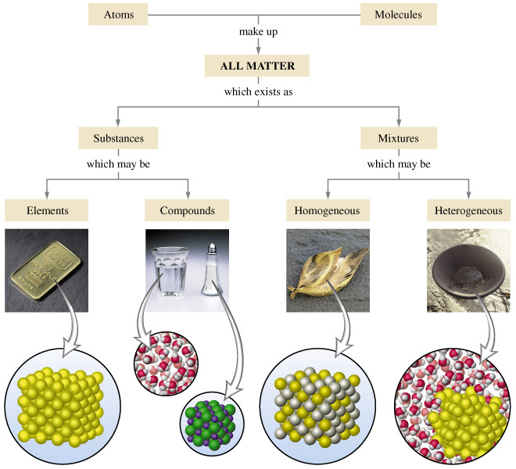
Lesson 1: Differences in the types of mixtures

Slide 3
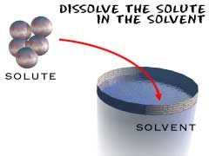
Solute vs Solvent
Solute- what is being dissolved
Salt
Solvent- what is doing the dissolving
Water is the universal solvent

Slide 4
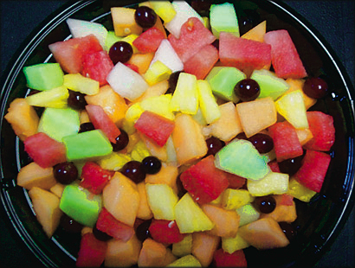
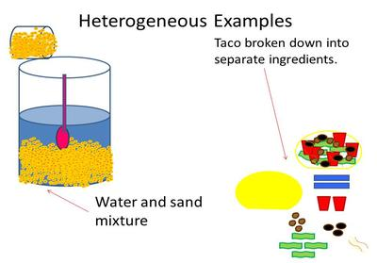
Heterogeneous- do not blend smoothly together- or refract light
2 or more components physically mixed NOT chemically combined

Slide 5
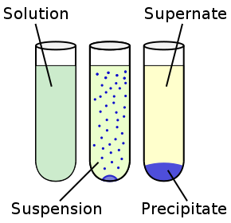
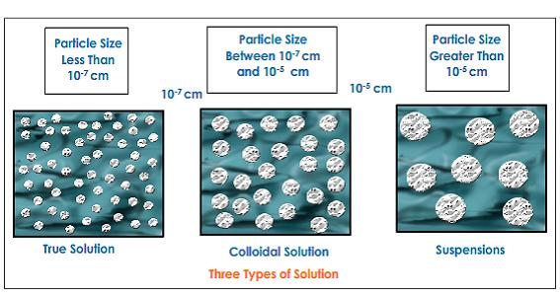
2 types of heterogeneous mixtures
Suspensions- solutions that settle out if left undisturbed
Examples: Sandy water, muddy water

Slide 6
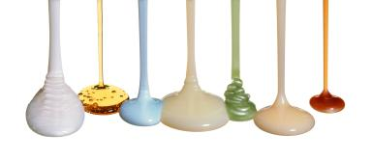
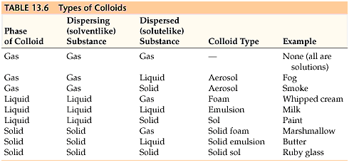
Colloids- particles medium sized but DO NOT settle out but are blended smoothly.

Slide 7
Homogeneous mixtures (solutions)- particles evenly mixed and uniform

Slide 8
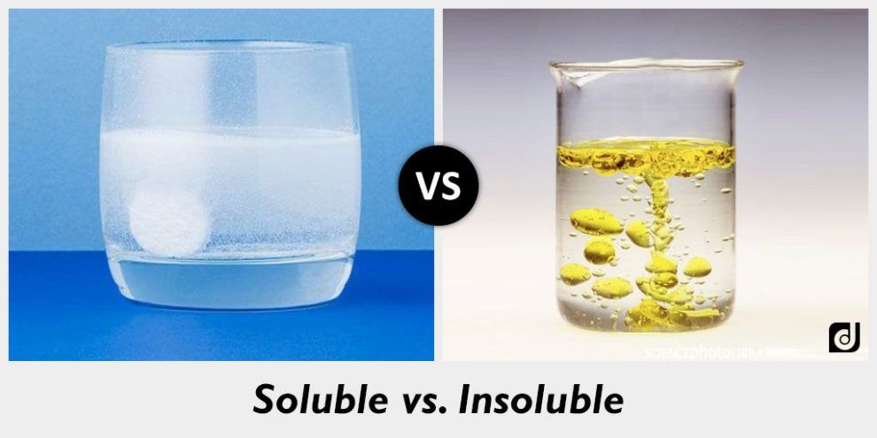
Soluble refers to the ability to be dissolved
Insoluble or nonsoluble refers to the inability to be dissolved.

Slide 9
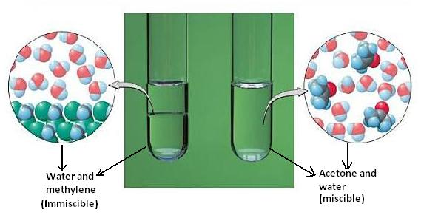
Miscible vs immiscible

Slide 10
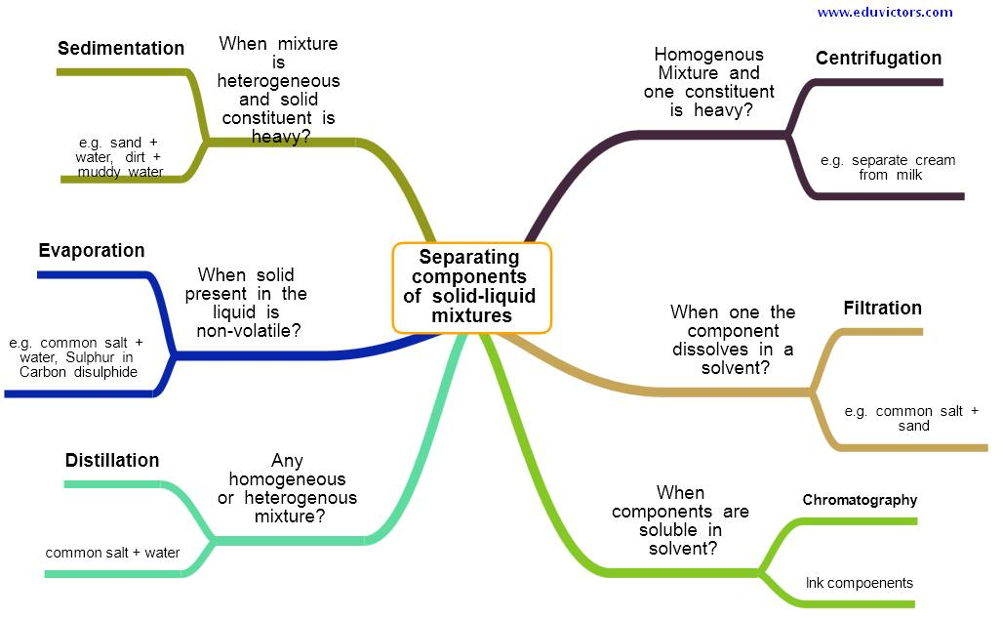
Separating Mixtures-- Review
video

Slide 11
Lesson 2- Concentration Expressed
Molarity (M)= mole solute/ L of solution
Example: What is the molarity of a solution that has 0.9 grams of sodium chloride in a 100 mL solution?

Slide 12
Molality (m)= mole of solute/ kg solvent
Example: What is the molality if 95 grams of Magnesium Oxide is dissolved in 1050 grams of water.

Slide 13
Percent by volume= (volume of solute/ volume of solution) x 100
What is the percentage of isopropyl alcohol is 91 mL of alcohol makes 100 mL of solution?

Slide 14
Mass percent= (mass of solute/mass of solution) x 100
If 2 grams of yeast is dissolved to prepare a 50 gram solution, what is the mass percent of the solution?

Slide 15
Normality (N)= Molarity x total positive oxidation number
What is the Normality of a 2M H₃PO₄ solution?

Slide 16
Dilution Problems---M₁V₁=M₂V₂
How much water should be added to dilute 12M Hydrochloric Acid to prepare 1 Liter of 1.5 Molar acid?

Slide 17
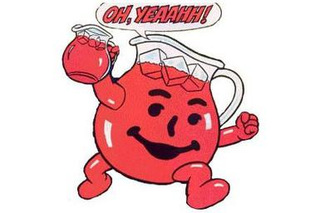
Lesson 3-How do you prepare a specific Molar Solution for kool aid?
Task: Prepare multiple Molarity solutions of kool aid in the lab.
Safety and Disposal
Check with your teacher before starting the lab- show your math

Slide 18
Lesson 4- Polarity and Solubility
Review- How do you know if a compound is ionic or covalent?
How do you know if a compound is polar or nonpolar?

Slide 19
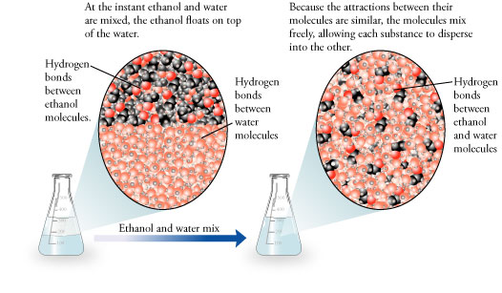
What is the general solubility RULE?
LIKE DISSOLVES LIKE
POLAR DISSOLVES POLAR
NONPOLAR DISSOLVES NONPOLAR
C₂H₆ and H₂O----soluble or insoluble?

Slide 20
Solute | Solvent | Soluble/nonsoluble
C₂H₆ | H₂O
MgCl₂ | H₂O
HCl | H₂O
CH₄ | C₃H₈
KI | C₆H₁₄

Slide 21
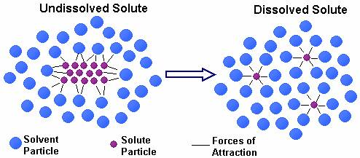
Solvation (dissolving) is when solvent surrounds solute.

Slide 22
Solvation can be increased by…
Increasing surface area
Agitation
Raising temperature
3 steps to solvation that involve ENERGY
1) separate intermolecular forces of solute
2) overcome intermolecular forces of solvent
3) solute and solvent interact

Slide 23
Video Review– Crash Course

Slide 24
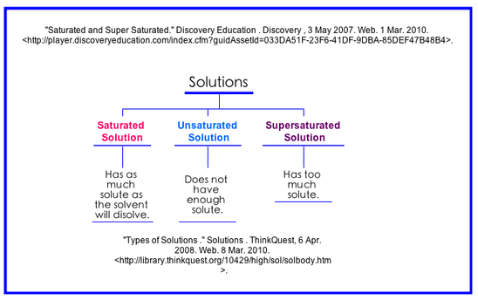
Lesson 5- Factors affecting solubility
Solubility- the amount of solute that dissolves in a given solvent.

Slide 25
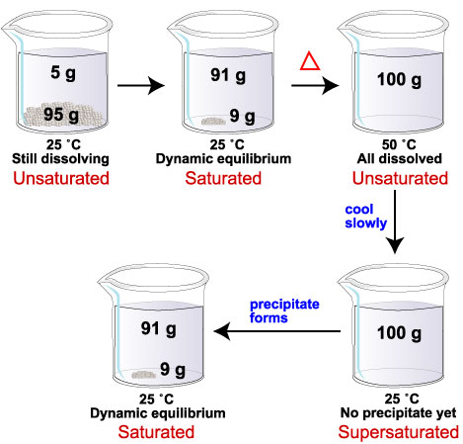

Slide 26
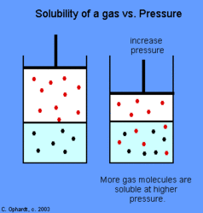
Factors affecting solubility
Increasing Temperature
Solids and liquids
Gases
Increasing Pressure
Solids and liquids
Gases

Slide 27
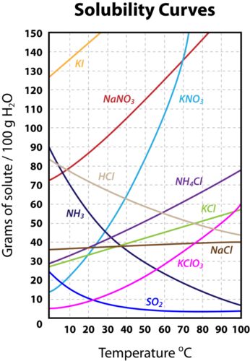

Slide 28
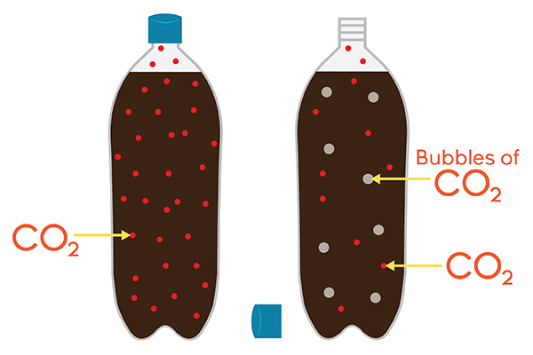
Henry’s Law--- S1/P1=S2/P2
At a given temperature, the solubility of a gas is DIRECTLY proportional to the pressure.

Slide 29
Lesson 6- Colligative Properties
Properties of solutions that are dependent on the “collection” of solute particles
Vapor Pressure Lowering
Boiling Point Elevation
Freezing Point Depression
Osmotic Pressure

Slide 30
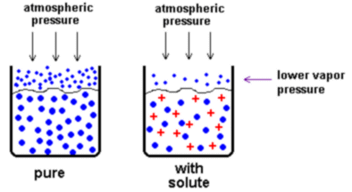
Vapor Pressure Lowering
When a nonvolatile solute takes up surface area at the surface of a liquid thus lowering the vaporization of the solvent.

Slide 31
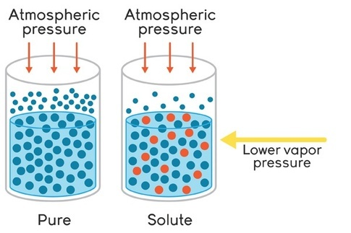
Boiling Point Elevation
If there is less Vapor Pressure then MORE HEAT is required to get enough vapor pressure to overcome Atmospheric pressure so the solution will boil.
Antifreeze

Slide 32
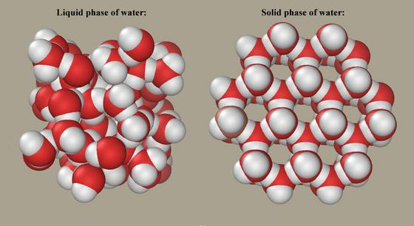
Freezing Point Depression
The solute gets in the solvent’s “way” and prevents crystallization so a lower temperature is needed for freezing.
The solute blocks the Intermolecular forces (Hydrogen bonding for water) from reorganizing into a solid structure.

Slide 33
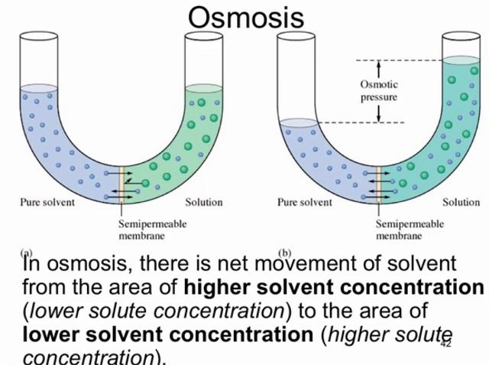
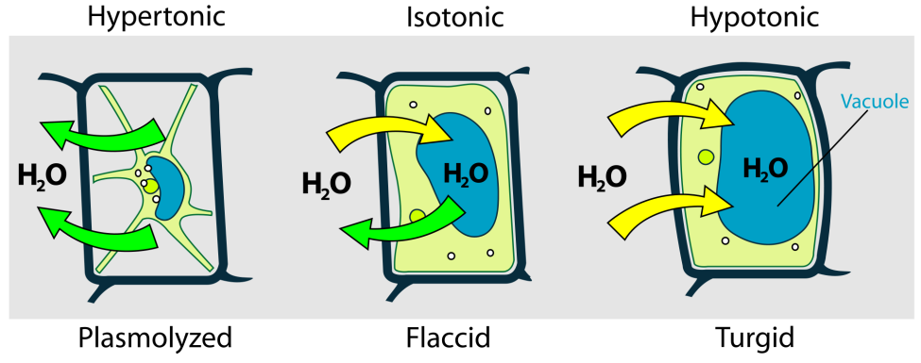
Osmotic pressure
When a semipermeable membrane allows some solvent but NOT the solute to pass thus building up pressure on one side.
Cells and turgor pressure

Slide 34
Calculations
∆ T_{F}=m x d.f. x k_{f}
∆T_{B}= m x d.f. x k_{b}
k_{b} water = 0.52 ˚C/m
k_{f} water = 1.86 ˚C/m
Dissociation factor (how many particles the solute breaks into. For a nonelectrolyte, d.f.=1)

Slide 35
Example
What would be the boiling point if 50 grams of CaCl₂ were dissolved in 1039 grams of water?

