Slide 1
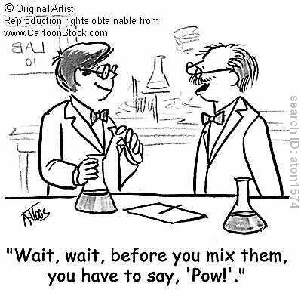
YOU ONLY GET ONE CHANCE
Safety Talk

Slide 2
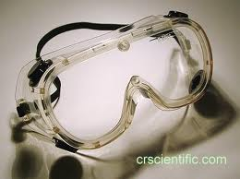
Appropriate Dress
Pants
Close toed shoes
Sleeves back
Jackets off
Goggles AT ALL TIMES
Aprons if there are wet chemicals
NO hanging jewelry (bracelets, necklaces)

Slide 3
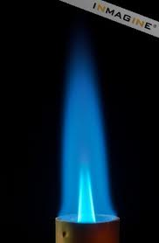
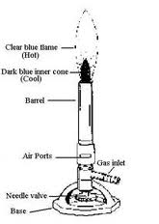
Bunsen Burners
Check the three main parts
Hose
Air port
Bottom valve
Have the match lit THEN TURN ON THE GAS
KEEP YOUR HEAD BACK NOT OVER THE FLAME
DO NOT PUT ANYTHING IN THE FLAME THAT IS NOT INSTRUCTED TO DO SO

Slide 4
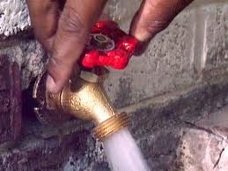
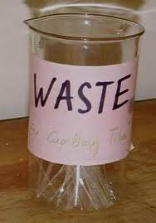
Disposing of Liquids
Aqueous (water)-
TURN ON WATER
Rinse down slowly
Flammable/Glycerin-
NEVER PUT DOWN DRAIN
WASTE BEAKER

Slide 5
Disposing of…
Solids-
TRASH
Broken Glass-
Broken glass boxes on the top of the lab benches
Spilled solid chemicals-
Wipe up with a paper towel and place in trash
Spilled liquid chemicals-
Acids= use a base
Bases= use an acid

Slide 6
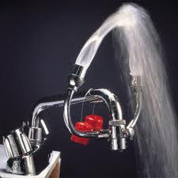
Eye wash/Shower/Fire Extinguisher
Locate them in the room.
How/When do you use them?

Slide 7
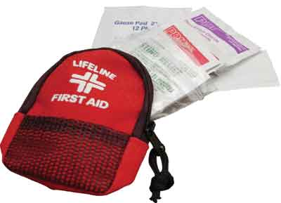
First Aid Kit
What’s in there anyway?
Where is it?

Slide 8
Reasons to see the Nurse/incident report/call home…

Slide 9
Food/Drinks in the lab??

Slide 10
Cleanliness at your lab station

Slide 11
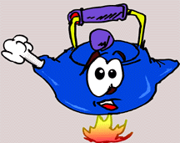
Hot Objects
Hold with appropriate tongs
CAN be placed on lab bench
CANNOT be placed on balances

Slide 12
Faulty equipment- DON’T USE IT!
Glass with cracks- put in broken glass box
Bunsen burners- Turn gas line off and then give to me
Clamps- Give to me

Slide 13
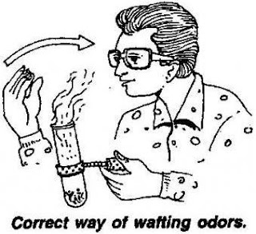
Smelling chemicals… WAFT DON’T HUFF!

Slide 14
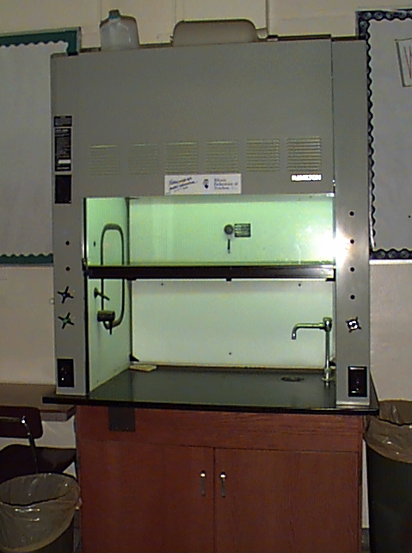
Fume Hood?
Where is it?
How do you turn it on?
When is it used?

Slide 15
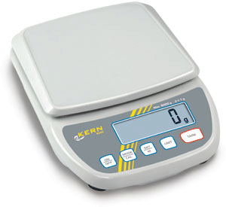
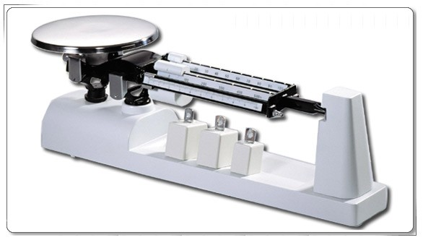
Balance Rules
Don’t press down on them with your hand, put a book, or any other unauthorized material on them.
If they are counting down, they are calibrating leave it alone.
Make sure they are on “g” for GRAMS not oz or lb.
If using the triple beam, make sure they are calibrated before using.

Slide 16
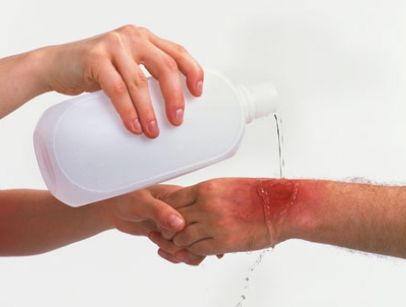
Chemical contact/burns
1st: Rinse for at least 60 seconds
2nd: Tell me
3rd: If we decide you don’t need to see the nurse but later in the day it starts hurting, come see me or go straight to the nurse.

Slide 17
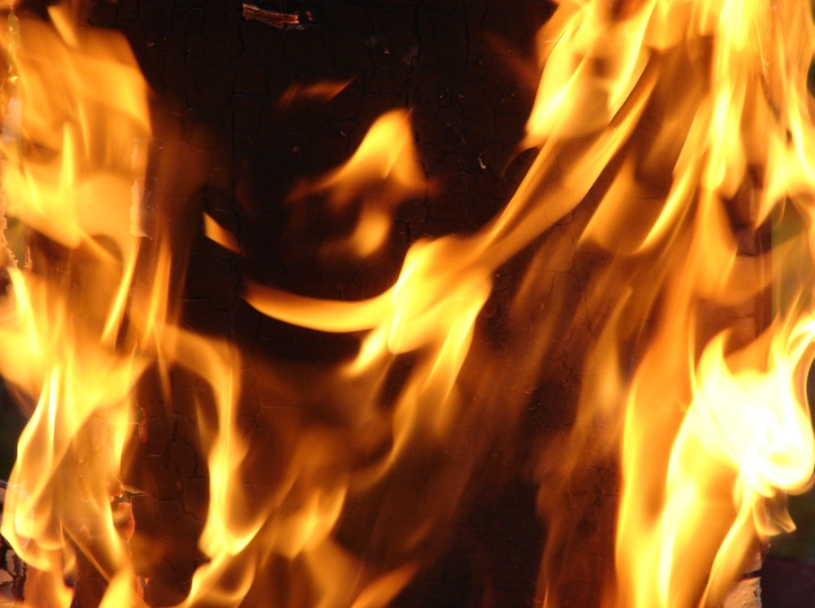
Fires
Self- fire blanket
Bench- blanket or extinguisher

Slide 18
The BIG RED BUTTON????

Slide 19
Involvement and expectations?
I expect you to be appropriately dressed for the labs (keep shoes in your drawer if needed).
I expect you to participate in the labs.
I expect you to act like a well-behaved student in the lab.
NO HORSE PLAYING
NO GOOFING
NO YELLING, THROWING, TYRING THINGS JUST TO SEE WHAT HAPPENS
YOU ONLY GET ONE CHANCE!

Slide 20
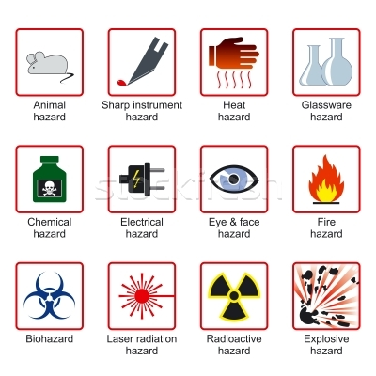
Corrosive

