Slide 1
Rules for Naming Acids
Unit 5: LT 2

Slide 2
ACIDS
ACIDS ALWAYS HAVE HYDROGEN IN THE FORMULA
BINARY ACIDS= HYDROGEN + 1 NONMETAL

Slide 3
Writing names for Binary Acids---2 elements
Naming Rules
Add the prefix hydro
Change the suffix of the nonmetal from
–ide to –ic
Hydro_______ic Acid
Examples:
HCl Hydrochloric Acid
H2S Hydrosulfuric Acid

Slide 4
Writing formulas for binary acids
Cross Charges!!!
H⁺ + Cl ⁻ → HCl

Slide 5
Practice Binary Naming
1. HF
2. HBr
3. HCl
4. H2S
5. H3P
6. HI

Slide 6
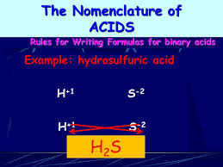
Practice Binary Acid Formulas
1. Hydrochloric
2. Hydrosulfuric
3. Hydrofluoric
4. Hydroiodic

Slide 7
Naming Ternary Acids— 3 elements (caps)
Acids containing a polyatomic ion (Ex: HNO₃, H₂SO₄, H₂CO₃, HClO₃, etc.)
NO HYDRO PREFIX!!!!
If the polyatomic ion ends in –ate, change the ending to –ic
________ic Acid HNO₃ Nitric Acid
If the polyatomic ion ends in –ite, change the ending to –ous
________ous Acid H₂SO₃ Sulfurous Acid

Slide 8
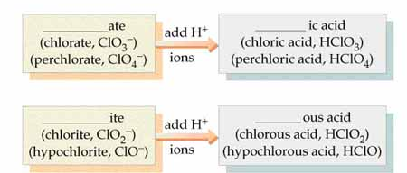
Writing Formulas for Acids
CROSS CHARGES AND SIMPLIFY
Ternary
H⁺ + SO₃ ²⁻ → H₂SO₃

Slide 9
Skip problems
On the front: 3-4, 6-9, 12-18
On the back: 1-3, 5-6, 8-9, 11, 13-17, 19-20, 22, 24-29

