Slide 1
Nomenclature Vocabulary and Rules

Slide 2
Different types of IONS- Charged atoms that have either lost or gained electrons
Monatomic ion- an ion formed from only one atom.
Ex. Na^{+,} Cl⁻, O²⁻
Cation- positive ion that has lost electrons, typically metals Ex. Ca²⁺
Anion- negative ion that has gained electrons, typically nonmetals Ex. N³⁻
Polyatomic Ion- an ion made up of two or more atoms bonded together that act as a single unit and have a charge.
Ex. PO₄³⁻, OH⁻

Slide 3
Types of Compounds
Binary Compound- a compound consisting of only 2 elements (no polyatomic ions) Ex. MgCl₂
Ternary Compound- a compound that consists of at least one polyatomic ion. Ex. Na₂CO₃
Ionic Compound- a compound consisting of a metal and nonmetal where electrons are transferred from metal to nonmetal forming ions with very strong attractions.
Ex. NaCl
Molecular Compound- a compound that consists of 2 or more nonmetals that share electrons to complete their octet. Ex. CO

Slide 4
Naming Binary Ionic Compounds
1st write the full name of the metal
2nd Check to make sure it is NOT a transition metal
3rd write the name of the nonmetal but change the ending to –ide
Practice: MgCl₂ Magnesium Chloride

Slide 5
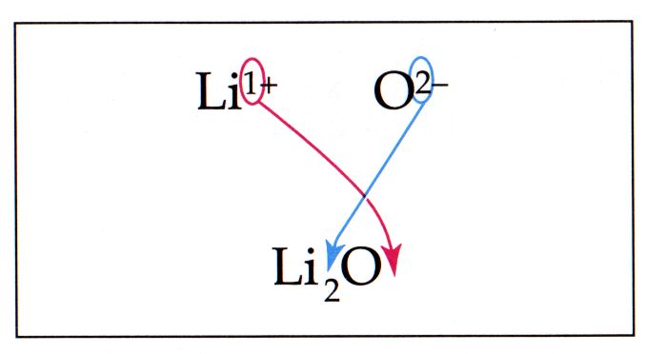
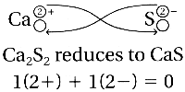
Writing formulas for binary ionic compounds
Criss-Cross the charges and SIMPLIFY to make the compound electrically neutral

Slide 6
Naming ternary ionic compounds
1st write the full name of the metal
2nd write the full name of the polyatomic ion– don’t change the ending!
Practice: Ba(OH)₂--- Barium Hydroxide

Slide 7
Writing Formulas for ternary ionic compounds
Criss-Cross the charges and SIMPLIFY to make the compound electrically neutral
If more than one of the polyatomic ions put the polyatomic ion in parentheses

Slide 8
Naming Compounds with Transition Metals
1st name of metal with Roman numeral indicating form of metal
2nd name of nonmetal with ending changed to –ide
Practice FeCl₃ Iron (III) Chloride

Slide 9
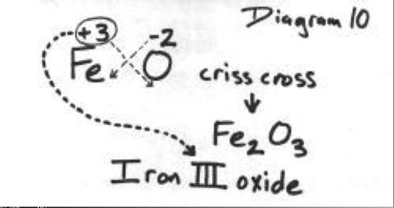
Writing formulas for compounds with Transition Metals
Criss-Cross the charges and SIMPLIFY to make the compound electrically neutral
Charge of metal is the Roman Numeral

Slide 10
Naming Molecular Compounds—USE PREFIXES
1st write the full name of the 1st nonmetal
Only write a prefix if it is more than 1
2nd write the name of the 2nd nonmetal and change the ending to -ide
ALWAYS use a prefix
Practice
CO--Carbon Monoxide, N₂O₂—dinitrogen dioxide

Slide 11
Writing formulas for molecular compounds
FOLLOW THE PREFIXES TO DETERMINE NUMBER OF EACH ELEMENT
PRACTICE– dinitrogen pentoxide---N₂O₅
Boron trisulfide--- BS₃

