Slide 1
LT3 Molecular Geometry

Slide 2
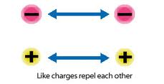
VSEPR- valence shell electron pair repulsion theory
Electrons, due to their like charge, position themselves to be as far apart from each other as possible!

Slide 3
Geometric shapes small molecules take on due to the VSEPR theory
Linear
Bent
Trigonal planar
Trigonal pyramidal
Tetrahedral
Trigonal bipyramidal
Octahedral
Square planar
There are additional shapes. We are going to focus on the first 5.

Slide 4
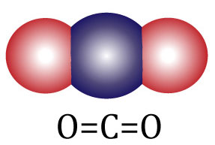
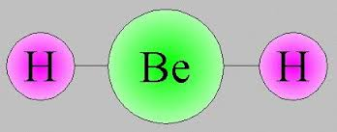
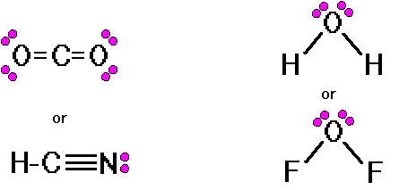
Linear
NON EXAMPLES- How are they different?
Central atom with 1 or 2 atoms attached
Bond angle 180 degrees
0 unshared pairs of electrons

Slide 5
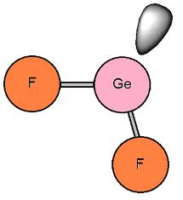
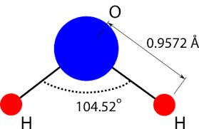
Bent
Central atom with 2 atoms attached
Bond angle 104.5 degrees
2 unshared pairs of electrons on the central atom
●●●●

Slide 6
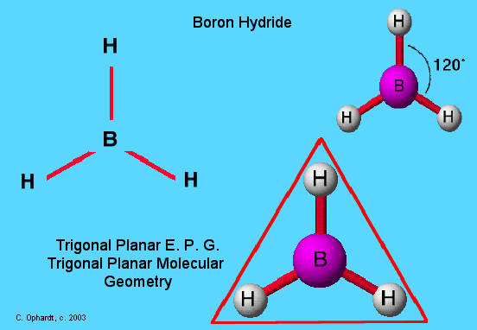
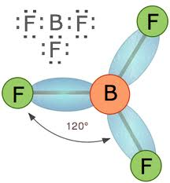
Trigonal Planar
Central atom with 3 atoms attached
Bond angle 120 degrees
0 unshared pairs of electrons on the central atom

Slide 7
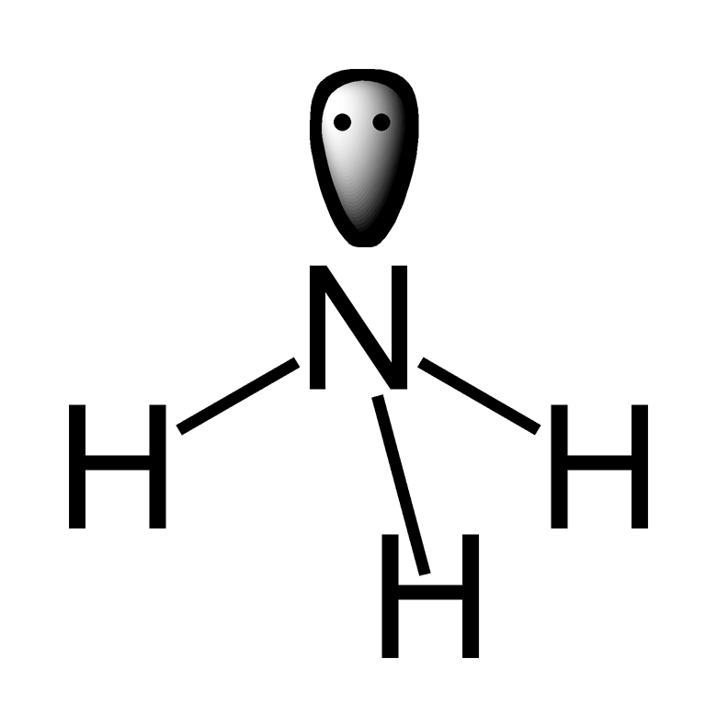
Trigonal pyramidal
Central atom with 3 attached
Bond angle 107.3 degrees
1 or 2 unshared pairs of electrons on the central atom
Unshared pair of electrons
Dashed line to show 3D structure

Slide 8
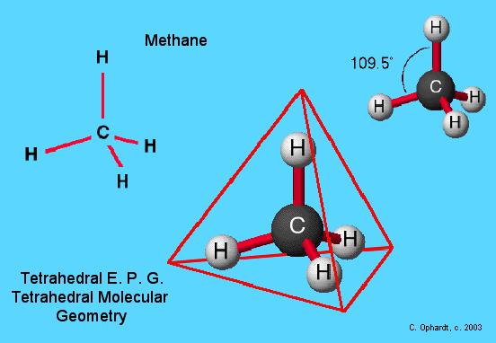
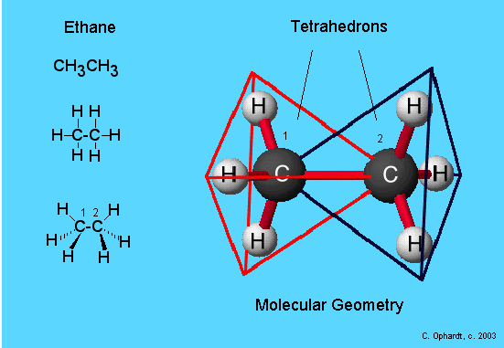
Tetrahedral
Central atom with 4 attached
109.5 bond angle
0 unshared pairs of electrons
Dashed line showing 3D shape

Slide 9
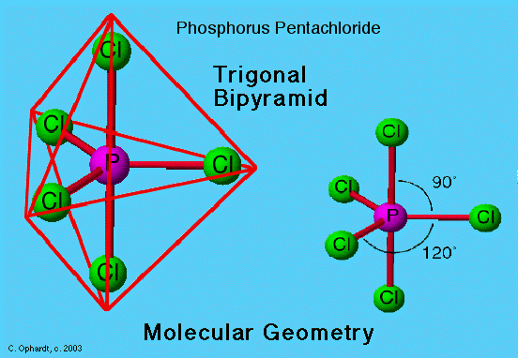
Trigonal bipyramidal
Central atom with 5 atoms attached
Bond angles: 90, 120, 180
0 unshared pairs of electrons

Slide 10
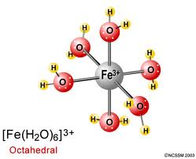
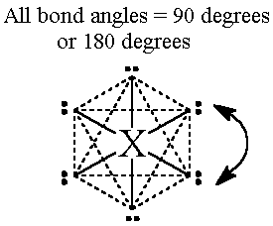
Octahedral
Central atom with 6 atoms attached
Bond angles: 90, 180
0 unshared pairs of electrons

Slide 11
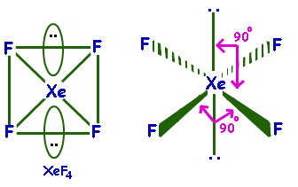
Square planar
Central atom with 4 atoms attached
Bond angles 90 and 180
2 unshared pairs of electrons

Slide 12
Practice determining SHAPE:

Slide 13
Get out a sheet of paper and practice a few more:
Molecule | Lewis Structure | Structural Formula | Shape Name | Bond Angle
CH₂O
C₂H₂
C₂H₄
H₂S
CH₃OH

Slide 14
Try these polyatomic ions:
BrO₃⁻
CN⁻
ClO₄⁻

Slide 15
Video link
REVIEW

Slide 16
Electronegativity REVIEW
Ability of atoms to attract electrons in a bond
STRENGTH

Slide 17
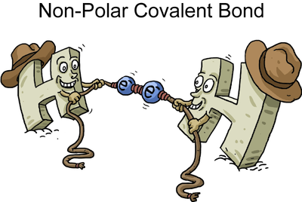
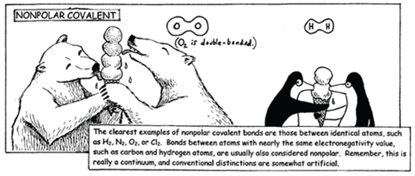
Nonpolar covalent bonds
Are when two atoms similar in electronegativity (strength) share electrons equally

Slide 18
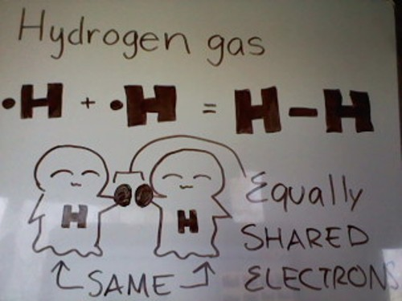
Diatomic molecules always have
NONPOLAR COVALENT BONDS

Slide 19
This means that in nonpolar covalent bonds the electronegavitiy difference is
VERY SMALL OR 0
< 0.4 difference between bonded atoms
General rule: The same element bonded to itself is a nonpolar covalent bond.

Slide 20
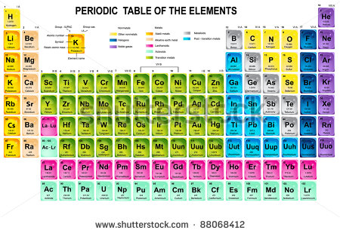
Looking at the Periodic Table, the _______________ the atoms are to each other the LOWER the electronegativity difference and more likely it is a _________ ______________.

Slide 21
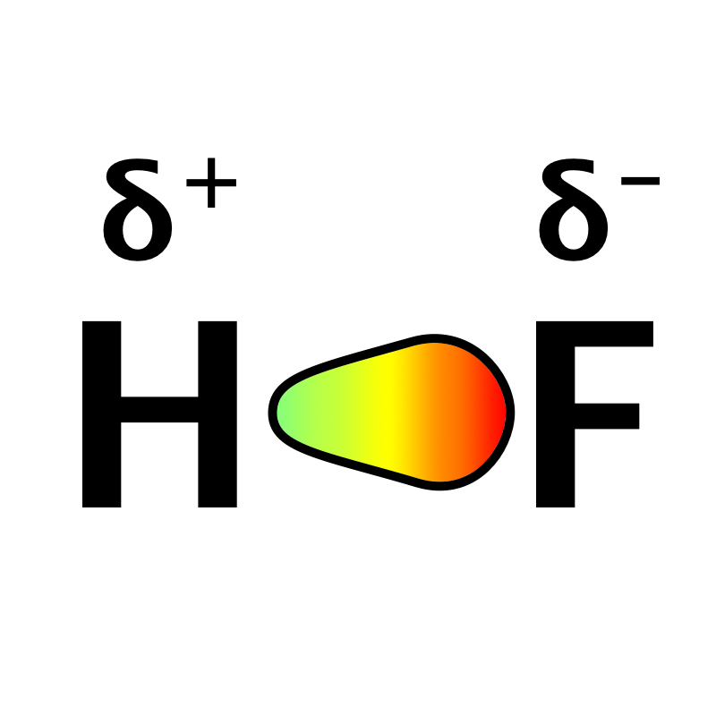
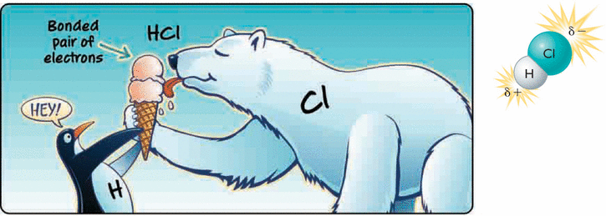
POLAR COVALENT BOND IS
A bond between two nonmetals that have a large difference in electronegativity (strength).
0.4-2 difference in electronegativity of bonded atoms
General Rule: 2 different nonmetals bonded

Slide 22
Looking at the Periodic Table, the _______________ the atoms are to each other the HIGHER the electronegativity difference and more likely it is a _________ ______________.

Slide 23
Illustrate HCl and H₂O

Slide 24
How do you know when it is ionic instead of covalent?
N and H i. H-Cl
F and F j. Mg and Cl
Ca and Cl
Al and Cl
H and Br
Mg and F
K and Cl
OR greater than
2 difference in
electronegativity

Slide 25
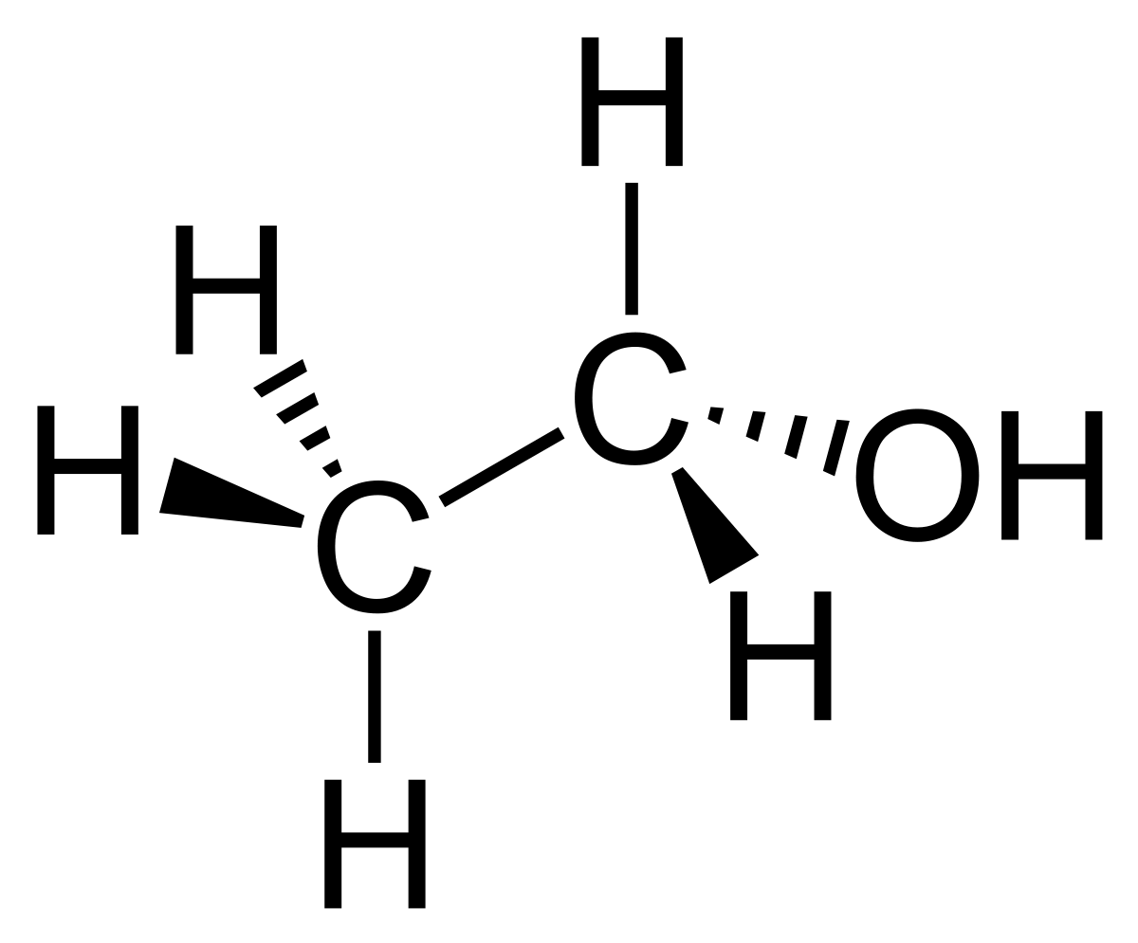
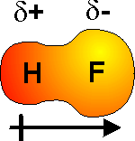
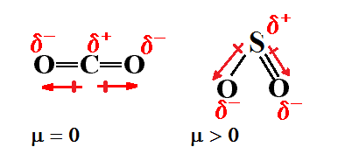
Dipoles are
molecules that have a distinct POSITIVE (+) end and NEGATIVE (-) end.
Any molecule with an -OH (hydroxyl group) has a negative region and is a dipole due to the Oxygen.

Slide 26
Polarity of molecules depends on 2 factors:
BOND TYPE
SHAPE

Slide 27
Always ask yourself is the bond _________ and is the shape _______.
CO₂ H₂O

