Slide 1
LT2 NOTES
NUCLEAR CHEMISTRY: RADIATION AND NUCLEAR STABILITY

Slide 2
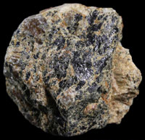
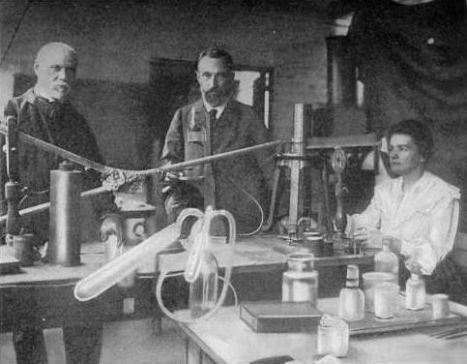
I. Who discovered nuclear radiation? How? Marie and Pierre Curie with the help of Henry Becquerel
Notes:
Becquerel was working on his understanding of x-rays (caused by high speed electrons) and phosphorescence when he stumbled upon radioactivity. He had been developing film with the use of sunlight. He believed Uranium absorbed the suns energy and then emitted it as X-rays to develop the film. On an overcast day an undeveloped film was in his pocket with a Uranium sample and the film partially developed which had been exposed to no sunlight. He suspected x-rays were coming off the Uranium and developed the film. Marie and Pierre Curie helped him discover it was something different than x-rays and named it RADIATION.
Marie Curie was from Poland (it was part of Russia at the time). She wanted to go to University but couldn’t in Russia so she went to live in France and go to school. She met her husband there and they worked on radioactivity until he was run over by a carriage. She continued the work into WWII where she started using x-rays in medicine. She died of leukemia due to long term exposure to radiation.

Slide 3
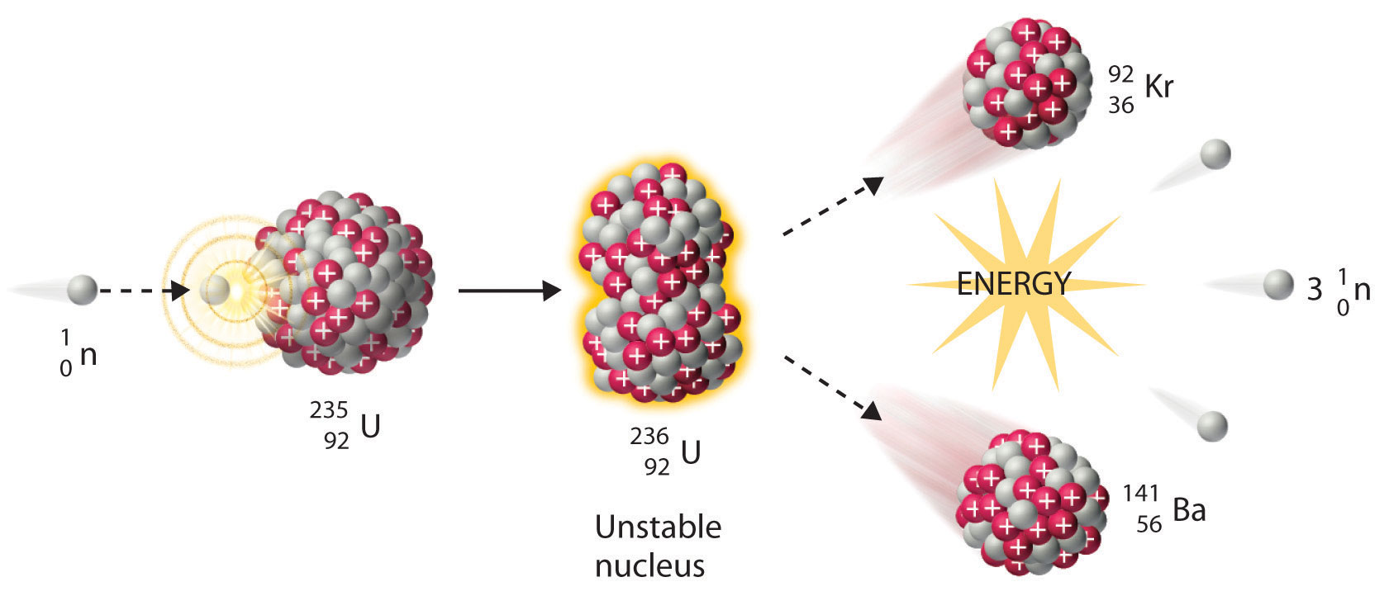
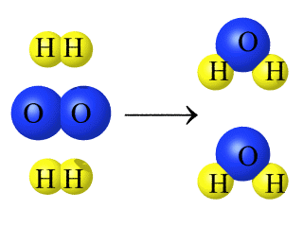
II. How are chemical and nuclear reactions different?
Nuclear-
Involves the nucleus
LARGE energy changes
Atoms of 1 element change into atoms of another element
Chemical-
Bonds involved: electrons involved
SMALL energy changes
Atoms keep identity
Affected by temperature, pressure, catalysts

Slide 4
IV.
What does nuclear stability depend on?
Neutrons and the size of the atom.
What happens when an atom is unstable?
It releases energy (radiation) to gain a more stable atomic configuration.
What is the process called?
Radioactive Decay or Radioactivity
Does the process require energy to be in to make it happen?
No it is spontaneous or is initiated with neutron bombardment.

Slide 5
Types of Radiation
Property | Alpha Radiation | Beta Radiation | Gamma Radiation
Composition | Alpha particle | Beta particle | High energy electromagnetic wave
Symbol
Charge | 2+ | 1- | 0
Penetrating power | Paper, clothing, air | Metal foil, wood | Not completely by lead/concrete, ground, water
Strength | Lowest | Medium | highest

Slide 8
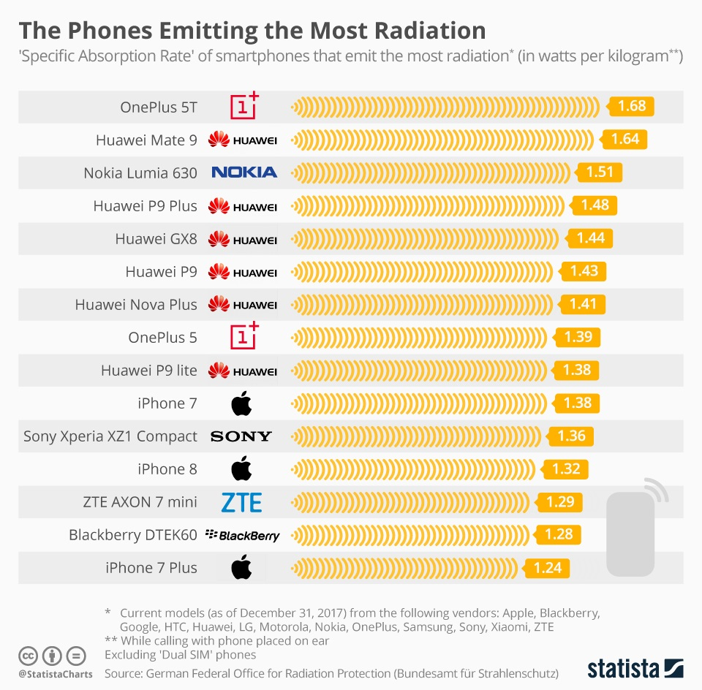

Slide 10
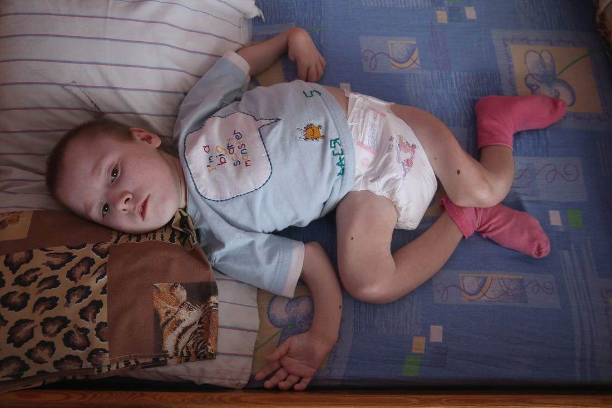
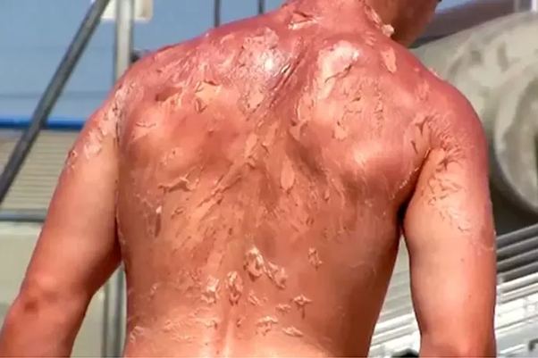

Slide 11
Examples of Decay Problems and Practice
Alpha:
Beta:
Gamma:

Slide 12
Write a sentence showing the connection between the terms radiation radioisotope, and radioactivity.

Slide 13
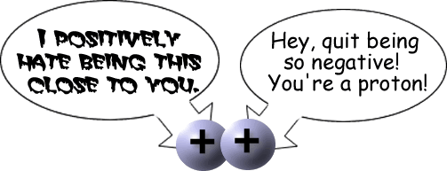
24.2 Why does the nucleus need something to stabilize it?

Slide 14
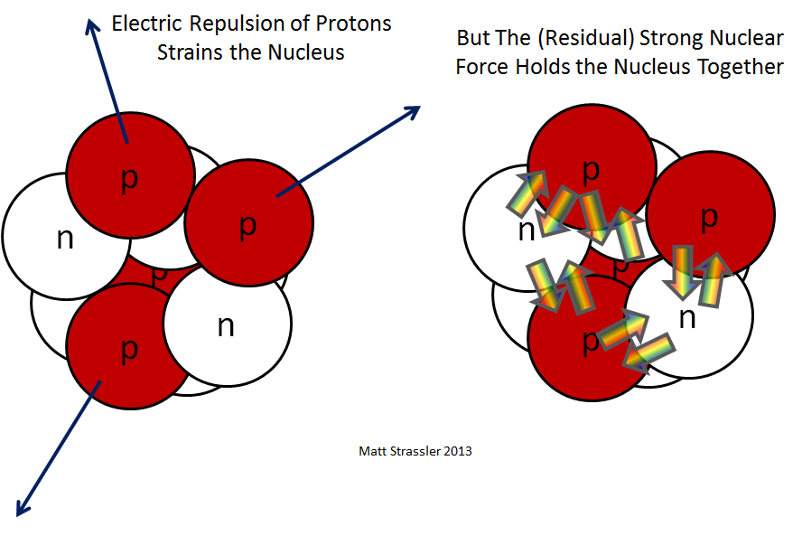
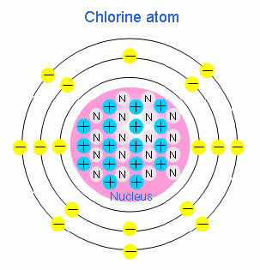
What 2 things stabilize the nucleus?

Slide 15
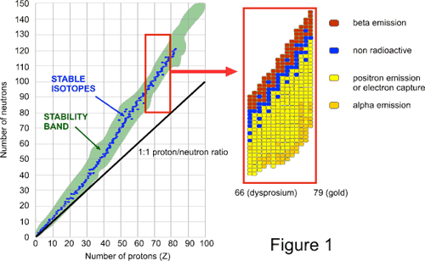
III. How does the neutron to proton ratio change as the atomic number increases?

Slide 16
IV.
Atomic #1-20 has a 1:1 ratio meaning 1 neutron can shield 1 proton.
Atomic #21-83 has about a 3:2 ratio meaning you need MORE neutrons that protons for shielding to be effective.
Large atoms (bigger than 83) are radioactive and go through _______Radioactive____ decay.
Why does this occur? Too much mass in the nucleus would cause decay.

Slide 17
¹³¹₅₃ I→⁰₋₁ e + ¹³¹₅₄ Xe Type of Atom--
Type of decay: BETA DECAY
Reasoning: Protons increase, mass stays the same--- neutron turns into a proton decreasing n:p ratio

Slide 18
Type of Atom:
²²⁶ ₈₈ Ra →⁴₂ He+²²²₈₆ Rn LARGE ATOMS
Type of Decay: Alpha Decay
Reasoning: Protons decrease by 2, neutrons decrease by 2--- Increasing n:p ratio

Slide 19
⁸ ₅ B → ⁰₊₁ e + ⁸₄ Be
Type: Positron
Reasoning: Proton decreases, mass stays the same--- proton turns into a neutron to increase n:p ratio

Slide 20
⁸¹₃₇Rb + ⁰₋₁ e→ ⁸¹₃₆ Kr + x ray photons Type of Atom
Type of Decay: Electron Capture
Reasoning: Decreases the number of protons by drawing an electron in--- increasing the n:p ratio

Slide 21
Why is gamma released?
Gamma is a photon or electromagnetic wave which is high energy.
Gamma is released WITH ALPHA OR BETA to get the nucleus to a LOWER ENERGY STATE (STABILIZE).

Slide 22
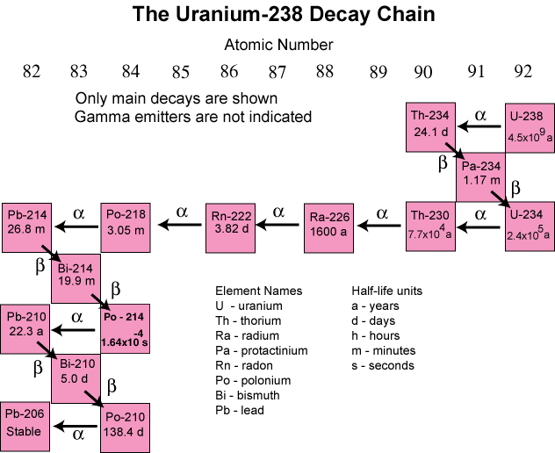
VI. What is a radioactive decay series? Multiple decay events that leads to a more stable product.

Slide 23
What is ½ life?
Amount of time it takes for half of a radioactive sample to decay into products.
Is radiation emitted for the entire half life or only at the end?
What type of radioisotopes are used in medicine?
Example: Carbon’s ½ life is 5730 years
How can you use Carbon to date fossils?

Slide 24
How is Carbon used to date fossils?
Compare the ratio of C-14 to C-12.
While alive the living organism takes in Carbon from the atmosphere and has a steady ratio of C-14 to C-12.
When the organism dies, the C-14 decays but is not replaced so the ratio changes.
About 1 in a trillion are C-14 atoms when the organism is alive.

Slide 25
½ life problem TRICKS
If you are given:
2 times
Divide big/Little= # of half lives
Cut gram amount in half that many times
If the problem says “original amount”– Multiply by 2 that many times
2 gram amounts
Cut big in ½ until you get to little
Set up proportion

