Slide 1
Ch. 7 LT1: Ionic Bonding and Metals

Slide 2
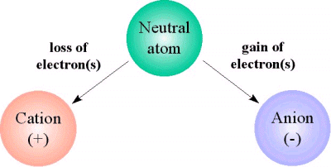
What are IONS?

Slide 3
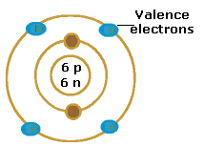
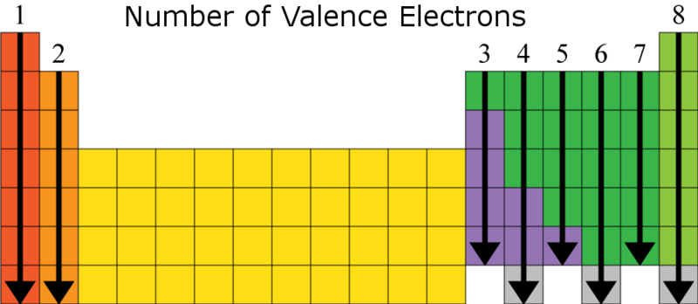
Valence Electrons– responsible for chemical reactivity and properties
Correlates with GROUP #

Slide 4
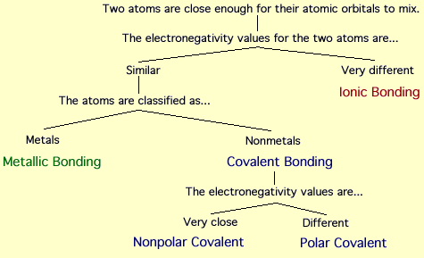
Chemical Bond- force holding 2 atoms together

Slide 5
Electrostatic attraction
Metallic- attraction of positive nucleus of one atom and negative electrons of another
BASED ON: ELECTRON SEA MODEL
Ionic- electrostatic attraction between ions
(METAL=CATION) (NONMETAL=ANION)

Slide 6
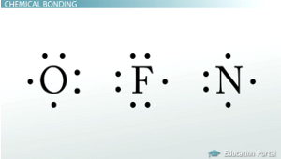
Electron Dot Structures- relate reactivity-

Slide 7
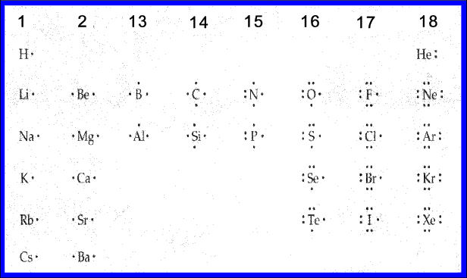
Complete electron dot structures-
OCTET RULE- ATOMS TEND TO LOSE, GAIN, OR SHARE ELECTRONS TO HAVE A FULL OCTET AND BE STABLE.

Slide 8
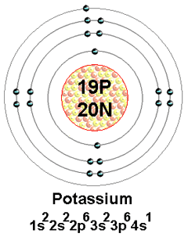
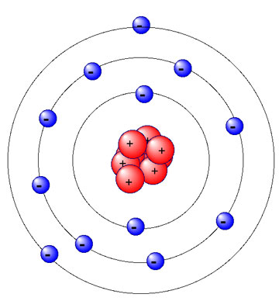
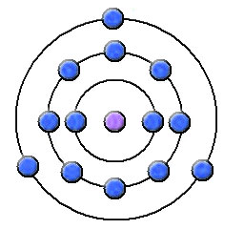
f. Oxidation Numbers- the stable ion that an element forms

Slide 9
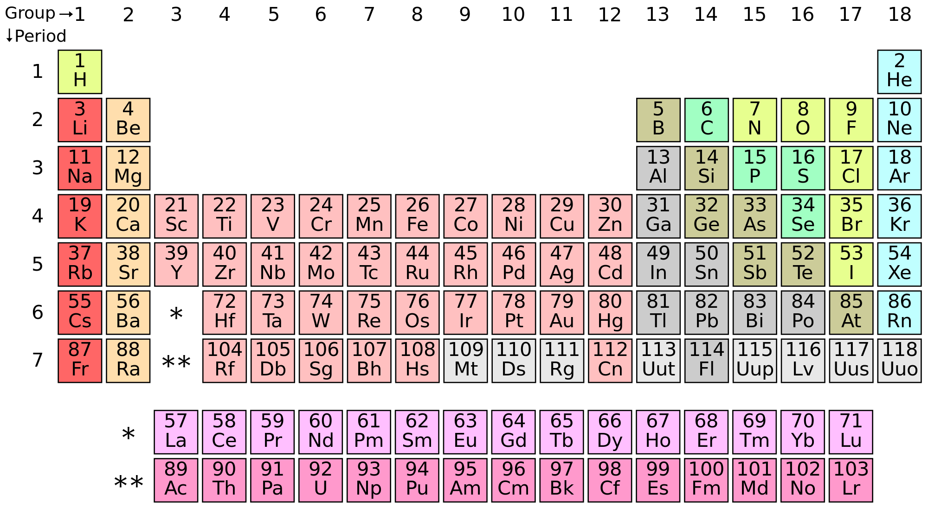

Slide 10
Transition Metals and Oxidation number
Zn ⁺², Cd ⁺², Ag ⁺¹
The rest use Roman Numerals because they VARY due to losing s and d block electrons in bonds.
Ex. Lead (IV), Copper (II)
I, II, III, IV, V, VI, VII, VIII, IX, X

Slide 11
Writing Symbols

Slide 12
II. Ionic Bonds
Main Idea: oppositely charged ions attract each other forming electrically neutral compounds.
A. Sodium (metal) transfers electrons to Chlorine (nonmetal) so that both achieve a full octet. These oppositely charge ions attract each other.

Slide 13
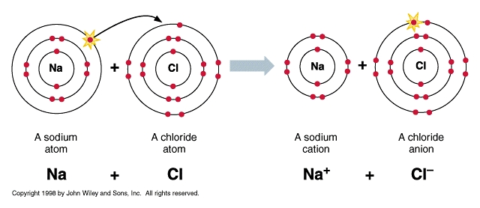
II. Ionic Bonds continued
Ionic Bond- electrostatic force holding oppositely charged particles together. Ex. Na+ Cl-

Slide 14
Using Lewis Structures to depict IONIC BONDING
Na and Cl
K and Cl

Slide 15
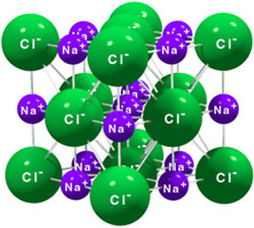
Ionic Compound- compounds containing ionic bonds Ex. NaCl
Forms crystalline solids

Slide 16
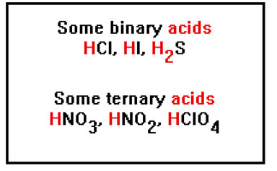
Binary Ionic Compound- a compound containing 2 types of elements– 1 type metal (or Hydrogen) and 1 nonmetal Ex. MgO, NaCl

Slide 17
Formulas
NaCl is a 1:1 ratio while MgCl2 is a 1:2 ratio.
K and I
B and S

Slide 18
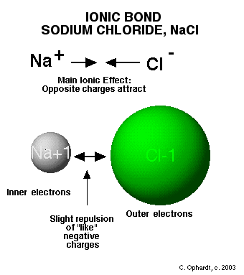
Properties of Ionic Compounds

Slide 19
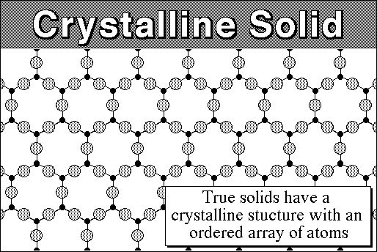
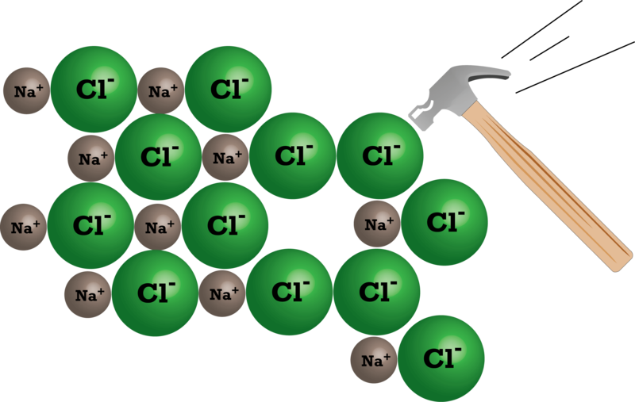
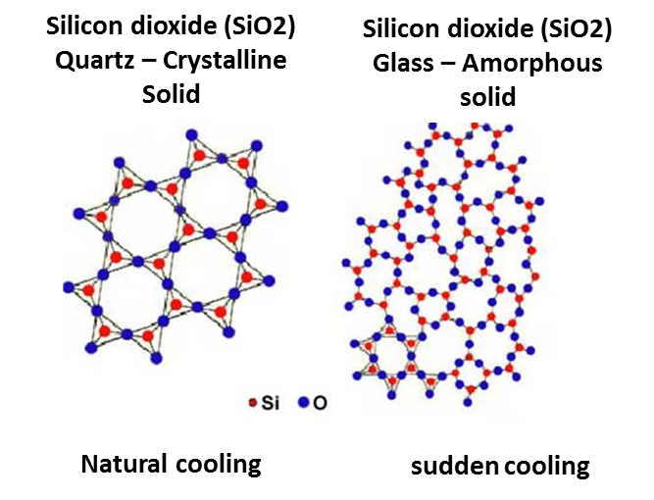
Crystalline Solids/crystal lattice

Slide 20
Crystalline Solids that are BRITTLE
Highly organized, 3-D repeating pattern
Very strong attractions between cations (+) and anions (-) INTERLOCK and form a crystal lattice. (like strong magnets)
Causes the compound to break or shatter when struck by a hammer because the charges line up (- and -, + and +) and LIKE charges repel

Slide 21
Melting Point/Boiling Point
DUE TO STRONG ATTRACTIONS BETWEEN IONS BOTH MP AND BP ARE RELATIVELY HIGH

Slide 22
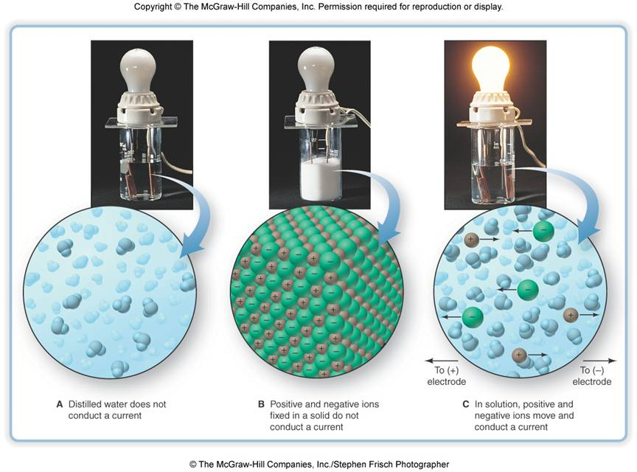
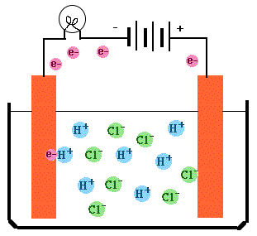
Conductivity/Electrolytes

Slide 23
Conductivity/electrolytes
Electrolytes are ionic compounds that are dissolved in water forming an aqueous solution that conducts electricity.
Ionic Compounds are very good conductors ONLY when dissolved in water or melted
It allows the ions to dissociate in the solution thus allow electrons to flow through

Slide 24
Lattice Energy and bond strength
Forming bonds releases energy= exothermic
Breaking bonds requires energy= endothermic
Lattice energy- the energy needed to break an ionic solid.
Higher lattice energy= ___________ bond
Smaller the atom= ______ lattice energy= ____ bonds
Larger the charge= _____ lattice energy= ____ bonds

Slide 25
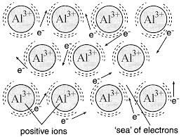
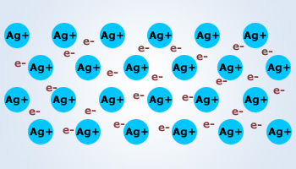
Metallic Bonding
What is it?
The attraction of a metallic cation (1 atom) for electrons of another atom.
Between which elements?
METALS
Based on what attraction?
OPPOSITE CHARGES ATTRACTING

Slide 26
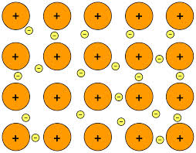
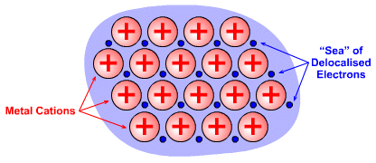
ELECTRON SEA MODEL
Delocalized Electrons- freely moving electrons of 1 atom attract to the cation of another atom.

Slide 27
PROPERTIES OF METALS
MELTING/BOILING POINT– HIGH
MP not as high because cations and electrons are already mobile
BP HIGH because separating oppositely charged particles takes lots of energy

Slide 28
MALLEABILITY, DUCTILITY, DURABILITY
Because electrons can slide past each other and keep cation from repelling and breaking.

Slide 29
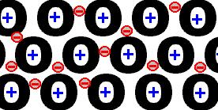
THERMAL CONDUCTIVITY AND ELECTORAL CONDUCTIVITY
Delocalized electrons offer a charge (the cation) for electricity to flow through

Slide 30
HARDNESS AND STRENGTH
The more delocalized electrons the more interference of cations from lining up so the STRONGER they are.
Transition metals lose s and d block electrons so they have more delocalized electrons which make them the strongest.

Slide 31
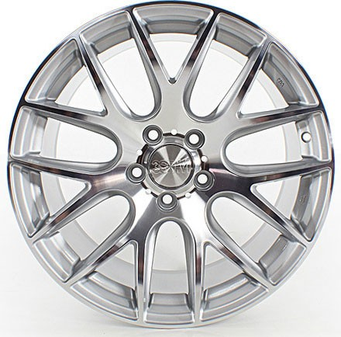
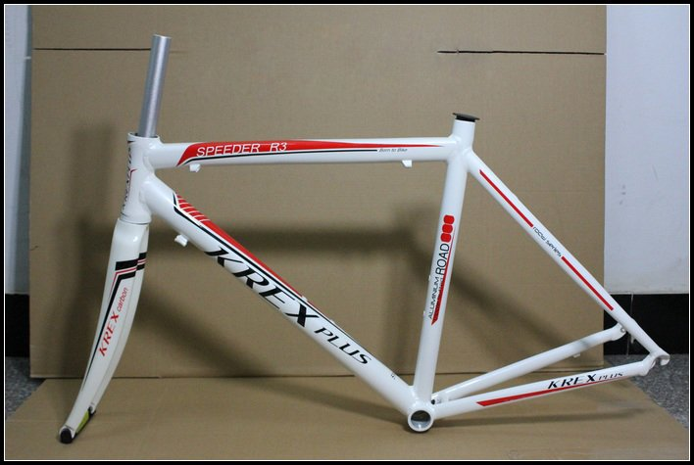
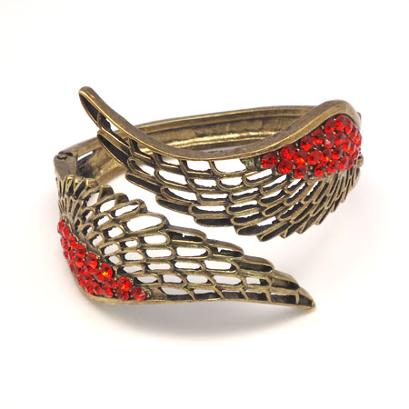
ALLOYS
WHAT ARE THEY?
Mixture of elements in which one is a metal
Has metallic properties
PROPERTIES
Used because they have better characteristics than pure metal
Light, strong, durable, shiny
Examples:
Steel, sterling silver, bicycle frames, glasses, airplane fuselage, jewlery

