Slide 1
LT1: Atomic Structure NOTES
Chapter 4

Slide 2
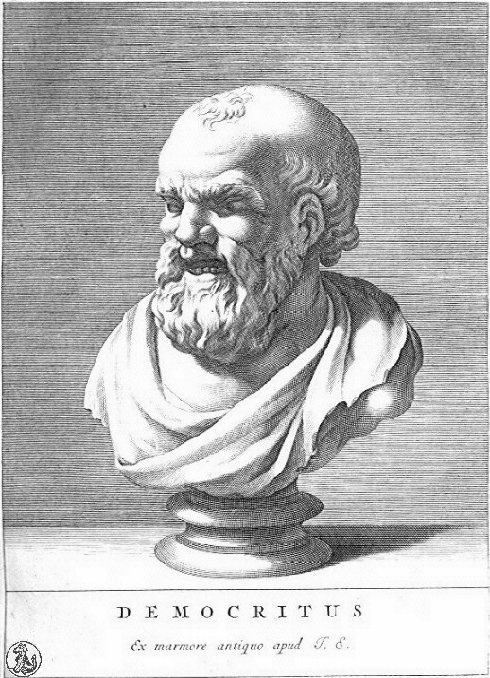
Democritus Contributions (460-370BC)
Matter is made of “atomos” meaning indivisible
ATOMS is derived from this word
Atoms cannot be created, destroyed or divided
Still a part of the Law of Conservation of Mass
Atoms move through empty space

Slide 3
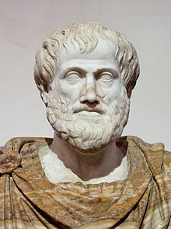
Aristotle contributions (384-322 BC)
Metaphysical views on Matter that are INCORRECT AND SET BACK IDEAS ABOUT MATTER FOR 2,000 YEARS.
Matter is made of Earth, fire, water and air
Earth, which is cold and dry
Water, which is cold and wet
Air, which is hot and wet
Fire, which is hot and dry
Aether, which is the divine substance that makes
up stars and planets.

Slide 4
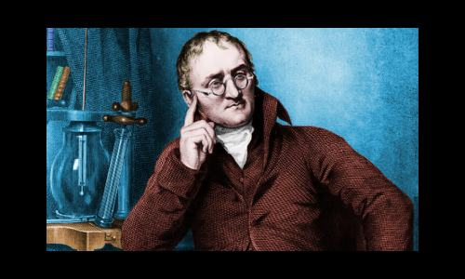
Dalton’s Atomic Theory (1766-1844)
Check if it is true or X if it is untrue and explain why.
All elements are composed of tiny indivisible particles called atoms.
Atoms of the same element are identical but different than atoms of different elements.
Atoms can be physically mixed or chemically combined to form compounds.
Chemical reactions occur when atoms are separated, joined, or rearranged. Atoms of one element can’t change into atoms of another element.

Slide 5
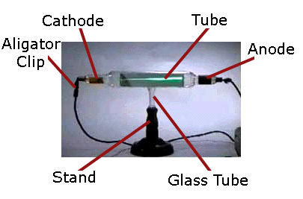
Thomson—Cathode Ray Tube- Electrons http://www.youtube.com/watch?v=7m7ja2AGc6g https://www.youtube.com/watch?v=XU8nMKkzbT8
Sir Williams Crookes discovered the cathode ray tube. It is a tube with a positive and negative end, metal pieces, connected to a battery.
As electricity strikes metal a beam travels through the tube and glows on a zinc screen.
A POSITIVE plate attracted the beam= particles are NEGATIVE (Opposites attract)
The particles are 1000 times
lighter than Hydrogen
NAMED= ELECTRONS

Slide 6
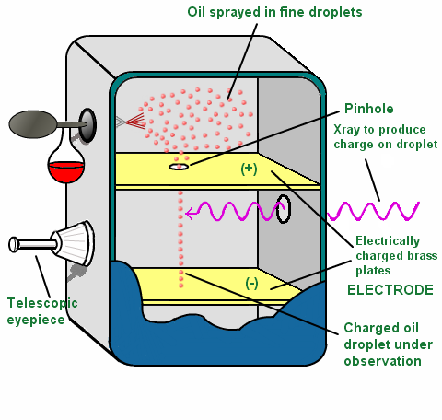
Millikan- Oil Drop Experiment- Mass to Charge ratio of electrons
Gravity and Electricity are used to determine the mass and charge of electrons
Gravity causes the drops to fall
Electricity (voltage) causes
the drops to rise
When gravity=electrical
charge the drops float.
Mass of drops and voltage
required for floating drops
are used to find the ratio.

Slide 7
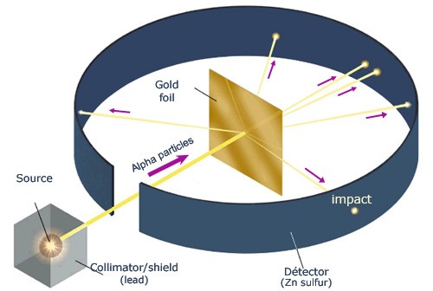
Rutherford- Gold Foil Experiment- Nucleus and Empty space http://www.youtube.com/watch?v=bSEOOMs5VNU
Shot alpha (+) particles (from Radium) at a piece of gold foil (made of atoms).
Most went straight through= most of an atom is empty space
Some bounced back= hit a positive part (like charges repel)= NUCLEUS
He could see they went straight through because they hit a zinc sulfide screen that glowed when stuck by charged particles

Slide 8
Additional discoveries
Rutherford went on to discover protons
James Chadwick (a student of Rutherford’s) discovered neutrons (1891-1974)

Slide 9
Particle | Symbol | Location | Charge | Relative mass
Proton | p⁺ | Nucleus | +1 | 1 amu
Neutron | n⁰ | Nucleus | 0 | 1 amu
Electron | e⁻ | Orbitals | -1 | 1/1840 amu

Slide 10
Predict what each subatomic particle will be responsible for in the formation of matter.
Protons (p⁺):__________________________________________
Neutrons (n⁰):_________________________________________
Electrons
(e-)____________________________________________

Slide 11
Draw a Timeline with the Scientists, experiment used, discovery and year

Slide 12
Part 2 Atomic Structure

Slide 13
Why are elements different when they are made of the same particles?
Term | Definition | Example
Atomic Number |  | What is the atomic number for Lithium, Potassium, Boron?
Mass Number |  | What is the formula for finding the number of neutrons?
Avg. Atomic Mass |  | What is the formula?

Slide 14
Practice
What does it mean to be electrically neutral?
Find the number of protons, neutrons and electrons for:
Chlorine-35
Calcium-40
Sodium-23
Silicon-28

Slide 15
More Practice
Element | Atomic # | # protons | # electrons | # neutrons | Mass #
Hydrogen-1
Helium |  |  |  | 2
Fluorine-19
Nickel-59

Slide 16
Atoms can differ but still have the same identity
Term | Definition | Example
Isotope | Atoms of the same element that differ in NEUTRON # | C-12 C-13 C-14
Ion | Atoms of the same element that differ in ELECTRON # | Na⁺, O²⁻

Slide 17
Ions
A positive ion is called a CATION. An atom can become a CATION by LOSING electrons.
A negative ion is called an ANION. An atom can become an ANION by GAINING electrons.

Slide 18
Interpreting a chemical symbol
⁷₃Li⁺
How many protons? Neutrons? Electrons?

Slide 19
Practice
Element | Atomic # | # protons | # electrons | # neutrons | Mass #
Hydrogen-1
Hydrogen-2
Hydrogen-3
Silicon- |  |  | 13 | 14
Silicon-29 |  |  | 15
What is different about the three “kinds” of Hydrogen? The same?

Slide 20
Atomic Mass (Mass #) vs. Average Atomic Mass
Which is given on the periodic table?
Why?

