Slide 1
Graphing and Data Reliability
Write on the back of the LT2 NOTES sheet with Scientific Method information OR on a sheet of paper.

Slide 2
Lab writing usually consists of…
A problem
A hypothesis
Materials
Methods
Results
Analysis
Conclusion

Slide 3
Materials and methods
Materials
Bulleted list of ALL the tools used
Methods
Numbered
Step by step instructions of completing the investigation

Slide 4
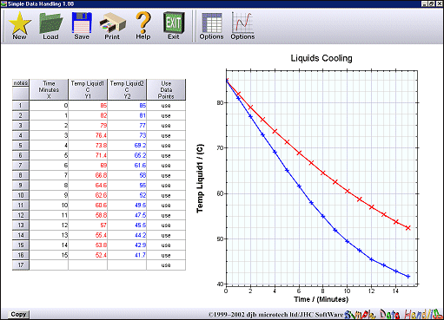
The Results section : includes a data table and usually a graph.

Slide 5
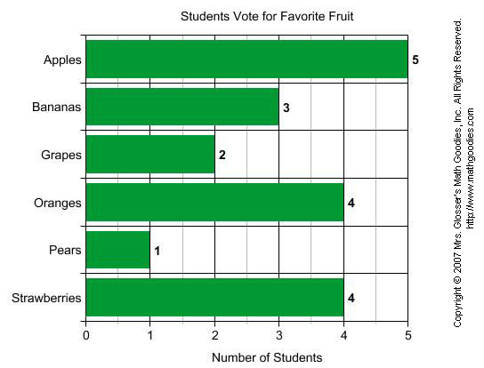
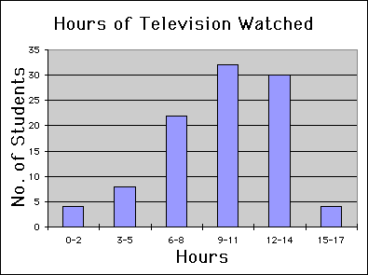
Types of graphs: BAR
Comparing data sets for discriminate values
Comparing categories

Slide 6
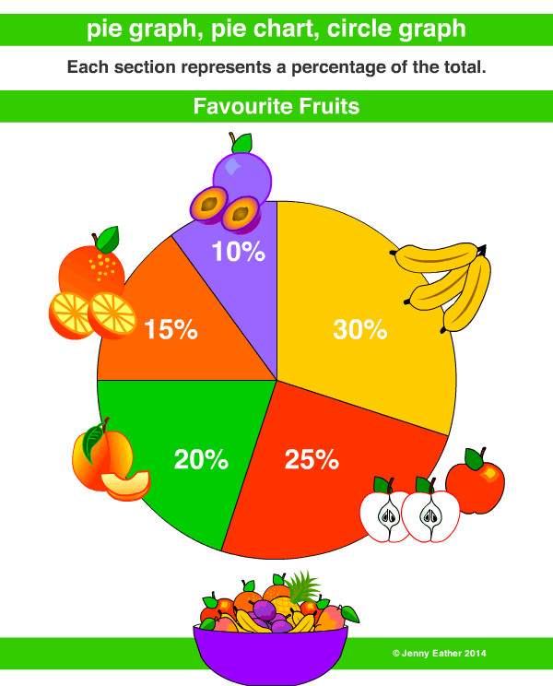
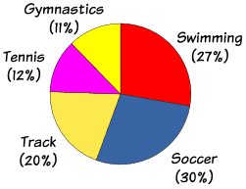
PIE
used to compare the parts of a whole OR percentages

Slide 7
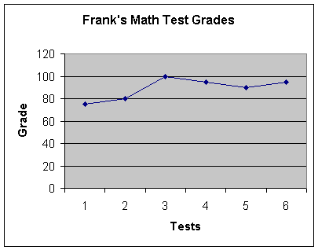
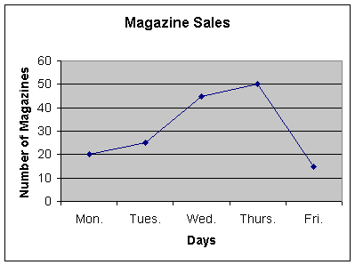
LINE
Represent data that correlates over a variable (often time)
Shows a positive or negative correlation/trend

Slide 8
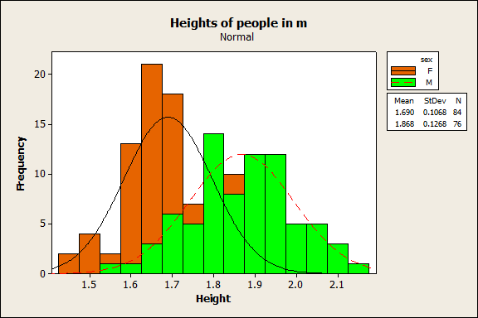
Histogram
It is similar to a Bar Chart, but a histogram groups numbers into ranges

Slide 9
Data Tables are created in WORD.
If hand drawn use a ruler.
They include labels and UNITS of measurement.
Ex.
Type of transportation | Speed (m/s) | Cost ($)
Train
Car

Slide 10
Graphs are created in Excel or Google sheets.
If hand drawn use Graph paper and format to fit page.

Slide 11
Analysis--
Claim: The hypothesis was supported/rejected by the data.
Evidence (2-3): Compare DATA (the numbers!!)
Reasoning: Why did the data come out this way?
Relate it back to the claim.

Slide 12
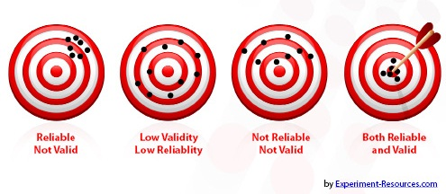
Conclusion--Data Reliability
Are there outliers in the data?
Do the outliers skew the average? How?
Are all data consistent?
Is it close to the accepted value (if known)?
Is there enough data to ensure reliability?

Slide 13
Examples of data sets
Trial 1: 68s
Trial 2: 72s
Trial 3: 67s
Trial 4: 71s
Trial 5: 90s
Average: 73.2s
Are the data consistent?
Is/are there outliers?
Does it skew the average in a way that makes the data invalid or unreliable?
Trial 1: 103 C
Trial 2: 115 C
Trial 3: 80 C
Trial 4: 70 C
Trial 5: 90 C
Average: 91.6 C
Are the data consistent?
Is/are there outliers?
Is the data invalid or unreliable?

Slide 14
Conclusion--Validity of Data- How do you increase support for your claim?
Increase sample size
Increase number of tests/trials
Have someone else follow your procedures to see if their results support yours.
Control more factors
Throw out the outlier data point that skew the average
Any others….?????

Slide 15
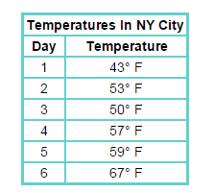
What type of graph should you use?
LINE

Slide 16
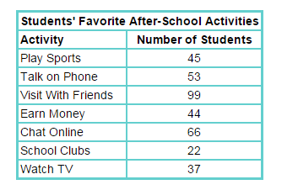
What type of graph should you use?
Bar or Pie if changed to percentages

Slide 17
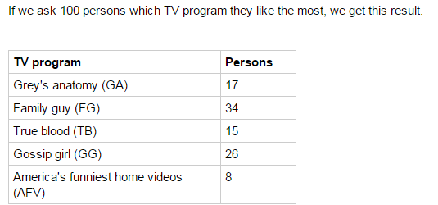
What type of graph should you use?
Pie

Slide 18
What type of graph should you use?
Histogram

Slide 19
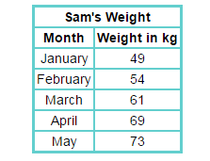
What type of graph should you use?
Bar

Slide 20
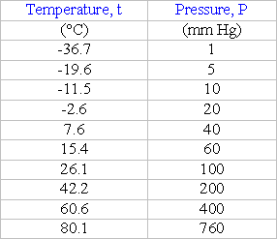
What type of graph should you use?
LINE

