Slide 1
LT4: Reaction Rate

Slide 2
Reaction Rate
The speed in which reactants turn into products
Reaction Rate= Can be used for either reactant or product concentration
Formula: concentration at time 2- concentration at time1 DIVIDED BY change in time(t₂-t₁)
Example: 0.010M-0.000M = 0.0050mol/(L*sec)
2 sec-0 sec

Slide 3
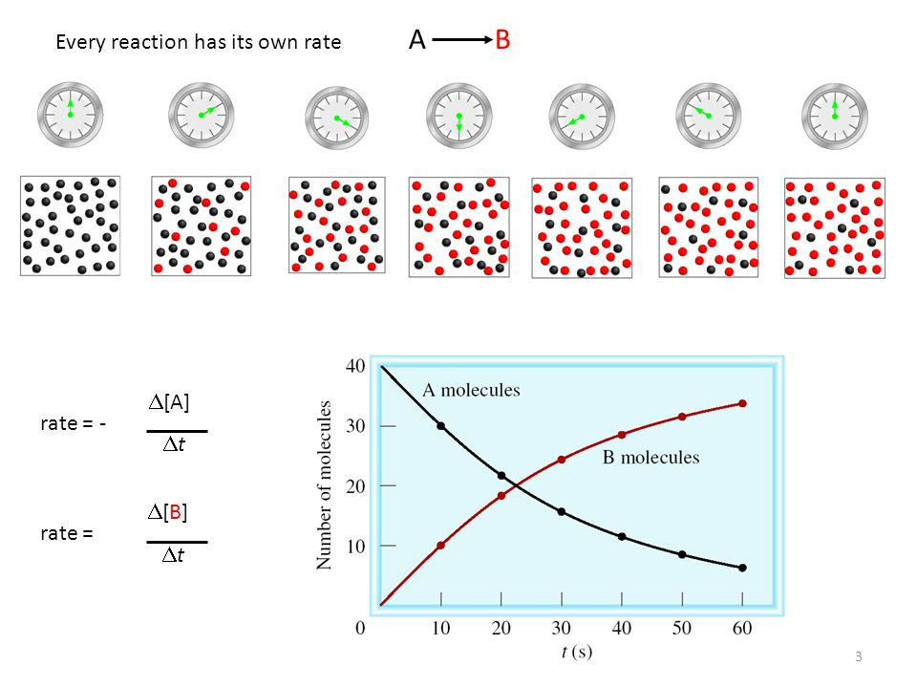

Slide 4
Collision Theory
Atoms, ions and molecules must collide in
order to react
Types of collisions:
Effective collisions result in products
Ineffective collisions do not result in product
2 Factors Determine if the collisions are EFFECTIVE:
Orientation- must hit in the right way
Energy- enough force to make bonds

Slide 5
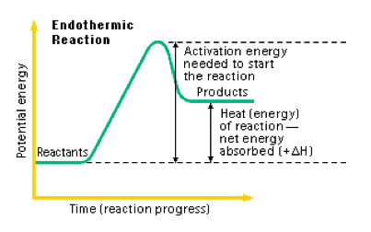
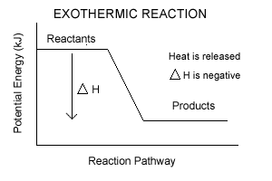
Kinetics
Activated Complex- transition state of unstable atoms that have separated as bonds broke
Delta H= ∆H
Change in energy

Slide 6
Endo vs. exothermic reactions
Endothermic- products bonds have more energy stored than reactants so ENERGY IS REQUIRED
Exothermic- reactants bonds have more energy stored than products so ENERGY IS RELEASED
Which do you think would be spontaneous?

Slide 7
How can you speed up or slow down a reaction?
Nature of Reactants
Temperature
Surface Area
Concentration
Agitation
Catalyst

Slide 8
Project- design an experiment to test 1 of the factors affecting reaction rate.
Research and discuss which factor you want to manipulate to see the affects on reaction rate.
Research and discuss HOW you want to test the factor.
What chemicals will you need?
What glassware will you need?

Slide 9
Pre-write from Title→ Data Table
You will be collecting time as one variable (rate)
You need at least 3 pieces of data (3 times) AND ATLEAST 2 TRIALS for each time to support or reject your hypothesis.

Slide 10
Nature of Reactants
What determines how reactive an element is?
How close the atom is to acquiring a full octet.
Some atoms are naturally more reactive than others and the more reactive it is, the faster the reaction will occur.

Slide 11
Concentration
The more particles (higher concentration), the more collisions, the higher chance of effective (correct orientation and energy) collisions, the faster the reaction rate.

Slide 12
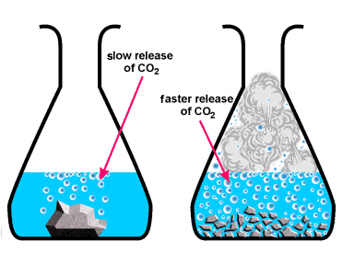
Surface Area
The more surface exposed for collisions to occur, the more chance of effective collisions, the faster the reaction rate.

Slide 13
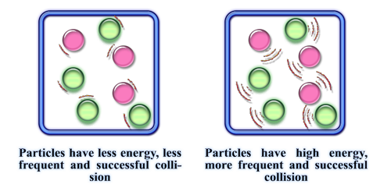
Temperature
The higher the temperature, the more kinetic energy of the reactants, the faster the atoms move, the more collisions, the higher chance of effective collisions, the faster the rate.

Slide 14
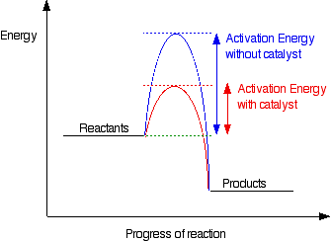
Catalysts
Catalysts lower activation energy thus speeding up a reaction.
Activation Energy is the energy needed to break the bonds of the reactants.
Enzymes are an example. The create a “shorter path” for reactants to reach products.

Slide 15
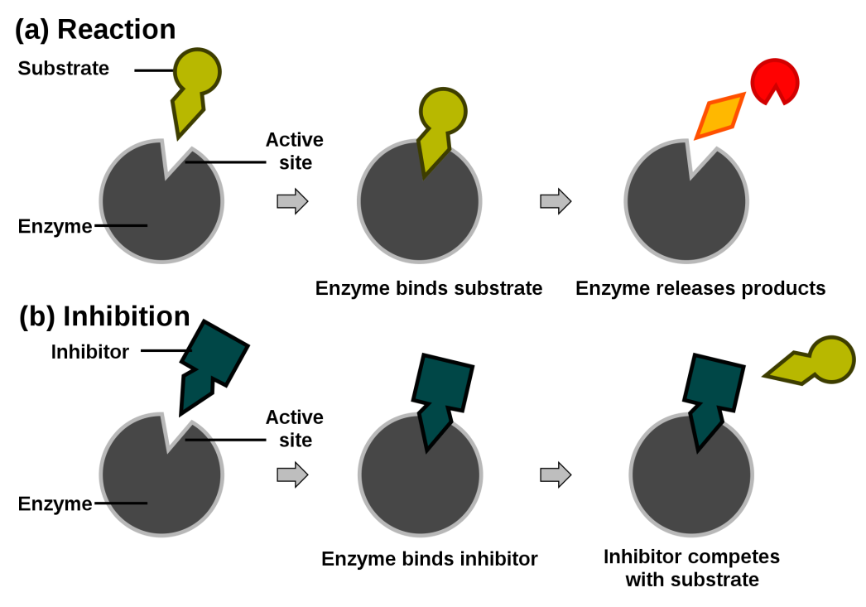
Inhibitors
Inhibitors slow the reaction down by binding on to a catalyst thus preventing its function or increase activation energy.
Food preservatives are an example.

Slide 16
Agitation (stirring)
The more movement of the particles the more collisions, the higher chance of effective (correct orientation and energy) collisions, the faster the reaction rate.

