Slide 1
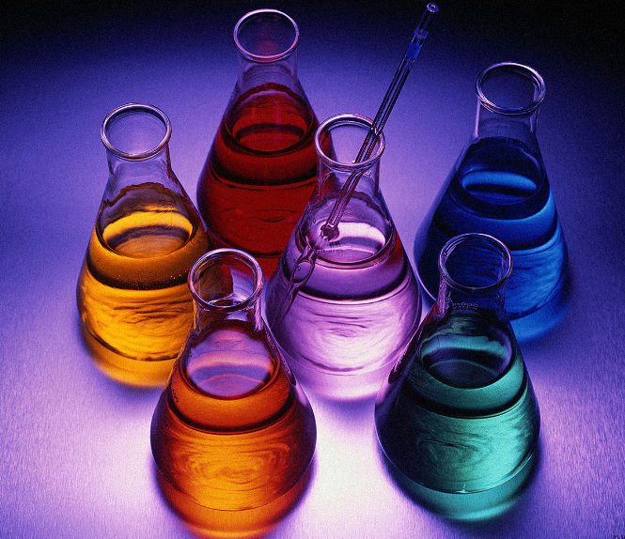
Chemistry lab tools

Slide 2
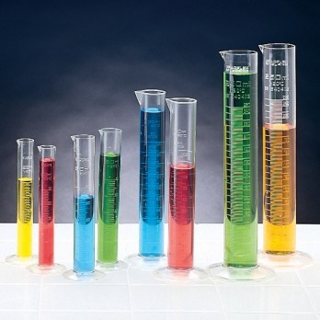
Figure 1,1: Graduated Cylinder
Used to measure liquid volume.
Do not heat or mix in.

Slide 3
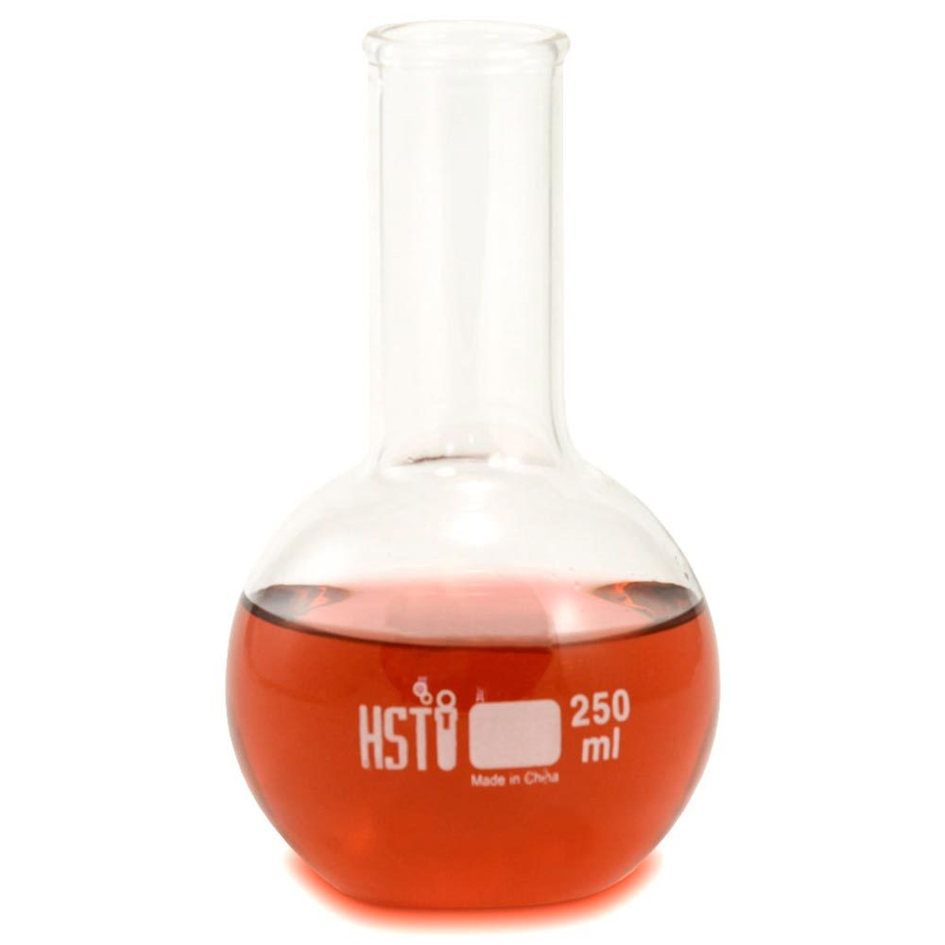
Figure 1,2: Florence Flask
It is used as a container to hold liquids. A Florence flask has a round body, a single long neck, and often a flat bottom.

Slide 4
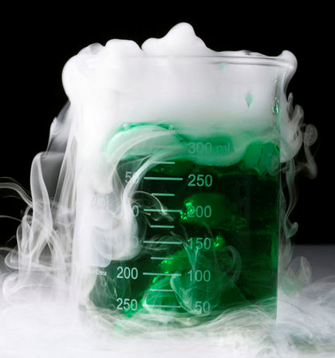
Figure 1,3:Beaker
A beaker is a simple container for stirring, mixing and heating liquids commonly used in many laboratories.

Slide 5
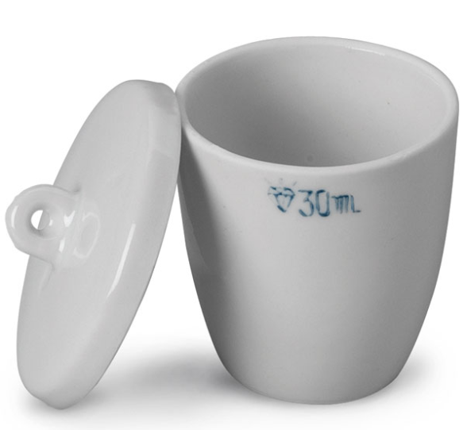
Figure 1,4:Crucible
A crucible is a cup-shaped piece of laboratory glassware that is used to hold samples which are to be heated to high temperatures.

Slide 6
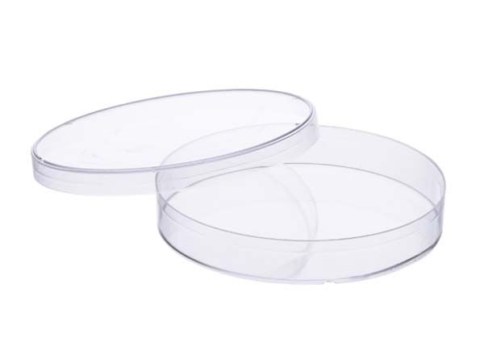
Figure 1,5: Petri Dish
Used to culture cells in a growing medium such as agar (a nutrient broth).

Slide 7
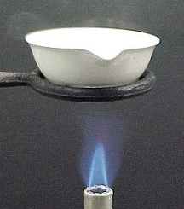
Figure 1,6:Evaporating Dish
The evaporating dish is a laboratory device used in evaporation of solids and fluids.

Slide 8
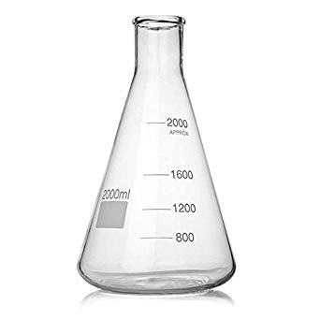
Figure 1,7: Erlenmeyer Flask
Used to mix liquids due to their shape.
Used in titrations.

Slide 9
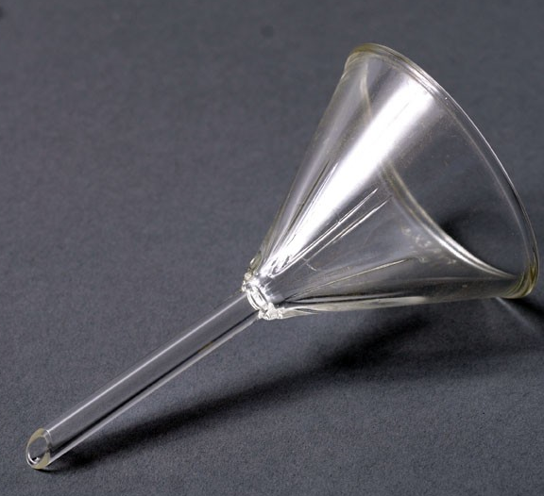
Figure 1,8:Funnel
Used to control liquids when pouring or pouring into a confined space.

Slide 10
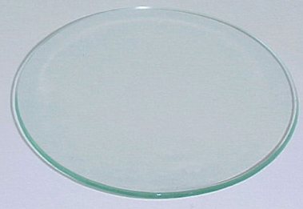
Figure 1,9:Watch Glass
They can serve as lids for evaporating dishes and beakers.
Watch glasses are nice for holding small samples for observation.

Slide 11
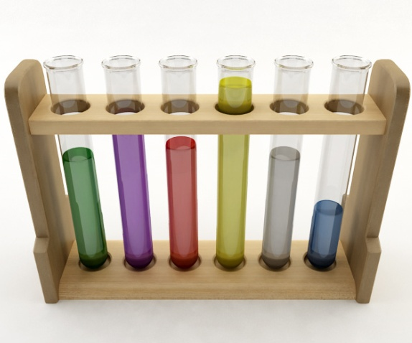
Figure 2,1: Test Tubes
Test tubes are used to hold small amounts of substance and materials for experiments or laboratory testing.

Slide 12
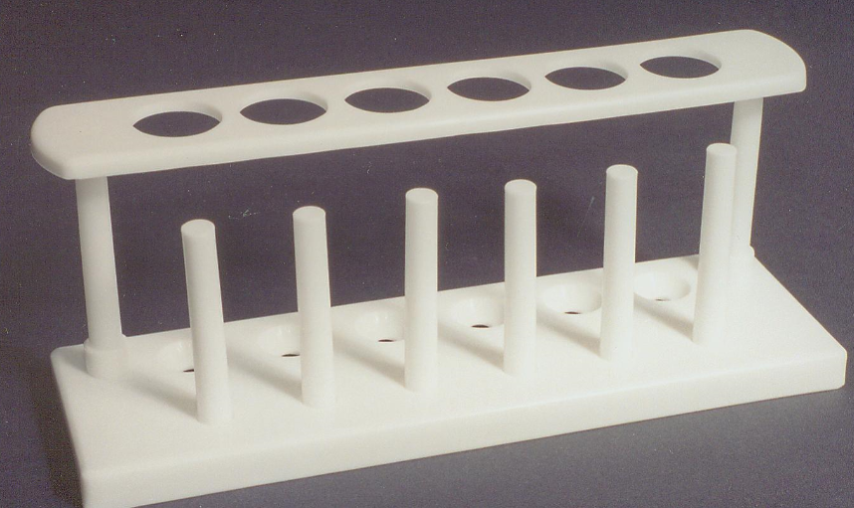
Figure 2,2:Test Tube Rack
The function of a test tube holder is to hold the test tubes and keep them in a secure, vertical position without being held by hand.

Slide 13
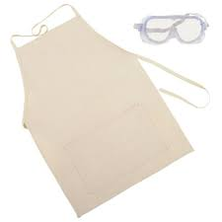
Figure 2,3 Goggles and Apron
Safety goggles must be worn at all times while working in the laboratory.

Slide 14
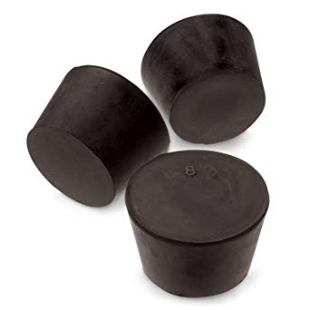
Figure 2,4 Stoppers
Several sizes to prevent gas from escaping or control the release.

Slide 15
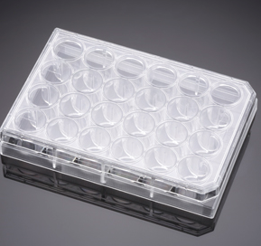
Figure 2,5 Well Plates
Used to test or mix small chemicals and substances also easy to observe many samples in one place.

Slide 16
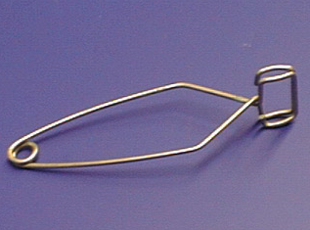
Figure 2,6:Test Tube Tongs
Most Chemistry labs have tongs that allow you to grip or hold small test tubes so you will not burn your hand or spill harmful chemicals on your fingers.

Slide 17
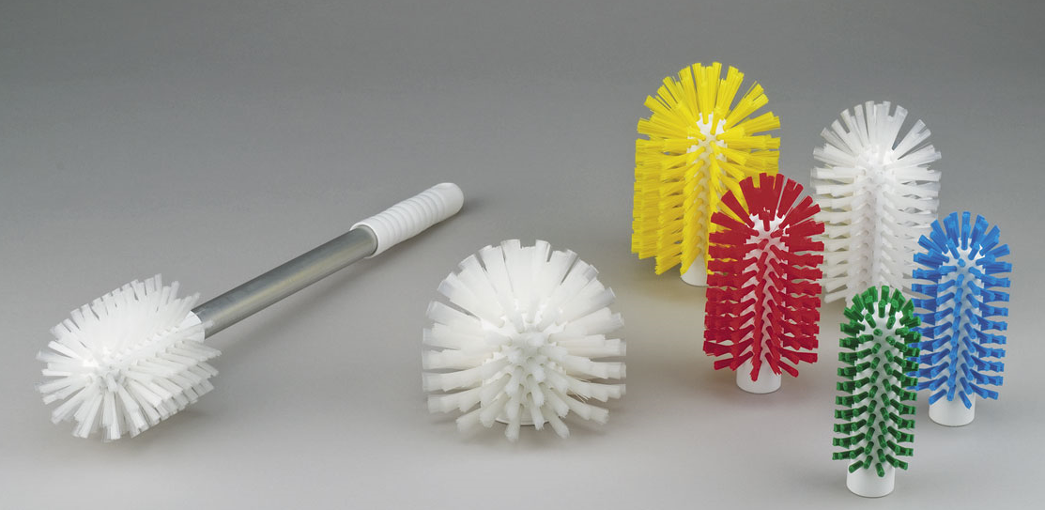
Figure 2,7 Cleaning Brushes
Used to clean test tubes, beakers, i.e.

Slide 18
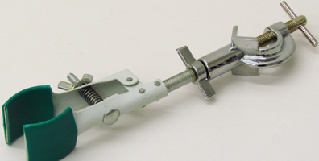
Figure 3,1:Utility Clamp
A utility clamp is an instrument that is used to hold or support items such as glassware or chemistry equipment.

Slide 19
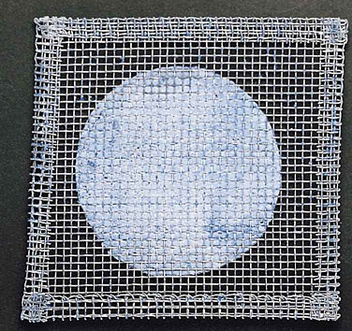
Figure 3,2:Wire Mesh
Distributes heat evenly from a burner flame.

Slide 20
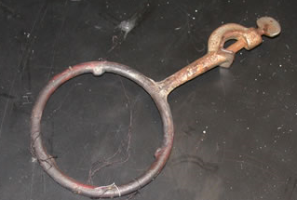
Figure 3,3:Iron Ring
In a chemistry laboratory, an iron ring is used to support flasks or funnels upright in a stand.

Slide 21
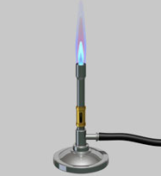
Figure 3,4:Bunsen Burner
A small gas burner that produces a hot, blue flame, used in chemistry laboratories, etc Used to heat up a chemical or burn something.

Slide 22
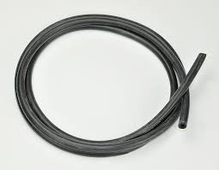
Figure 3,5 Rubber hose
Used to connect apparatus to transfer liquids or gases

Slide 23
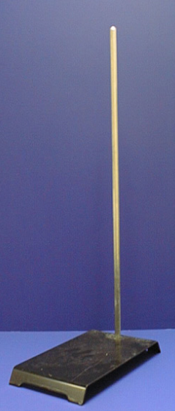
Figure 3,6:Ring Stand
A metal stand consisting of a long upright rod attached to a heavy rectangular base that is used with rings and clamps for supporting laboratory apparatus.

Slide 24
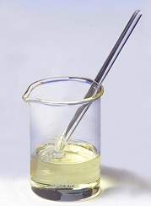
Figure 4,1:Stirring Rod
A stirring rod or stir rod is a piece of laboratory equipment used to mix chemicals and liquids for laboratory purposes.

Slide 25
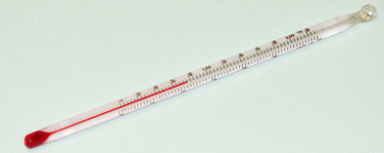
Figure 5,1:Thermometer (Alcohol)
Alcohol thermometer finds the temperature change.

Slide 26
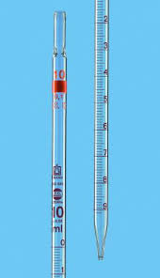
Figure 5,2 Graduated Pipet
Glass; common sizes are 10mL, 25mL; used to measure solution volumes; less accurate than a volumetric pipet.

Slide 27
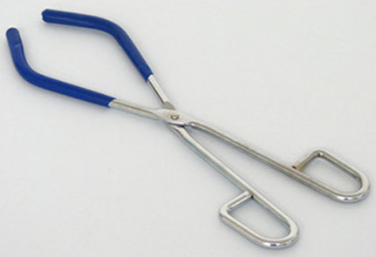
Figure 5,4:Beaker Tongs
Used to handle hot beakers, or to transfer or move without touching the beaker.

Slide 28
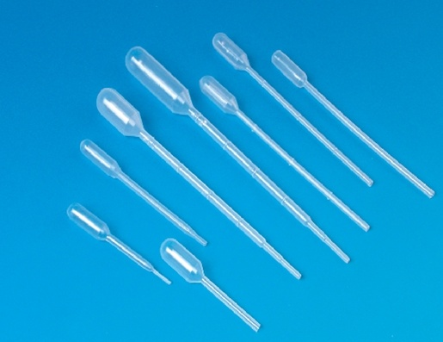
Figure 5,5 Pipet
A narrow, usually calibrated glass tube into which small amounts of liquid are suctioned for transfer or measurement.

Slide 29
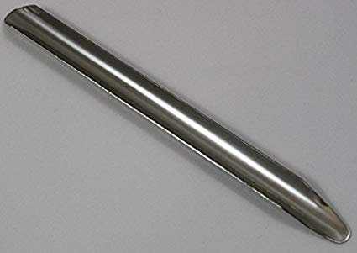
Figure 5,6 Scoop/Scoopula
Used to pick up small amounts of solid chemicals. They can be used to remove chemicals from bottles. They are used like a spoon.

Slide 30
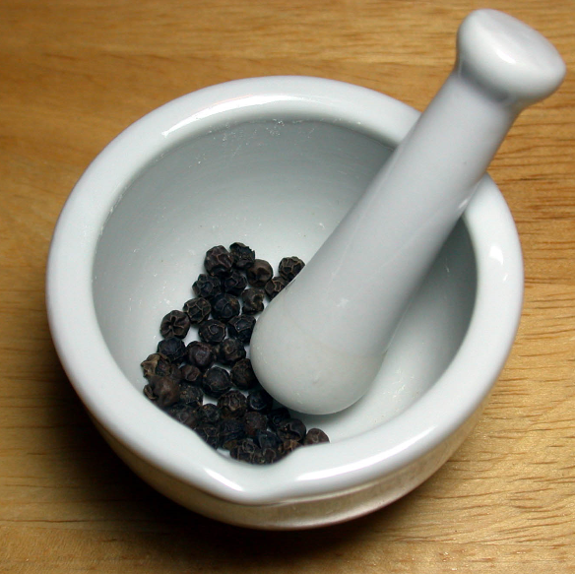
Figure 5,8:Mortar and Pestle
A mortar and pestle is a tool used to grind and mix substances. The pestle is a heavy small bat.
The mortar is a bowl, which can be made from porcelain, wood, carved stone or other materials.

Slide 31
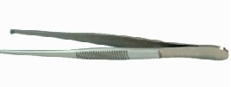
Figure 5,9:Forceps
Forceps are a handheld, hinged instrument used for grasping and holding objects.

Slide 32
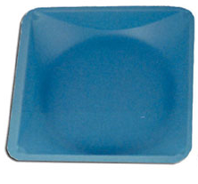
Figure 5,10:Weighing Tray
Used for weighing solid samples on a balance.

Slide 33
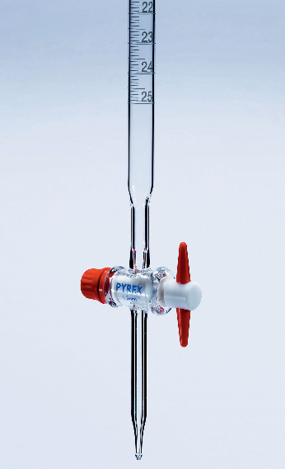
Burette
A burette is graduated tube of glassware that has a stopcock at its bottom end.
It is used to dispense precise volumes of liquid reagents.

Slide 34
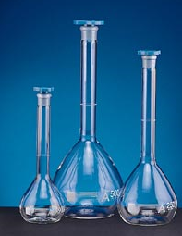
Volumetric Flask
A volumetric flask is a piece of laboratory glassware that is used to prepare a chemical solution of known volume.

Slide 35
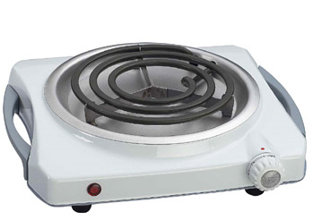
Hot Plate
A hot plate is used to heat substances when a burner flame is not available or the substance is highly flammable.

Slide 36
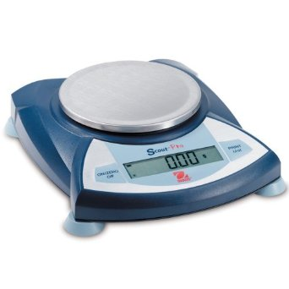
Electronic Balance
Find the mass of substances on a weigh tray.
Grams is the desired unit in Science.

