Slide 1
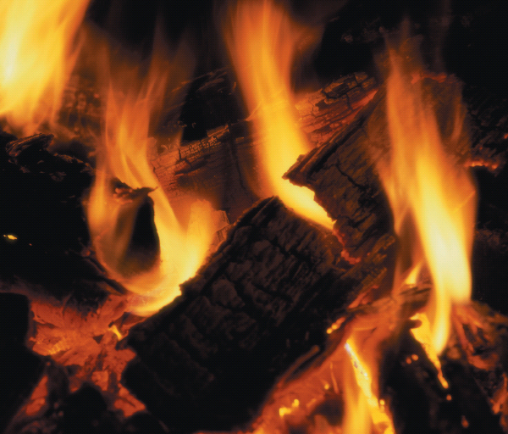
Chapter 4
Properties of Matter
A burning log undergoes chemical change resulting in the release of energy in the form of heat and light. The physical properties of the log change during the chemical reaction.
Introduction to General, Organic, and Biochemistry 10e
John Wiley & Sons, Inc
Morris Hein, Scott Pattison, and Susan Arena

Slide 2
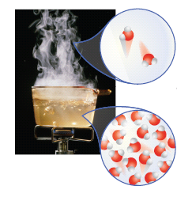
Properties of Substances
Physical Properties can be determined without changing the substance’s chemical composition.
Notes:
Figure 4.1 Physical property: The boiling point of water is a physical property. At its boiling point water changes from a liquid to a gas but the molecules remaing water molecules. They are still water but are further apart.

Slide 3
Properties of Matter

Slide 4
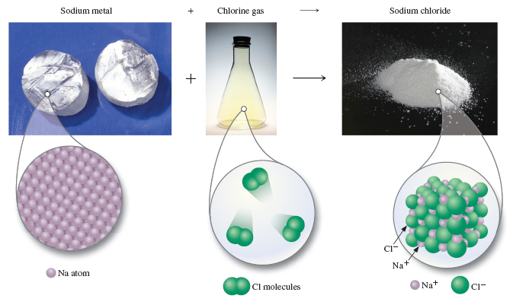
Properties of Substances
Chemical Properties describe the substance’s ability to react and to form new substances.
Notes:
Figure 4.2 Chemical Property. When sodium metal reacts with chlorine gas a new substance called sodium chloride forms.

Slide 5
Your Turn!
Which is not a physical property of aluminum?
Aluminum is silver and has luster.
The melting point of aluminum is 660º C.
Aluminum reacts with acid to produce an aluminum salt and hydrogen gas.
The density of aluminum at 25º C is 2.70 g/cm³.

Slide 6
Your Turn!
Which property of acetone is a chemical property?
The specific gravity of acetone is 0.79.
The boiling point of acetone is 56°C.
Acetone is a clear, colorless liquid
Acetone is a flammable liquid.

Slide 7
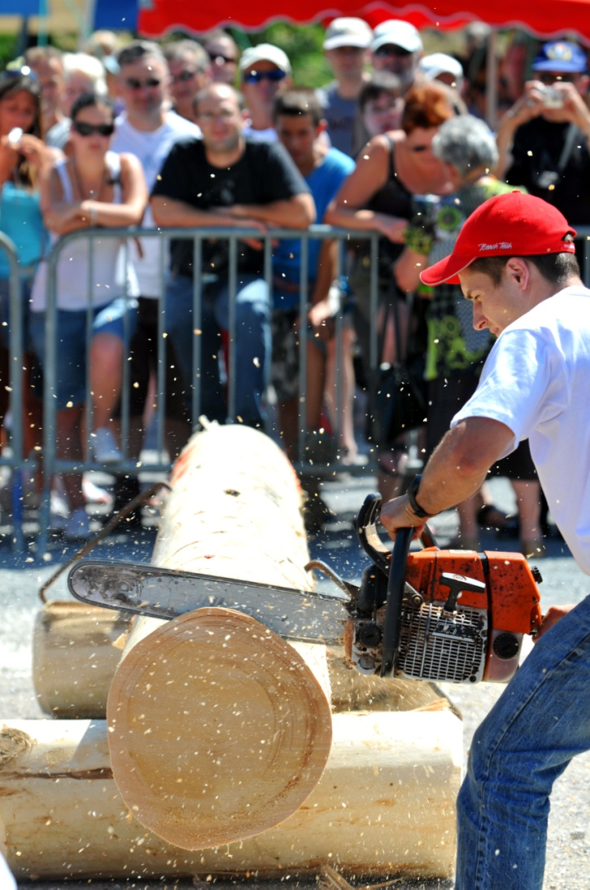
Physical Changes
Physical Changes are changes in physical properties or changes in state with no change in chemical composition.

Slide 8
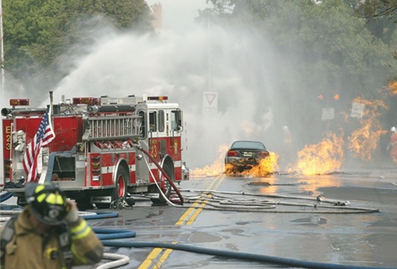
Chemical Changes
Chemical Changes involve the formation of new substances with new chemical and physical properties.
Combustion of gasoline is a chemical change.

Slide 9
Chemical Change
Which of the following observations is not a chemical change?
converting coal (coal is a form of carbon) to carbon dioxide
converting hydrogen to water (water is H₂O)
converting iron to steel (steel is an alloy of iron)
converting sulfur to acid rain (acid rain contains H₂SO₄)

Slide 10
Your Turn!
Which is a chemical change?
A. Corrosion of steel
B. Freezing water
C. Evaporating gasoline
D. Forming fog

Slide 11
Your Turn!
Which is a chemical change?
Dry ice sublimes
A penny tarnishes
Ice cream melts
Rock is ground into sand

Slide 12
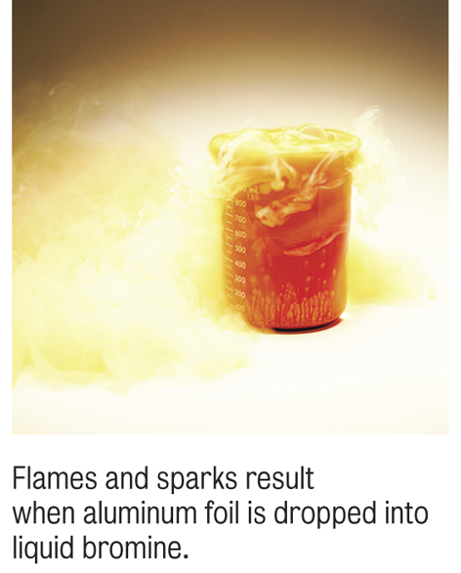
Conservation of Mass
The law of conservation of mass states that no change is observed in the total mass of the substances involved in a chemical change.
2Al_{(s)} + 3Br_{2(l)} → 2AlBr_{3(s)}
5.4g Al + 47.9g Br₂ → 53.3g AlBr₃
53.3g reactant → 53.3g product
mass of reactants = mass of products

Slide 13
Your Turn!
Carbon, when burned completely, forms carbon dioxide. If 11.7g of carbon combines with 31.3g of oxygen, what mass of carbon dioxide will be produced?
11.7g
19.6g
31.3g
43.0g

Slide 14
Energy
Energy is the capacity to do work.
Potential energy (PE) is stored energy, or energy due to position.
Burning gasoline: Energy stored in chemical bonds converted to kinetic energy.
Kinetic energy (KE) is energy associated with motion.
Steam at 100°C has more kinetic energy than water vapor at 25°C because the gas molecules are moving faster at the higher temperature.

Slide 15
Energy
Energy can be converted from one form to another
Mechanical
Chemical
Electrical
Heat
Nuclear
Light
In chemistry, energy is most frequently released as heat.

Slide 16
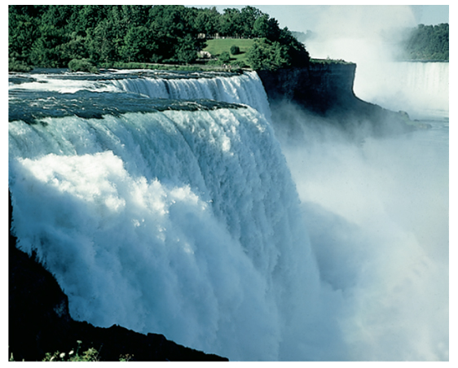
Energy Transformations
The mechanical energy of falling water is converted to electrical energy at the hydroelectric plant at Niagara Falls.
As the water falls potential energy is converted to kinetic energy and turns a turbine to produce electrical energy.

Slide 17
Your Turn!
What happens to the kinetic energy of a particle when a gas is heated?
Kinetic energy increases
Kinetic energy decreases
Kinetic energy remains constant
Depends on the gas

Slide 18
Energy Units
The SI unit for energy is the joule (J).
A commonly used unit for heat is the calorie (cal).
4.184 joules = 1 cal (exactly)
1 calorie or 4.184 J is the amount of heat needed to change the temperature of 1gram of H₂O 1°C.
Since joules and calories are so small we usually use kilojoules and kilocalories.
1kilojoules (kJ) = 1000 J
1 kcal = 1000 cal = 1 nutrition Calorie (Cal)

Slide 19
Conversions Between Units
How many kilojoules of energy are found in a 350 Calorie (350 kcal) frozen dinner?
Solution map: kcal → cal → J → kJ
Three conversion factors are needed:

Slide 20
Heat and Temperature
Imagine warming 2 different sized samples of Cu from 25°C to 100°C. The larger sample will require more energy (heat).
Temperature is a measure of the intensity of the thermal energy (or how hot a system is) and is independent of the quantity of the Cu.
The amount of heat needed for the temperature change depends on the quantity of substance and the magnitude of the temperature change.
Cu
10 g at 25°C
Cu
50 g at 25°C

Slide 21
Heat: Quantitative Measurement
Specific Heat is the amount of energy needed to change the temperature of 1 gram of a substance 1°C.
2 blocks are the same mass and are 25°C. Heat is consistently applied both. The block of copper ends up with a higher temperature than the block of iron. Why?
Cu has a lower specific heat than Fe, so less energy is required to change its temperature.
Fe
Cu
heat
Notes:
Specific heat of Cu = .385 J/g°C
Specific heat of iron = .473 J/g°C

Slide 22
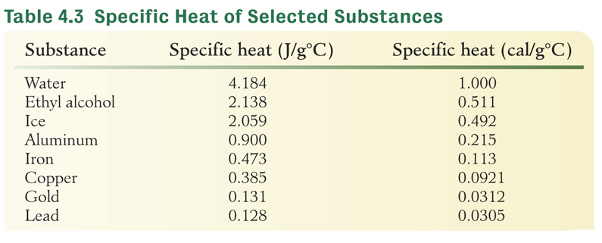
Heat: Quantitative Measurement
heat = mass × specific heat × Δt where Δt = T_{final} - T_{initial}
Why does the weather near the coast rarely exhibit extremely hot or cold temperatures?

Slide 23
Your Turn!
The specific heat of iron is 0.473 J/g^{º}C and the specific heat of lead is 0.128 J/g^{º}C. In order to raise the temperature of one gram of those metals by one degree Celsius
Both metals require the same amount of energy
The iron requires more energy than the lead
The lead requires more energy than the iron
No correct answer is given

Slide 24
Heat: Quantitative Measurement
Calculate the heat released as 55.2 g of copper (.385 J/g°C) cools from 85.0°C to 22.0°C.
heat = mass x specific heat x Δt
Heat change = 55.2 g × .385 J/g°C × (22.0-85.0)°C
Heat change = -1340 J
The negative value means that the copper lost energy, or energy was released to the surroundings.

Slide 25
Heat: Quantitative Measurement
A 59.23-g sample of an unknown, silver, pure metal was heated to 98.9°C and then put into110.5-g of water at 24.3°C. The water was heated by the hot metal to a temperature of 26.4°C. What is the specific heat of the metal?
 | Solid | Water
mass | 59.23 g | 110.5 g
Specific heat | unknown | 4.18 J/g°C
Δt | (26.4-98.9) °C | (26.4-24.3)°C

Slide 26
Heat: Quantitative Measurement
Heat gained by the water:
110.5 g × 4.18 J/g°C × (26.4-24.3)°C = 970. J
Heat lost by solid = heat gained by water = -970. J
 | Solid | Water
mass | 59.23 g | 110.5 g
Specific heat | unknown | 4.18 J/g°C
Δt | (26.4-98.9) °C | (26.4-24.3)°C
Notes:
A 59.23-g sample of an unknown, silver, pure metal was heated to 98.9°C and then put into a coffee-cup calorimeter containing 110.5-g of water at 24.3°C. The water was heated by the hot metal to a temperature of 26.4°C. What is the specific heat of the metal?

Slide 27
Your Turn!
The specific heat of iron is 0.473 J/g^{º}C. How much energy is required to heat a 40.0 g sample of iron from 35.0ºC to 75.0ºC?
757 J
2080 J
6690 J
1320 J

Slide 28
Energy in Chemical Changes
In all chemical changes, matter either absorbs or releases energy.
Chemical reactions can be used to produce different forms of energy.
We burn wood to produce heat and light.
Chemical reactions in the car battery produce the electricity needed to start our cars.

Slide 29
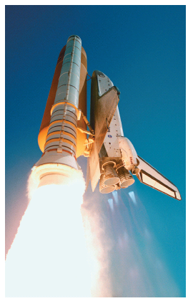
Energy in Chemical Changes
Chemical changes are often used to produce energy.
Notes:
Figure 4.5 One of the chemical changes helping to power the space shuttle is 2H₂ + O₂→ 2H₂O

Slide 30
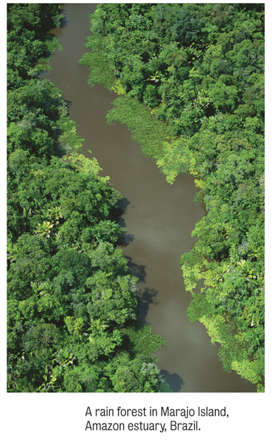
Energy in Chemical Changes
Energy can be used to cause chemical reactions.
Photosynthesis
Electrolysis

Slide 31
Your Turn!
Which of the following processes release energy?
Walking
Gasoline burning in our car engines
Dehydrating grapes to make raisons
Blowing up a balloon

Slide 32
Conservation of Energy
The law of conservation of energy: Energy can be neither created nor destroyed, though it can be transformed from one form to another.

Slide 33
Energy Changes
Changes to a system that require energy have positive energy values meaning that the system gains energy.
Changes to a system that release energy have negative values because the system lost energy in the process.
For example, burning paper would have a negative energy value because the system loses energy as heat.
Boiling water would have a positive energy value because the system has to gain energy to boil the water.

Slide 34
Your Turn!
Which of the following processes result in the system losing energy and having negative energy values?
arctic ice melting
dry ice changing to vapor
starting a car
dynamite exploding

Slide 35
Your Turn!
Which of the following physical changes does not require energy to take place?
Evaporation
Melting
Condensation
Sublimation

Slide 36
Energy in the Real World
Chemical reactions in the sun produce the heat and light our planet needs to survive.
Plants use photosynthesis to store energy from the sun.
Plants decay and eventually produce fossil fuels (after millions of years).
We burn fossil fuels to do work.

Slide 37
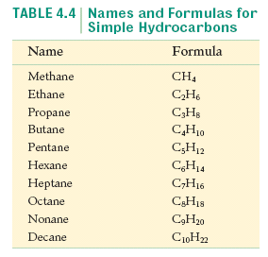
Energy in the Real World
Petroleum is composed of hydrocarbons.
Natural gas is usually a mixture of methane with small amounts of ethane propane and butane.
Coal is essentially carbon. It provides roughly 20% of US energy needs.

Slide 38
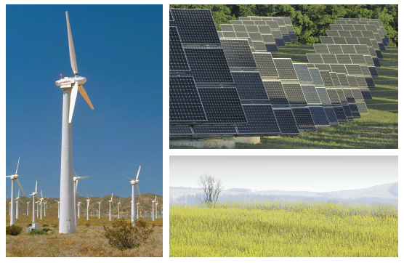
Exploring Other Energy Resources

