Slide 1
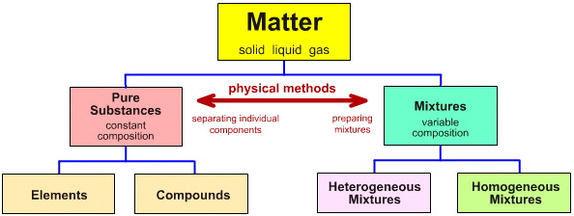
Chapter 3 Matter NOTES (LT3)

Slide 2
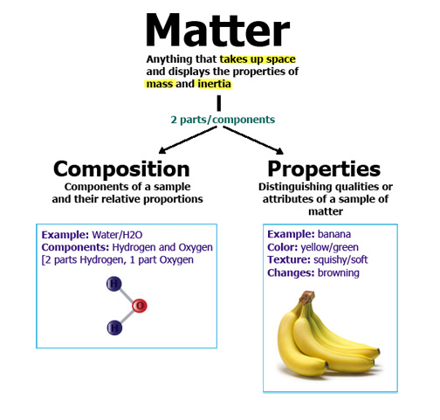
Define Matter and discuss states:
Notes:
D

Slide 3
Physical State | Particle Arrangement | Kinetic energy | Volume | compressibility
Solid
Liquid
Gas

Slide 4
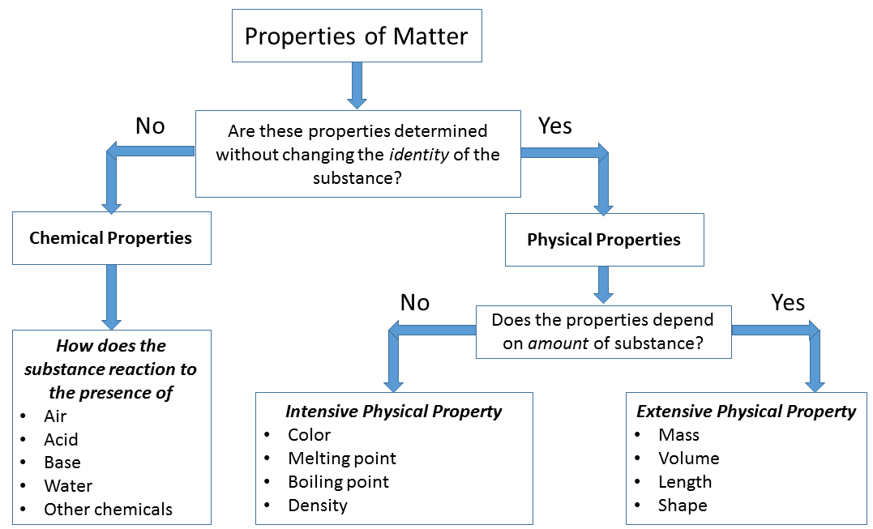
Properties of matter:
Temperature and Pressure determine
Test to Determine Property:
Physical:
Chemical:

Slide 5
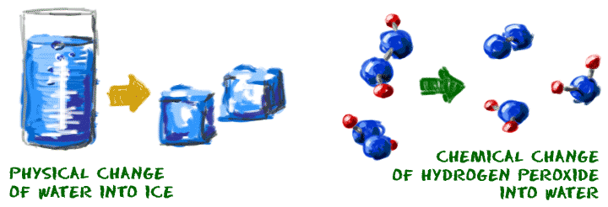
Changes of matter:
Type of Change | Definition | Example | Test to determine
Physical Change
Chemical Change

Slide 6
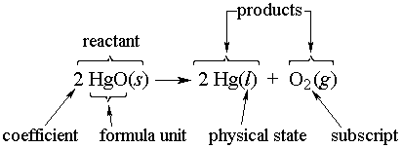
Chemical Reactions involve chemical change:
Terms like decompose, rust, explode, rot, oxidize, corrode, tarnish, ferment, burn refer to chemical reactions.
yield

Slide 7
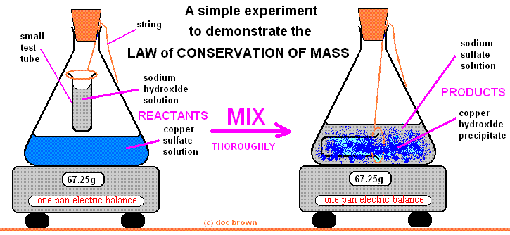
Law of conservation of mass: mass is neither created or destroyed; mass is conserved in a chemical reaction

Slide 8
Evidence of Chemical Change– How do you know if a chemical reaction took place? Signs?
1.
2.
3.
4.
5.
6.
7.
8.

Slide 9
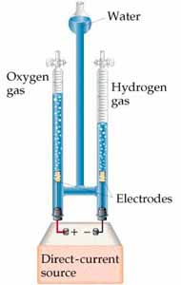
If you start with 2 grams of water and decompose it completely into hydrogen and oxygen gas, how much should the gases weigh combined?

Slide 10
Mixtures vs. pure substances
Physical combination of 2 or more substances not chemically bound in fixed ratios.
Made of the same type of atom
Doesn’t blend smoothly throughout
Constant composition throughout
2 or more elements chemically bound in fixed ratios.

Slide 11
Mixture | Definition | Example | Ways to Separate
Homogeneous (solutions) | Constant composition throughout
Heterogeneous | Doesn’t blend smoothly throughout

Slide 12
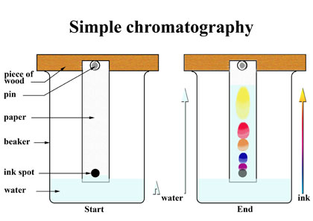
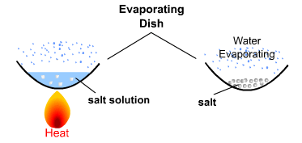
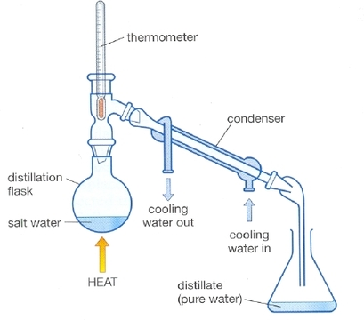
Ways to separate homogeneous mixtures:

Slide 13
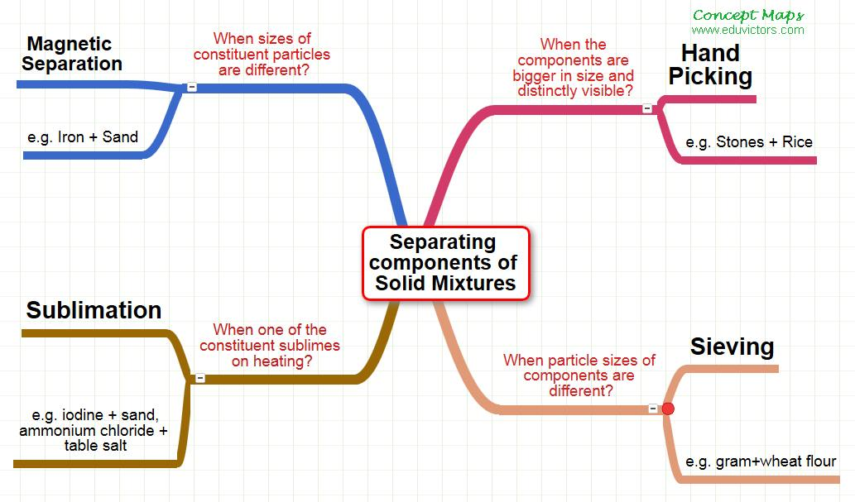
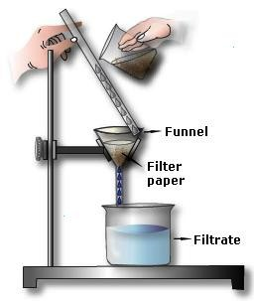
Ways to separate heterogeneous mixtures:
EVAPORATION

Slide 14
DISTILLATION VIDEO
https://www.youtube.com/watch?v=KCs1F_44dy4
How does distillation work and why is it used instead of just evaporation?

Slide 15
How can you distinguish between elements and compounds?
Substance | Definition | Example | Characteristics Compared
Element | Made of the same type of atom
Compound | 2 or more elements chemically bound in fixed ratios.

