Slide 1
Chapter 3
Elements and Compounds
This reclining
Buddha in the Grand Palace in Bangkok, Thailand, is made of gold.
Introduction to General, Organic, and Biochemistry 10e
John Wiley & Sons, Inc
Morris Hein, Scott Pattison, and Susan Arena

Slide 2
Elements
An element is a fundamental substance that cannot be broken down by chemical means to simpler substances.
There are 118 known elements.
All but 4 of the first 92 elements occur in nature.
All elements beyond 92 except for plutonium (94) are man made.

Slide 3
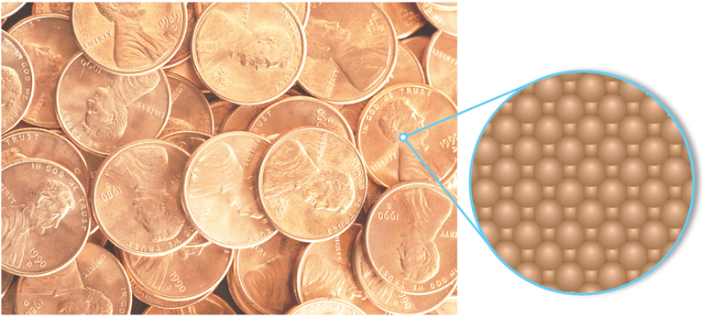
Elements
An atom is the smallest particle of an element that can exist.
Notes:
Figure 3.1 The surface of a penny is made up of tiny identical copper atoms packed tightly together.

Slide 4
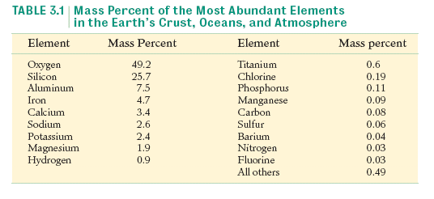
Distribution of Elements

Slide 5
Your Turn!
The most abundant element in the earth’s crust, oceans, and atmosphere is
A. Water
B. Hydrogen
C. Iron
D. Oxygen

Slide 6
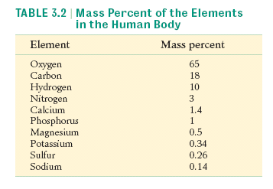
Distribution of Elements

Slide 7
Names of the Elements
The names of the elements are derived from a variety of sources:
Iodine comes from Greek iodes, which means violetlike.
Bismuth comes from the German weisse masse, which means white mass.
Germanium was named for Germany, where it was discovered.

Slide 8
Symbols of the Elements
Rules for symbols of elements
Symbols have either one or two letters.
If one letter is used, it is capitalized.
If two letters are used, only the first is capitalized.
N nitrogen I iodine Ni nickel
C carbon O oxygen Co cobalt

Slide 9
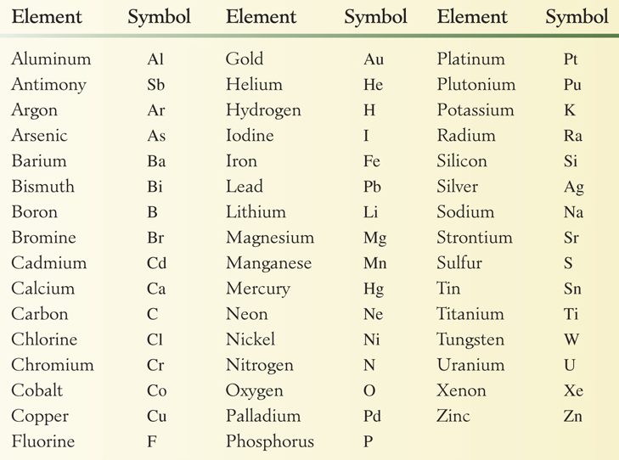
Symbols of Common Elements
Notes:
Table 3.3 Symbols of the most common elements

Slide 10
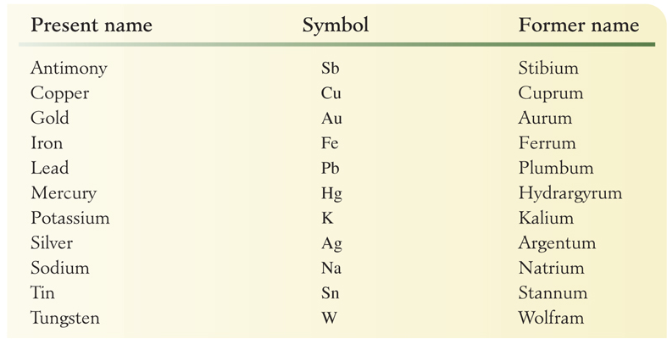
Symbols of Elements Derived from Early Names
Notes:
Table 3.4 Symbols of the elements derived from early names

Slide 11
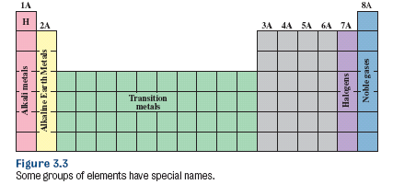
Introduction to the Periodic Table
Elements are arranged in order of increasing atomic number.
Elements within a group have similar properties.
The representative elements are groups IA-VIIA and the noble gases.

Slide 12
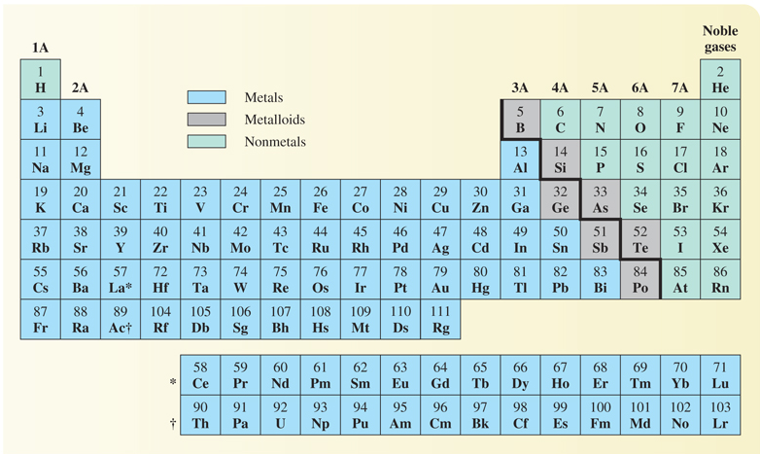
Metals, Nonmetals and Metalloids
Notes:
Table 3.5 The Periodic Table

Slide 13
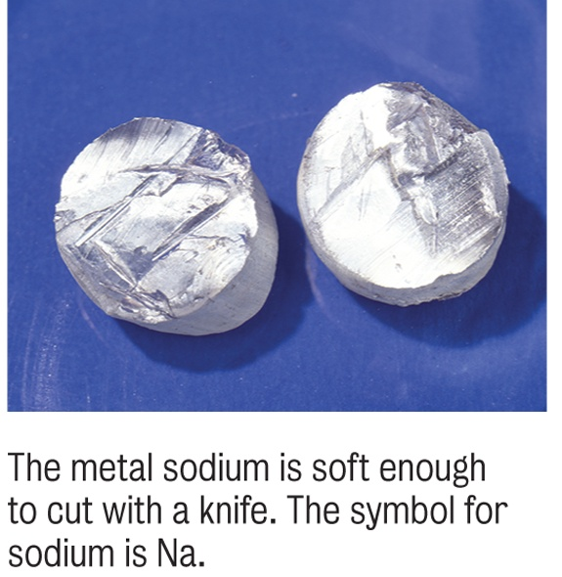
Classifying Elements: Metals
Some properties of metals:
Lustrous
Malleable
Conduct heat and electricity
Ductile
High density
High melting point

Slide 14
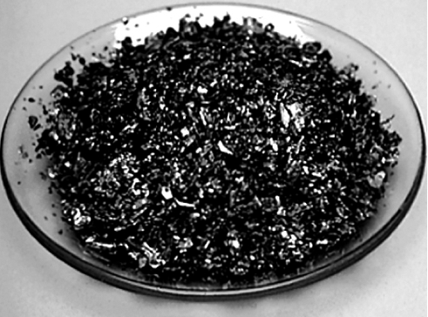
Classifying Elements: Nonmetals
Some properties of nonmetals:
Dull (if solid)
Brittle (if solid)
Poor conductors of heat and electricity
Non-Ductile
Low density
Low melting point
Iodine crystals

Slide 15
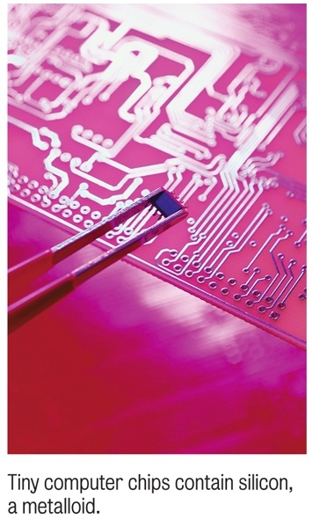
Classifying Elements: Metalloids
Metalloids have properties that are intermediate between those of metals and those of nonmetals.
Some are used to make the semiconductors we need for computer chips.

Slide 16
Your Turn!
A solid sample of an unknown element is dull and brittle and does not conduct heat or electricity. How should the element be classified?
Metal
Nonmetal
Metalloid
Transition element

Slide 17
Your Turn!
The majority of the elements are
Metals
Gases
Nonmetals
Metalloids

Slide 18
Your Turn!
Which is not a metalloid?
Boron (B)
Silicon (Si)
Germanium (Ge)
Aluminum (Al)

Slide 19
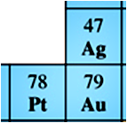
Elements in Their Natural States
Most elements are found as compounds in nature because they are very reactive.
The noble metals (gold, silver and platinum) are nonreactive and are found as elements in nature.
The noble gases are the least reactive elements and are found in uncombined form.

Slide 20
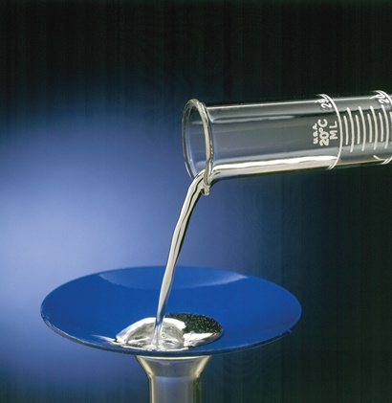
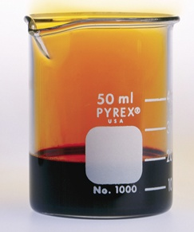
Physical States of the Elements
Most are solids at room temperature.
Some are gases (the noble gases, nitrogen, oxygen, fluorine and chlorine).
Two are liquids (mercury and bromine).

Slide 21
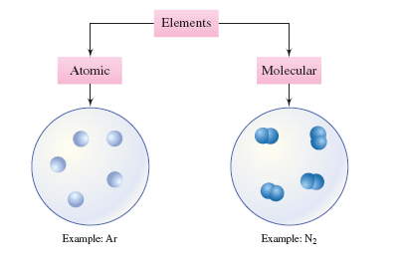
Elements

Slide 22
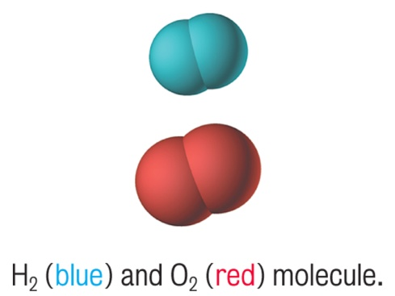
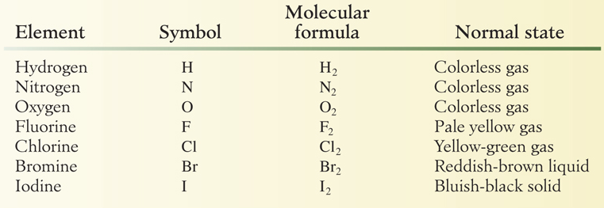
Elements That Exist as Diatomic Molecules
Diatomic molecules each contain exactly two atoms.
There are 7 diatomic elements.

Slide 23
Compounds
Compounds are composed of two or more elements combined in a definite proportion by mass.
Elements are always combined in whole number ratios. Al₂O₃ KNO₃ CaCl₂
Can be decomposed chemically into simpler substances.
Each compound has unique properties that are different from the elements that make it up.

Slide 24
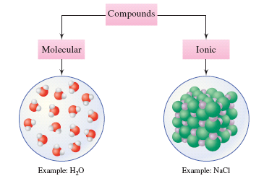
Compounds

Slide 25
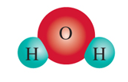
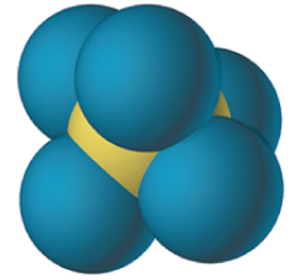
Molecules
A molecule is the smallest uncharged individual unit of a compound.
Usually composed of two or more nonmetals.
Can be solids, liquids or gases.
Do not conduct electricity.
H₂O
H₂O₂
PCl₅

Slide 26
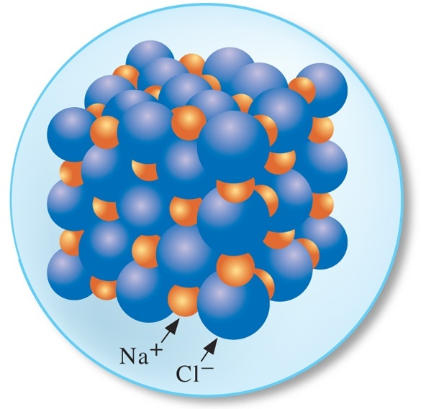
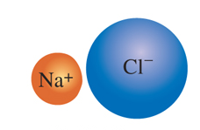
Ionic Compounds
Contain ions (charged particles).
Compounds are held together by the attractive forces between the cations (positive ions) and the anions (negative ions).
Formulas are the simplest whole number ratio of each element.
Solids at room temperature.
Conduct electricity when molten.
NaCl

Slide 27
Your Turn!
Which of the following is true?
Metals form anions with negative charges.
Metals form anions with positive charges.
Metals form cations with positive charges.
Metals form cations with negative charges.

Slide 28
Chemical Formulas
Specifies the number of atoms of each element in the compound.
When the formula contains more than one of a group of atoms that occurs as a unit, parentheses are placed around the group and a subscript is placed to the right of the group.
Notes:
Figure 3.9 c Explanation of the formula of Ca(NO₃)₂

Slide 29
Your Turn!
The formula for table sugar is C₁₂H₂₂O₁₁. How many oxygen atoms are found in a molecule of sugar?
1
12
22
11

Slide 30
Your Turn!
Aluminum sulfate is a compound that is often found in baking powder. How many sulfur atoms are found in Al₂(SO₄)₃?
4
12
3
7

Slide 31
Your Turn!
The formula for ethyl alcohol is CH₃CH₂OH. How many H atoms are found in a molecule of ethyl alcohol?
6
3
5
1

