Slide 1
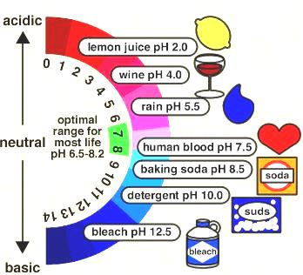
Chapter 19 Acids and Bases

Slide 2
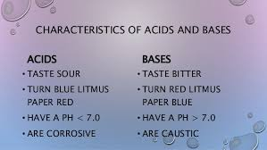
Lesson 7 Characteristics, Theories and Acid Base Pairs

Slide 3
Theories..
Theory | Description
Arrhenius | Acids- Hydrogen containing compounds that ionize to form H⁺ ions in aqueous solutions. Bases- Hydroxide containing compounds that ionize to for OH⁻ ions in aqueous solutions.
Bronsted-Lowry | Acid- H⁺ ion donor NH₃ + H₂O → NH₄⁺ + OH⁻ Base- H⁺ ion acceptor H₂SO₄ + H₂O → H₃O⁺ + HSO₄⁻ Amphoteric*** Hydronium**** Acid Conjugate Base Pairs**
Lewis | Acids- electron pair acceptor (H⁺ needs a pair of electrons to be stable) Bases- electron pair donor (OH⁻ Oxygen has a pair of electrons to share)

Slide 4
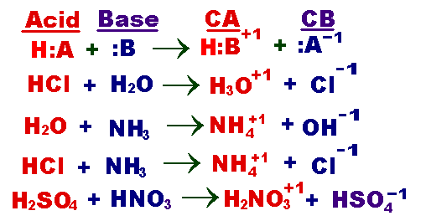
Acid-Conjugate Base pairs

Slide 5
Obj. 3 Illustrate the reaction between HCl and water and Label the Acid- Conjugate Base Pair. (more practice on page 625 and handout)

Slide 6
Lesson 8 Self ionization of water and K_{w}
Water molecules produce ions
H₂O → H⁺ + OH⁻

Slide 7
Answer the 4 inference problems on your notes…

Slide 8
Practice Problems on page 596

Slide 9
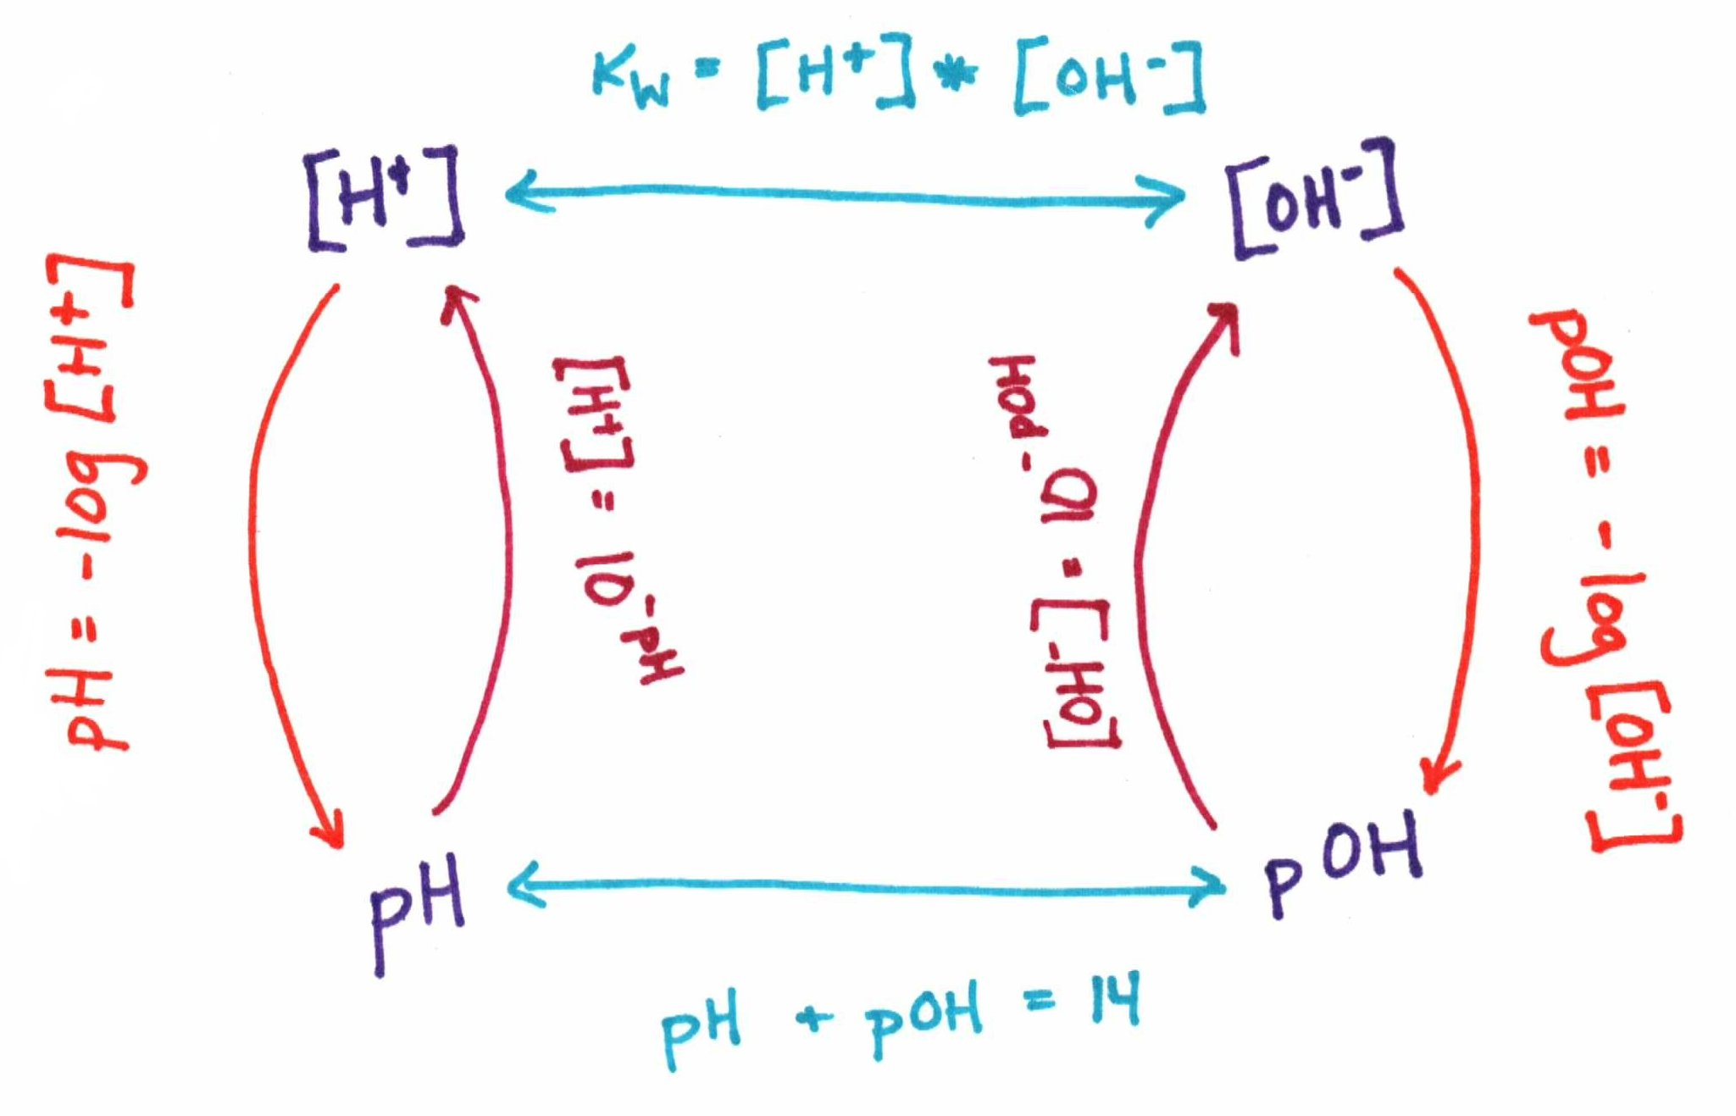
Lesson 9 pH and pOH

Slide 10
Describe pH. What does it measure? What is the equation? What is the relationship between pH and H⁺ ions.

Slide 11
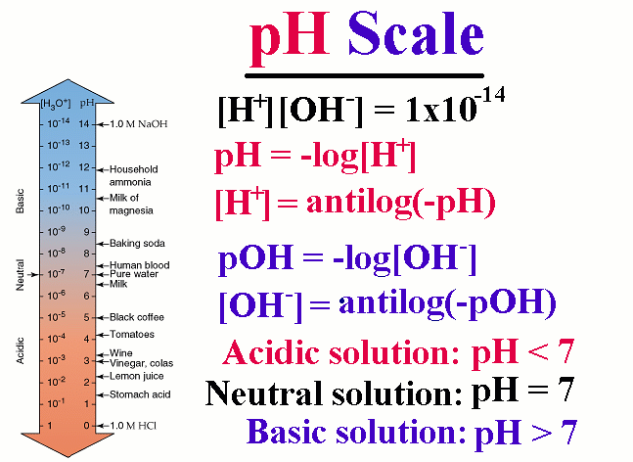

Slide 12
Describe pOH. What does it measure? What is the equation? What is the relationship between pOH and OH⁻ ions.

Slide 13
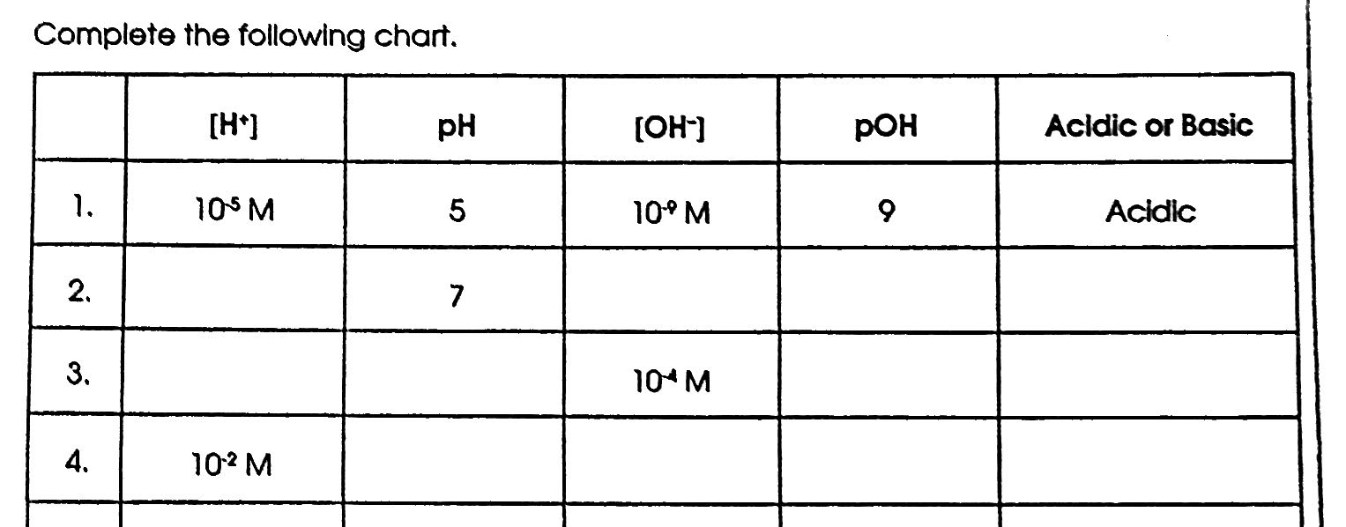
Obj. 8 Solve the pH and pOH problems…

Slide 14
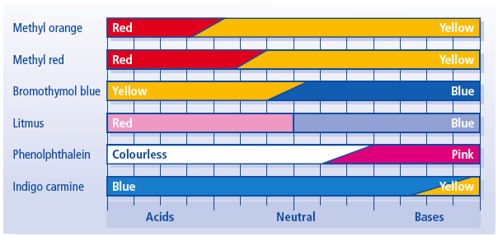
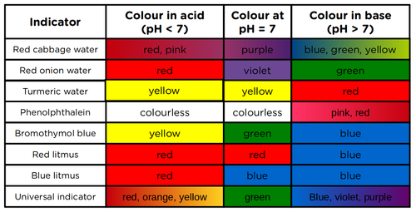
Lesson 10 Indicators and Titrations

Slide 15
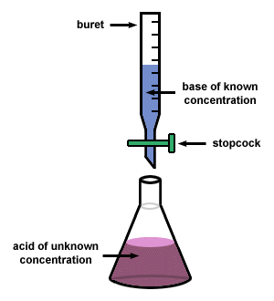
Titrations- to determine the unknown Molarity of an acid or a base with a controlled neutralization reaction and a known concentration solution.
Neutralization reaction- acid and base react and form a SALT and water
Salts are anions from acids and
cations from bases
HCl + NaOH → NaCl + H₂O
M₁V₁=M₂V₂ (for monoprotic acids)
N₁V₁=N₂V₂
Tools used for titration:

Slide 16
Practice Problems for Titrations

