Slide 1
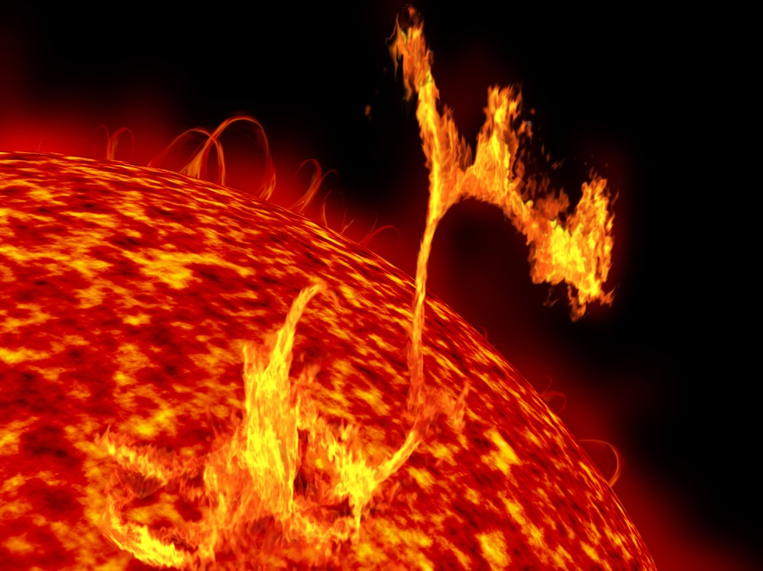
Chapter 18
Nuclear Chemistry
The energy of the sun comes from nuclear reactions. Solar flares are an indication of fusion reactions occurring at a temperature of millions of degrees.
Introduction to General, Organic, and Biochemistry 10e
John Wiley & Sons, Inc
Morris Hein, Scott Pattison, and Susan Arena

Slide 2
Radioactivity
Radioactivity is the spontaneous emission of particles and/or energy from an unstable nucleus of an atom.
Nucleons are the protons and neutrons in the nucleus of an atom.
Nuclide is how we refer to any isotope of an atom.
Radioactive nuclides are unstable nuclides that spontaneously emit radiation.
Stable nuclides are considered stable because they are not radioactive.

Slide 3
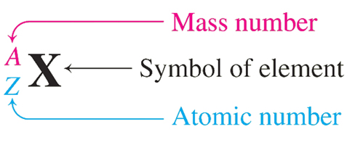
Isotopic Notation - Review
Mass number – 238
Atomic number – 92
Uranium-238 has 238 nucleons (92 protons and 146 neutrons).
Lead-210 has 210 nucleons (82 protons and 128 neutrons).

Slide 4
Your Turn!
How many protons, neutrons and nucleons are found in the nuclide:
83 protons, 127 neutrons and 210 nucleons
210 protons, 83 neutrons and 127 nucleons
127 protons, 83 neutrons and 210 nucleons

Slide 5
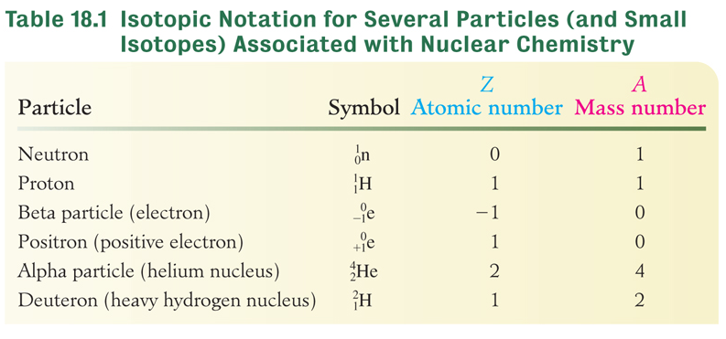
Types of Radiation

Slide 6
Treatment of Hyperthyroidism
Iodine-131 is incorporated into the thyroid hormone thyroxine.
β emitted by the radioactive isotope destroys nearby thyroid cells, thus decreasing the activity of the thyroid gland and bringing the disease under control.

Slide 7
Natural Radioactivity
Radioactive decay is the continuous disintegration of radioactive nuclides.
The rate of decay is independent of temperature, pressure or the chemical or physical state of the nuclide.
Every radioactive nuclide has a characteristic half-life (t_{½}).
The half-life is the time required for one-half of a specific amount of a radioactive nuclide to disintegrate.

Slide 8
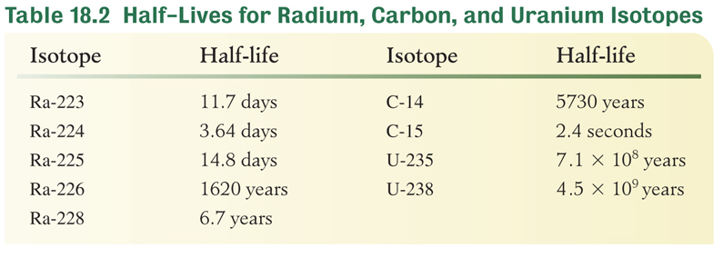
Half-Life
We can use the half-life of a radioactive nuclide to predict the amount remaining after a particular length of time.

Slide 9
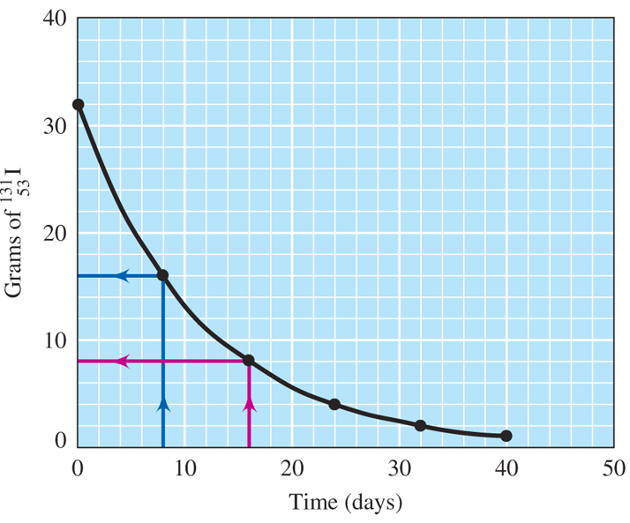
Half-Life of I-131
The half-life of I-131 is 8 days. How much I-131 from a 32-g sample remains after 5 half-lives?

Slide 10
Half-Life of C-14
The relative amount of radioactive carbon-14 is stable in living organisms, but the amount decreases after the organisms death. How many half-lives must elapse so that less than 1.0% of the radioactivity remains?
It takes almost 7 half-lives to get below 1.0%.
t_{½} = 5730 years How many years is 7 half-lives?
5730 years/half-life x 7 half-lives = over 40,000 years!

Slide 11
Your Turn!
A 4.0 g sample of Ra-226 decays to 1.0 g. If the half-life of Ra-226 is 1620 years, how much time has elapsed?
540 years
810 years
3240 years
4860 years

Slide 12
Your Turn!
The half-life of Au-198 is 2.7 days. What mass of Au-198 will remain unchanged if a 12.0 g sample decays for 13.5 days?
12.0 g
0.750 g
384 g
0.375 g

Slide 13
Your Turn!
As the temperature of a solid radioisotope increases, its half-life
Increases
Decreases
Remains the same

Slide 14
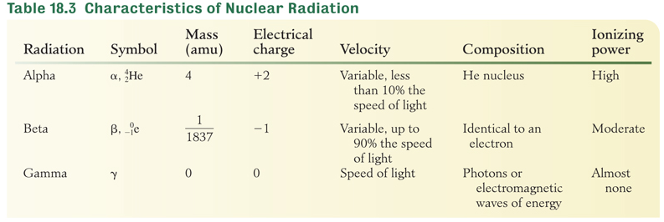
Characteristics of Nuclear Radiation

Slide 15
Your Turn!
Which form of nuclear emission requires the greatest amount of shielding to provide protection from radiation injury?
Alpha
Beta
Gamma

Slide 16
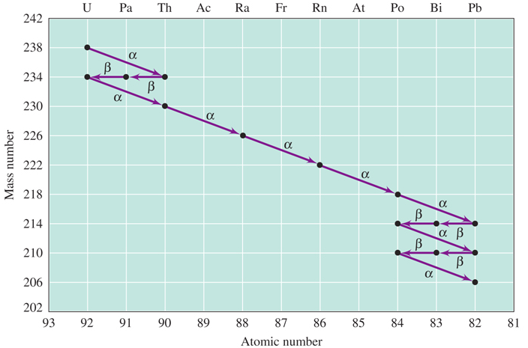
Uranium Disintegration Series
Figure 18.3 decays by a series of emissions to form the stable nuclide

Slide 17
Your Turn!
What nuclide is formed when U-238 undergoes one alpha decay and two beta decays?
U-238
U-234
Th-230

Slide 18
Transmutation of Elements
Transmutation is the conversion of one element into another by either natural or artificial means.
Transmutation occurs spontaneously in natural radiation.
The first artificial transmutation was done in 1919 in Ernest Rutherford’s lab:

Slide 19
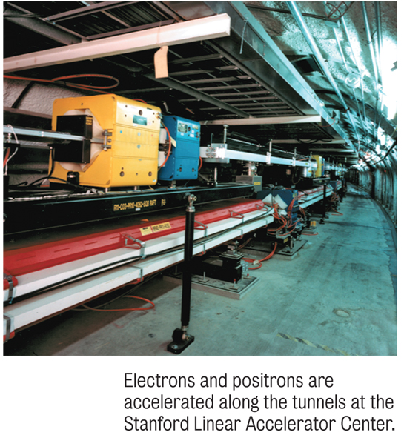
Transmutation
Many elements have been made using particle accelerators.
Californium:
Roentgenium:

Slide 20
Artificial Radioactivity
Irene and Frederick Joliot-Curie discovered that the bombardment of aluminum-27 with alpha particles resulted in the emission of neutrons and positrons:
First phosphorus-30 is produced along with a neutron:
Then silicon 30 is produced along with a positron:

Slide 21
Artificial Radioactivity
The radioactivity of nuclides produced by bombarding stable isotopes with small particles like neutrons or alpha particles is known as artificial radioactivity or induced radioactivity.
The Joliot-Curies received the Nobel Prize in chemistry in 1935 for the discovery of artificial, or induced, radioactivity.

Slide 22
Your Turn!
In an artificial transmutation process, a nucleus of Be-9 absorbs a proton, emits a particle, and is converted into Li-6. What was the particle emitted?
A proton
A neutron
An electron
An alpha particle

Slide 23
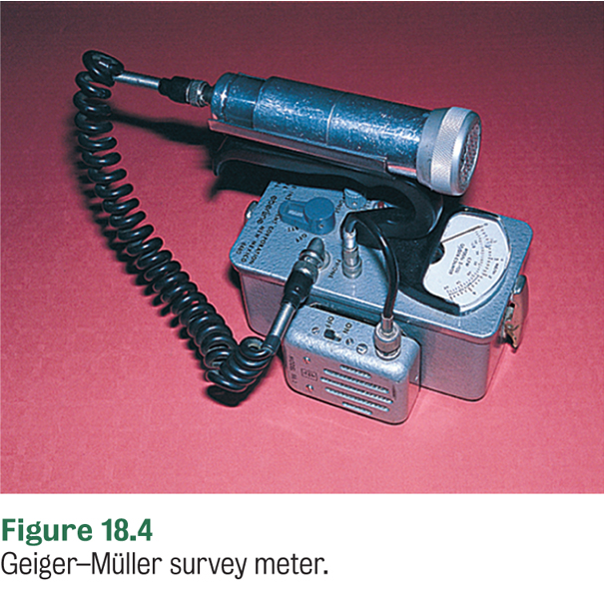
Measurement of Radioactivity with a Geiger Counter
Ionizing radiation is high energy radiation that causes atoms or molecules to become ionized.
If ionizing radiation enters the Geiger counter tube, argon in the tube is ionized and an electric current passes between two electrodes.
Radiation is measured in counts/min or counts/s.

Slide 24
Curie: A Unit for Measuring Radioactivity
The curie is the unit used to express the amount of radioactivity produced by an element.
One curie (Ci) = 3.7 x 10¹⁰ disintegrations per second.
This definition came from the element radium, which has an activity of 1Ci/g
Because a curie is so large the millicurie (one thousandth of a curie) and the microcurie (one millionth of a curie) are more commonly used.

Slide 25
Other Units of Radiation
The rem takes into account the degree of biological effect caused by the type of radiation exposure. For example, alpha particles are 10 times more ionizing than beta particles so the factor is 10 for an alpha particle and a 1 for a beta particle.

Slide 26
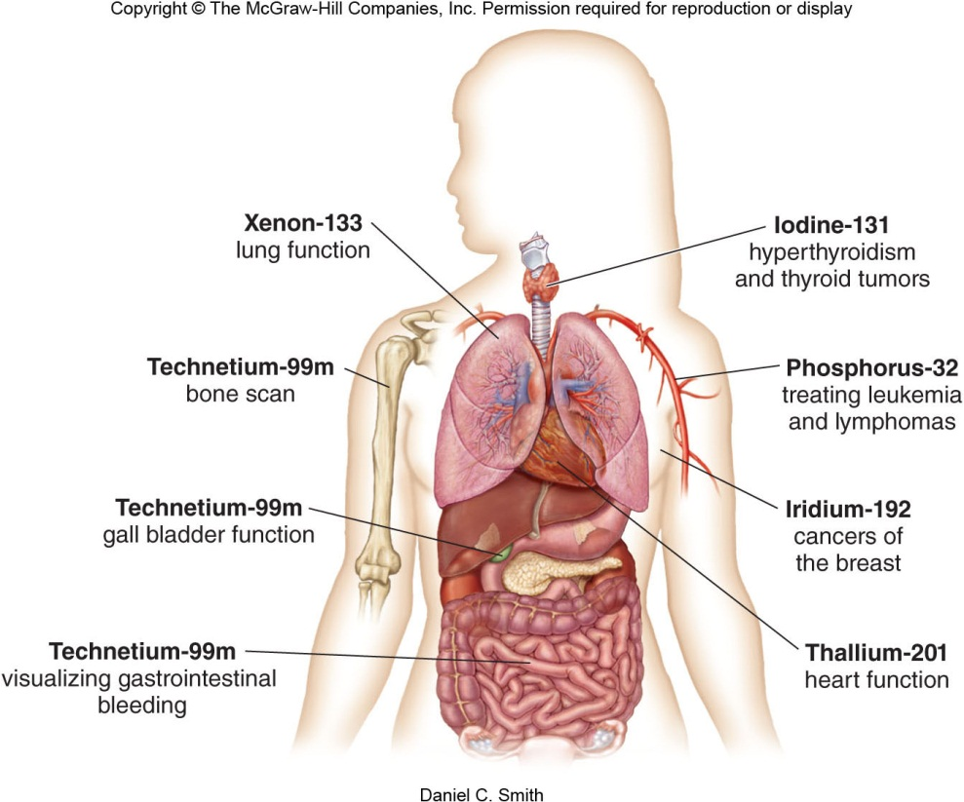
Medical Uses of Radiation
For diagnosis – usually injected or ingested.
For treatment –
^{1.} External to the body (beam of radiation produced by decaying Co-60 can be focused on a tumor). Radiation sickness usually occurs and some destruction of healthy tissue often occurs. ^{2.} Internally at the site of the tumor within the body. Ex) I-131 for hyperthyroidism or radioactive “seeds”/wire implanted close to the tumor. I-125 used for prostate cancer.

Slide 27
Medical Uses of Radiation
Average radiation dose per year for an individual is estimated at 0.27 rem.
No biological effects are noticed if the dose is less than 25 REM.
A single dose of 25-100 rem causes a temporary decrease in white blood cell count.
Radiation sickness (nausea, vomiting, fatique & prolonged decrease in white blood cell count) are visible at a dose of more than 100 REM.
The LD₅₀ (lethal dose that kills 50% of the population) is 500 REM.
600REM would be fatal for the entire population.

Slide 28
Medical Uses of Radiation
PET Scans – Positron Emission Tomography (READ page 459)
PET Scans used to detect: stroke, Alzheimer’s Disease, tumors, coronary artery disease, and cancer.

Slide 29
Nuclear Fission
In nuclear fission a heavy nuclide struck by a neutron splits into two or more intermediate-sized fragments.
Characteristics of nuclear fission:
Upon absorption of a neutron, a heavy nuclide splits into one or more smaller nuclides (fission products).
The mass of the nuclides ranges from abut 70-160 amu.

Slide 30
Nuclear Fission
Two or more neutrons are produced from the fission of each atom.
Large quantities of energy are produced as a result of the conversion of a small amount of mass into energy.
Many nuclides produced are radioactive and continue to decay until they reach a stable nucleus.

Slide 31
Nuclear Fusion
Nuclear fusion is the process of uniting the nuclei of two light elements to form one heavier nucleus.
The masses of the two nuclei that fuse into a single nucleus are greater than the mass of the nucleus formed by their fusion. The difference in mass produces the great amount of energy released.
3.0150 amu
1.0079 amu
4.0026 amu
4.0229 amu
4.0229 amu – 4.0026 amu = 0.0203 amu

Slide 32
Fusion Power
The potential for fusion power is great because
Virtually infinite amounts of energy are possible from fusion power.
While uranium supplies are limited, deuterium supplies are abundant (sea water).
Fusion power is much “cleaner” than fission power because it doesn’t generate radioactive waste.
There are no fusion reactors yet because of the difficulty of maintaining the temperatures needed for fusion.

Slide 33
Your Turn!
In a fusion reaction two nuclei of H-2 combine to form a nucleus of
H-4
He-4
He-2
Li-4

Slide 34
Your Turn!
Which statement does not describe nuclear fusion?
This reaction occurs at very high temperatures
This reaction uses uranium as a fuel
This reaction converts mass into energy
This reaction does not occur naturally on Earth

Slide 35
Your Turn!
In which type of reaction do the nuclei of two light elements unite to form a heavier nucleus?
Fission
Fusion
Alpha decay
Beta decay

Slide 36
Biological Effects of Radiation
Ionizing radiation is radiation with enough energy to dislocate bonding electrons and create ions when passing through matter.
Alpha particles, beta particles, gamma rays and X-rays are all ionizing.
Ionizing radiation damages or kills living cells.
Radiation damage is greatest in the nuclei of the cells that are undergoing rapid cell division, making nuclear therapy useful for cancer treatment.

Slide 37
Your turn!
Which is true about ionizing radiation?
It dislocates bonding electrons and creates ions
It can damage DNA molecules
Both large acute doses and small chronic doses are harmful
All the above are true

