Slide 1
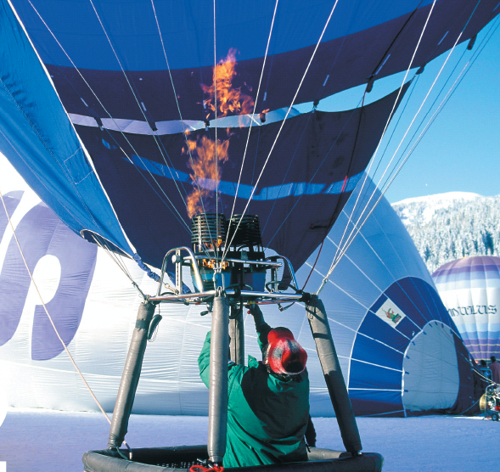
Chapter 12
The Gaseous State of Matter
The air in a hot air balloon expands
When it is heated. Some of the air
escapes from the top of the balloon,
lowering the air density inside the
balloon, making the balloon buoyant.
Introduction to General, Organic, and Biochemistry 10e
John Wiley & Sons, Inc
Morris Hein, Scott Pattison, and Susan Arena

Slide 2
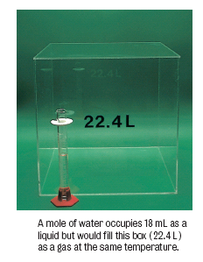
General Properties
Gases
Have an indefinite volume
Expand to fill a container
Have an indefinite shape
Take the shape of a container
Have low densities
Have high kinetic energies
Notes:
A mole of water occupies 18 mL as a liquid but would fill this box (22.4 L) as a gas at the same temperature.

Slide 3
Kinetic Molecular Theory (KMT)
Assumptions of the KMT and ideal gases include:
Gases consist of tiny particles
The distance between particles is large compared with the size of the particles.
Gas particles have no attraction for each other
Gas particles move in straight lines in all directions, colliding frequently with each other and with the walls of the container.

Slide 4
Kinetic Molecular Theory
Assumptions of the KMT (continued):
Collisions are perfectly elastic (no energy is lost in the collision).
The average kinetic energy for particles is the same for all gases at the same temperature.
The average kinetic energy is directly proportional to the Kelvin temperature.

Slide 5
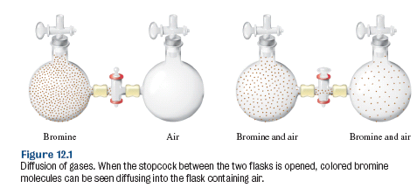
Diffusion

Slide 6
Effusion
Gas molecules pass through a very small opening from a container at higher pressure of one at lower pressure.
Graham’s law of effusion:

Slide 7
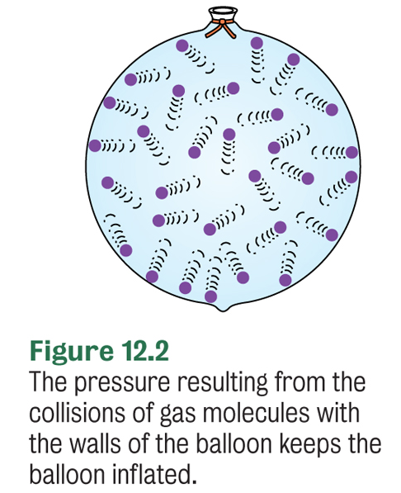
Measurement of Pressure
Pressure depends on the
Number of gas molecules
Temperature of the gas
Volume the gas occupies

Slide 8
Atmospheric Pressure
Atmospheric pressure is due to the mass of the atmospheric gases pressing down on the earth’s surface.

Slide 9
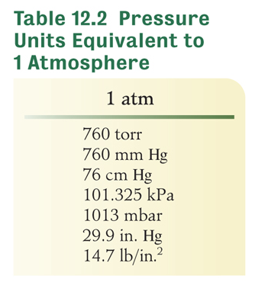
Your Turn!
A pressure of 3.00 atm is equal to
819 torr
3000 torr
2280 torr
253 torr

Slide 10
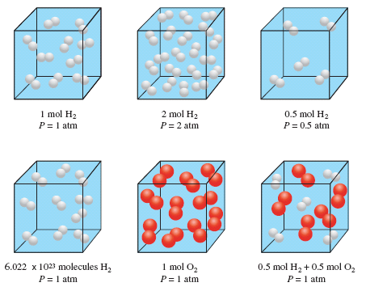
Dependence of Pressure on Number of Molecules
P is proportional to n (number of molecules) at T_{c} (constant T) and V_{c} (constant V).
The increased pressure is due to more frequent collisions with walls of the container as well increased force of each collision.
Notes:
Figure 12.4 The pressure exerted by a gas is directly proportional to the number of molecules present. In each case shown, the volume is 22.4 L and the temperature is 0°C.

Slide 11
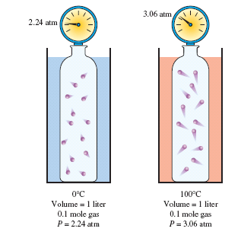
Dependence of Pressure on Temperature
P is proportional to T at n_{c} (constant number of moles) and V_{c}.
The increased pressure is due to
more frequent collisions
higher energy collisions
Notes:
Figure 12.5
The pressure of a gas in a fixed volume increases with increasing temperature. The increased pressure is due to more frequent and more energetic collisions of the gas molecules with the walls of the container at the higher temperature.

Slide 12
Your Turn!
If you change the temperature of a sample of gas from 80°C to 25°C at constant volume, the pressure of the gas
will increase.
will decrease.
will not change

Slide 13
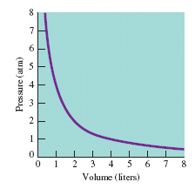
Boyle’s Law
What happens to V if you double P?
V decreases by half!
What happens to P if you double V?
P decreases by half!
Notes:
Figure 12.6 Graph of pressure versus volume showing the inverse PV relationship of an ideal gas.

Slide 14
Your Turn!
A 6.00 L sample of a gas at a pressure of 8.00 atm is compressed to 4.00 L at a constant temperature. What is the pressure of the gas?
4.00 atm
12.0 atm
24.0 atm
48.0 atm

Slide 15
Your Turn!
A 400. mL sample of a gas is at a pressure of 760. torr. If the temperature remains constant, what will be its volume at 190. torr?
A. 100. mL
B. 400. mL
C. 25.0 mL
D. 1.60x10² mL

Slide 16
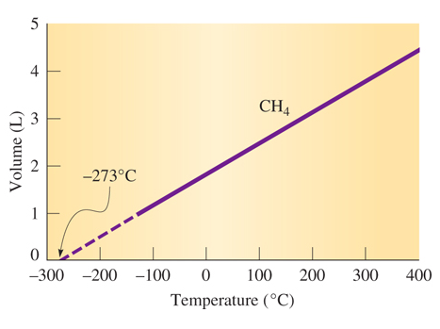
Charles’ Law
The volume of an ideal gas at absolute zero (-273°C) is zero.
Real gases condense at their boiling point so it is not possible to have a gas with zero volume.
The gas laws are based on Kelvin temperature.
All gas law problems must be worked in Kelvin!
Notes:
Figure 12.8 Volume-temperature relationship of methane (CH₄). Extrapolated portion of the graph is shown by the broken line.

Slide 17
Your Turn
The volume of a gas always increases when
Temperature increases and pressure decreases
Temperature increases and pressure increases
Temperature decreases and pressure increases
Temperature decreases and pressure decreases

Slide 18
Your Turn!
A sample of CO₂ has a volume of 200. mL at 20.0 ° C. What will be its volume at 40.0 °C, assuming that the pressure remains constant?
18.8 mL
100. mL
213 mL
400. mL

Slide 19
Your Turn!
A sample of gas has a volume of 3.00 L at 10.0 °C. What will be its temperature in °C if the gas expands to 6.00 L at constant pressure?
20.0°C
293°C
566°C
142°C

Slide 20
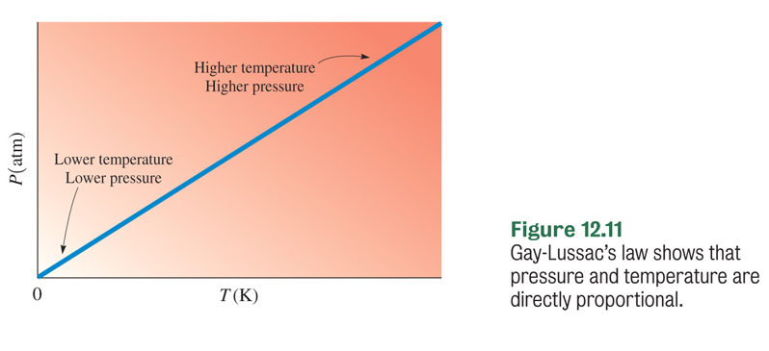
Gay-Lussac’s Law

Slide 21
Combined Gas Laws
Used for calculating the results of changes in gas conditions.
Boyle’s Law where T_{c}
Charles’ Law where P_{c}
Gay Lussacs’ Law where V_{c}
P₁ and P₂ , V₁ and V₂ can be any units as long as they are the same. T₁ and T₂ must be in Kelvin.

Slide 22
Your Turn!
A sample of gas has a volume of 8.00 L at 20.0 ° C and 700. torr. What will be its volume at STP?
1.20 L
9.32 L
53.2 L
6.87 L

Slide 23
Dalton’s Law of Partial Pressures
The total pressure of a mixture of gases is the sum of the partial pressures exerted by each of the gases in the mixture.
P_{Total} = P_{A} + P_{B} + P_{C} + ….
Atmospheric pressure is the result of the combined pressure of the nitrogen and oxygen and other trace gases in air.

Slide 24
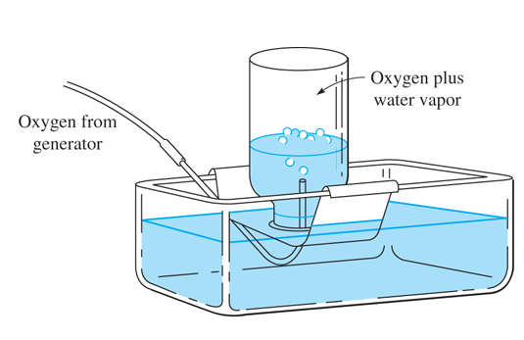
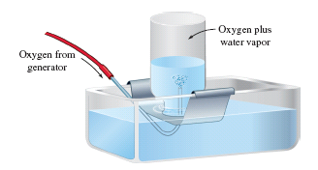
Collecting Gas Over Water
Gases collected over water contain both the gas and water vapor.
The vapor pressure of water is
constant at a given temperature
Pressure in the bottle is
equalized so that the P_{inside} = P_{atm}
Notes:
Figure 12.12 Oxygen collected over water.

Slide 25
Your Turn!
A sample of oxygen is collected over water at 22 ° C and 762 torr. What is the partial pressure of the dry oxygen? The vapor pressure of water at 22°C is 19.8 torr.
742 torr
782 torr
784 torr
750. torr

Slide 26
Avogadro’s Law
Equal volumes of different gases at the same T and P contain the same number of molecules.
The ratio is
the same:
1 volume
1 molecule
1 mol
1 volume
1 molecule
1 mol
2 volumes
2 molecules
2 mol
Notes:
Figure 12.14 Avogadro’s Law proved the concept of diatomic molecules for hydrogen and chlorine

Slide 27
Density of Gases
Calculate the density of nitrogen gas at STP.
Note that densities are always cited for a particular temperature, since gas densities decrease as temperature increases.

Slide 28
Your Turn!
Which of the following gases is the most dense?
H₂
N₂
CO₂
O₂
Carbon dioxide fire extinguishers can be used to put out fires because CO₂ is more dense than air and can be used to push oxygen away from the fuel source.

Slide 29
Ideal Gas Law
Calculate the volume of 1 mole of any gas at STP.
Knowns n = 1 mole T = 273K P = 1 atm
Set-Up
Molar volume!
Calculate

Slide 30
Your Turn!
What is the molar mass of a gas if 40.0 L of the gas has a mass of 36.0 g at 740. torr and 30.0 ° C?
33.1 g
23.0 g
56.0 g
333 g

Slide 31
Gas Stoichiometry
Convert between moles and volume using the Molar Volume if the conditions are at STP : 1 mol = 22.4 L.
Use the Ideal Gas Law if the conditions are not at STP.
Notes:
Figure 12.16 Summary of the primary conversions involved in stoichiometry. The conversion for volumes of gases is included.

Slide 32
Your Turn!
How many moles of oxygen gas are used up during the reaction with 18.0 L of CH₄ gas measured at STP?
CH_{4(g)} + 2 O_{2(g)} → CO_{2(g)} + 2 H₂O_{(l)}
1.61 moles
2.49 moles
18.0 moles
36.0 moles

Slide 33
Your Turn!
What volume of sulfur dioxide gas will react when 12.0 L of oxygen is consumed at constant temperature and pressure?
2 SO₂ + O₂ → 2 SO₃
6.00 L
12.0 L
24.0 L
60.0 L

Slide 34
Real Gases
Most real gases behave like ideal gases under ordinary temperature and pressure conditions.
Conditions where real gases don’t behave ideally:
At high P because the distance between particles is too small and the molecules are too crowded together.
At low T because gas molecules begin to attract each other.
High P and low T are used to condense gases.

