Slide 1
Chapter 10
Modern Atomic Theory
and the Periodic Table
The amazing colors in these fireworks explosions are the result of electrons transferring between energy levels in atoms.
Introduction to General, Organic, and Biochemistry 10e
John Wiley & Sons, Inc
Morris Hein, Scott Pattison, and Susan Arena

Slide 2
Electromagnetic Radiation
Frequency tells how many waves pass a particular point per second.
Speed tells how fast a wave moves through space.
Figure 10.1 The wavelength of this wave is shown by λ. It can be measured from peak to peak or trough to trough.

Slide 3
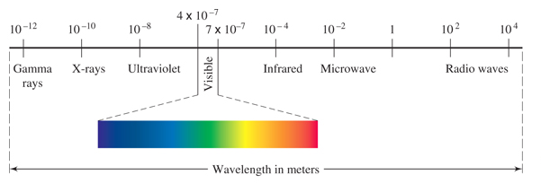
The Electromagnetic Spectrum
Visible light is only a small part of the electromagnetic spectrum.

Slide 4
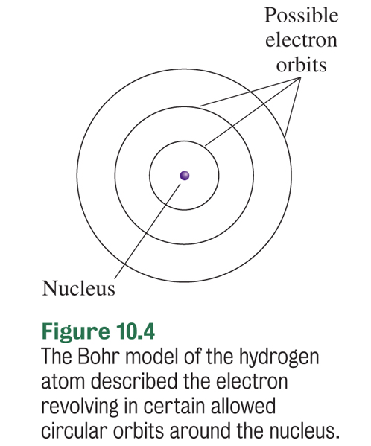
Bohr Model (1912-1913)
Danish physicist Niels Bohr proposed that electrons in an atom are organized into discrete energy levels.
He pictured the negative electrons in orbits around the positive nucleus.
His evidence: the line spectra of the elements.

Slide 5
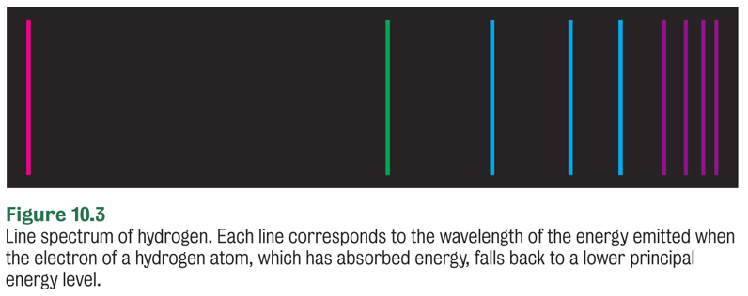
Line Spectrum
Atoms absorb energy to give off light..
Prisms or diffraction gratings separate the light into a line spectrum for the element.

Slide 6
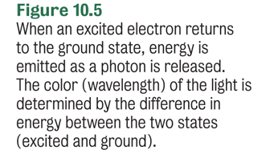
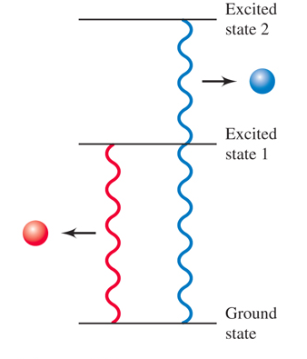
Line Spectrum

Slide 7
Why so many lines?
Absorbed energy
5
4
Potential energy of hydrogen electron
3
Released energy
2
Each line in the spectrum corresponds to electrons moving from a higher energy level to a lower energy level.
1

Slide 8
Your Turn!
The lowest possible energy level for an electron is known as
Low state
Ground state
Basement state
Excited state

Slide 9
Bohr Model
Was based on electrons having fixed energy levels and therefore quantized amounts of energy.
Accounted for spectral lines.
Worked very well for hydrogen but did not work well for heavier atoms.
Another model is needed that describes the behavior of electrons as waves.

Slide 10
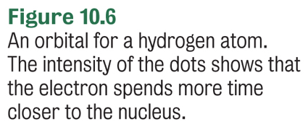
The Wave-Mechanical Model
This mathematical model of the atom describes the energy of the electron with some certainty, but the actual location of the electron is uncertain.
An orbital is the region in space where there is a high probability of finding an electron with a given energy.

Slide 11
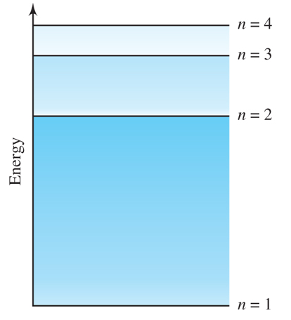
Energy Levels of Electrons
Electrons in atoms are organized into discrete principal energy levels (n, where n is an integer).
Lowest energy level is n = 1, then n = 2, etc.
As n increases, the energy of the electron increases, and the electron is on average further from the nucleus.
Notes:
Figure 10.7 The first four principal energy levels in the hydrogen atom. Each level is assigned a principal quantum number n.

Slide 12
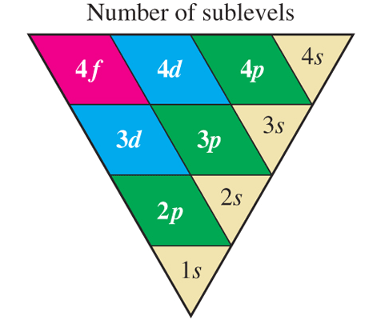
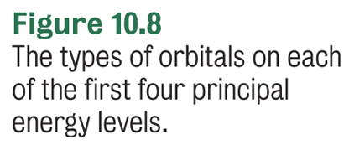
Sublevels
Energy levels are subdivided into sublevels.
n = 1 has the sublevel 1s.
n = 2 has the sublevels 2s and 2p.
Each sublevel is made up of orbitals of the same type and energy.

Slide 13
Electron Spin
Each electron in an atom appears to be spinning on its axis.
Pauli exclusion principle states that an atomic orbital can hold a maximum of two electrons, which must have opposite spin.
What is the maximum number of electrons in any orbital?
2

Slide 14
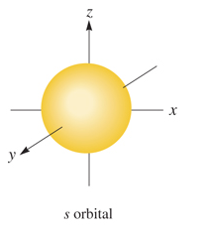
s Sublevels
Every principal energy level has an s sublevel that contains a single s orbital. (1s, 2s, 3s, etc.)
There is a 90% probability of finding the electron within a spherical region surrounding the nucleus.
Each s orbital holds 2 electrons with opposite spin.

Slide 15
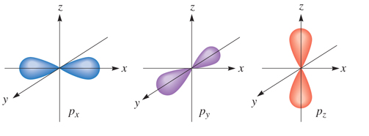
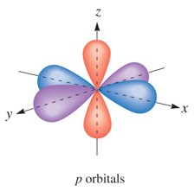
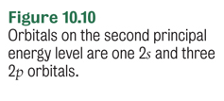
p Sublevels
Every principal energy level starting at n = 2 has a p sublevel (2p, 3p, etc.) that contains 3 equal energy p orbitals. The orbitals only differ by their orientation in 3-D space.

Slide 16
d Sublevels
Every principal energy level starting at n = 3 has a d sublevel (3d, 4d, etc.) that contains 5 equal energy d orbitals. These orbitals have more complex shapes and are higher in energy than the s and p orbitals.

Slide 17
Summary
Each subshell is composed of orbitals
The number of orbitals depends on the subshell
2 electrons per orbital
Subshell s p d f
Number of Orbitals 1 3 5 7
Electrons 2 6 10 14

Slide 18
Rules for Distributing Electrons
No more than two electrons can occupy one orbital.
Electrons occupy the lowest energy orbitals available. s < p < d < f for a given value of n
Each orbital in a sublevel is occupied by a single electron before a second electron enters. (Hunds Rule)

Slide 19
Your Turn!
In the fourth principal energy level, which sublevel contains electrons with the greatest energy?
4s
4p
4d
4f

Slide 20
Your Turn!
How many orbitals are found in a 5p sublevel?
1
3
5
7

Slide 21
Your Turn!
What is the maximum number of electrons that can occupy the third principal energy level?
2
6
8
18

Slide 22
Electron Configuration
Another useful atomic structure shows the distribution of electrons in the atom.

Slide 23
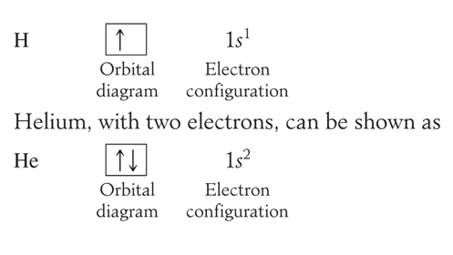
Orbital Diagram
Electron configurations can also be shown with orbital diagrams. Each box represents an orbital.
Up and down arrows represent electrons of opposite spin.

Slide 24
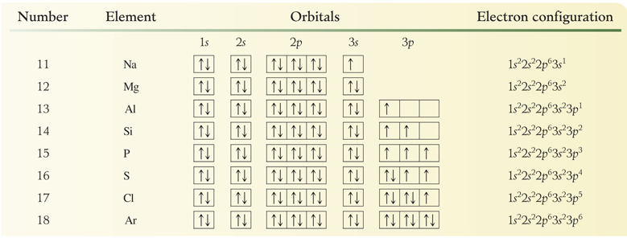
Atomic Structure
Remember to sum the superscripts in the electron configuration. They should add up to the atomic number for the element.

Slide 25
Valence Electrons
The valence electrons include all of the electrons in the highest principal quantum number (the outermost energy level).
These electrons are the electrons that are involved in bonding.
Phosphorus: 1s² 2s² 2p⁶ 3s² 3p³
Phosphorus has 5 valence electrons.

Slide 26
Your Turn!
Atoms of which element have the following electron configuration?
1s² 2s² 2p⁶ 3s²3p⁶
Cl
Ca
Ar
S

Slide 27
The Periodic Table
Each horizontal row in the periodic table is called a period.
The number of each period corresponds to the outermost energy level of the element.
For example, Ar is in period 3 and its outermost energy level is 3.
1s² 2s² 2p⁶ 3s²3p⁶
Argon has 8 electrons in energy level 3.

Slide 28
The Periodic Table
Groups or Families contain elements whose properties are similar.
Representative Elements – A Groups
Alkali Metals –1A
Alkaline Earth Metals – 2A
Halogens – 7A
Noble Gases – 8A

Slide 29
Other Groups to Know
Transition Metals – B Groups
Inner Transition Metals
Lanthanides (Rare Earth) – Atomic Nos. 58 -71
Actinides – Atomic Nos. 90 – 103

Slide 30
Valence Electrons and Groups
In the following groups, the group number is the number of valence electrons.
Elements within a group have the same valence electron configuration.

Slide 31
Your Turn!
In which category of the periodic table does each element contain valence electrons in the second principal energy level?
The alkaline earth elements
The alkali metals
Group 2A
Period 2

Slide 32
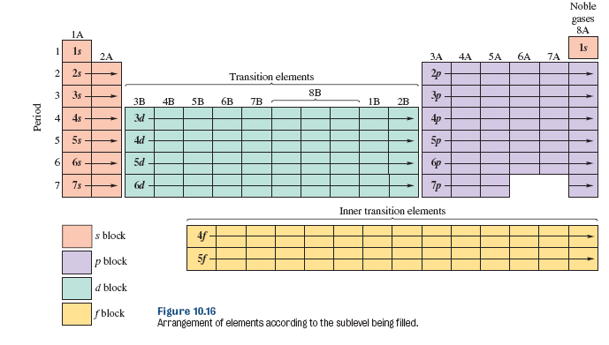
Electron Configurations and the Periodic Table

Slide 33
Electron Configurations and the Periodic Table
The number of the period corresponds with the highest occupied energy level.
The group numbers for the representative elements are equal to the total number of valence electrons.
The elements within a group have the same number of valence electrons.
The elements within each of the s, p, d, f blocks are filling s, p, d, f orbitals.
There are discrepancies within the transition elements.

Slide 34
Abbreviated Electron Configurations
Use the symbol of the nearest preceding noble gas to represent the electron configuration of the core electrons.
Phosphorus: 1s² 2s² 2p⁶ 3s² 3p³
[Ne] 3s² 3p³
Core Electrons
Valence Electrons

Slide 35
Your Turn!
The electron configuration, [Ar] 4s¹, is the ground state electron configuration of
Potassium
Phosphorous
Fluorine
Sodium

Slide 36
Your Turn!
The electron configuration, [Ne] 3s² 3p¹, is the ground state electron configuration of
Sodium
Aluminum
Argon
Sulfur

