Slide 1
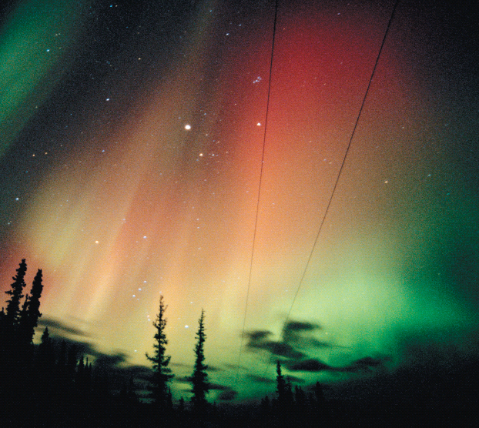
Chapter 1
An Introduction to Chemistry
The spectacular colors of the aurora borealis are the result of chemistry in our atmosphere.
Introduction to General, Organic, and Biochemistry 10e
John Wiley & Sons, Inc
Morris Hein, Scott Pattison, and Susan Arena

Slide 2
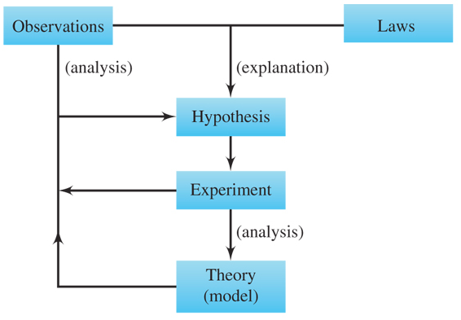
The Scientific Method
Law: Statements of natural phenomena to which there are no known exceptions.
Hypothesis: A tentative explanation of the facts that can be tested further
Theory: Well-tested hypothesis.
Notes:
Figure 1.2 The scientific method

Slide 3
Your Turn!
A clear colorless liquid is combined with a second clear colorless liquid and the mixture is observed. Which of these is not an observation?
The test tube became hot.
The reaction is exothermic.
The mixture is cloudy.
The mixture is white.

Slide 4
Your Turn!
Which of these is a law?
Atoms consist of protons, neutrons, and electrons.
All matter is composed of atoms.
Atoms can form chemical bonds by sharing electrons.
The volume of a gas increases with increasing temperature.

Slide 5
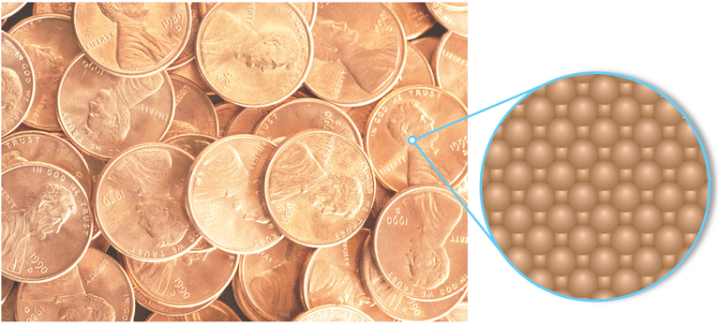
The Particulate Nature of Matter
Matter is anything that has mass and occupies space.
Matter is composed of discrete, tiny, fundamental particles called atoms.
The surface of a penny is made up of tiny identical copper atoms packed tightly together.
Notes:
Figure 3.1 The surface of a penny is made up of tiny identical copper atoms packed tightly together.

Slide 6
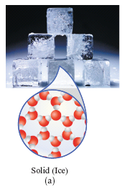
Solids
Definite shape
Definite volume
Essentially incompressible
Particles are tightly packed together
Particles are held together by very strong forces of attraction

Slide 7
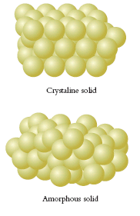
Solids
Crystalline solids exist in regular, repeating, three-dimensional geometric patterns.
Amorphous solids do not have any regular, internal geometric pattern.

Slide 8
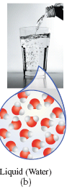
Liquids
Indefinite shape
Definite volume
Only slightly compressible
Particles are mobile, able to move around each other
Particles are held together by strong forces of attraction

Slide 9
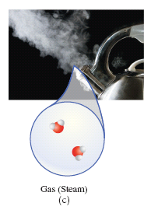
Gases
Indefinite shape
Indefinite volume
Compressible
Particles are far apart and are small compared to the volume they occupy
The attractive forces are so weak that the particles are independent of each other

Slide 10
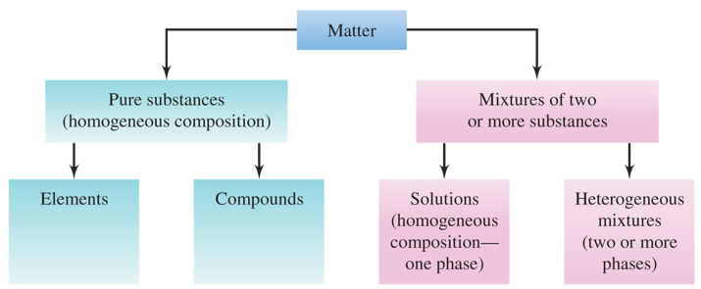
Classifying Matter
Notes:
Figure 1.7 Classification of matter. A pure substance is always homogeneous in composition, whereas a mixture always contains two or more substances and may be either homogeneous or heterogeneous.

Slide 11
Your Turn!
Freshly opened Coke is an example of a
An element
A compound
A homogeneous mixture
A heterogeneous mixture

Slide 12
Your Turn!
Air is an example of a
An element
A compound
A homogeneous mixture
heterogeneous mixture

Slide 13
Your Turn!
A clear, colorless liquid is heat in a beaker until all of the liquid is gone. The walls of the beaker are coated with a white crystalline solid. The liquid was:
An element
A compound
A homogeneous mixture
A heterogeneous mixture

